Slide 1
Role of Quasi-Biennial Oscillation in modulationg Subseasonal variability of Indian Summer Monsson
Shubham Waje^{1,2}, Susmitha Joseph¹, Phani M. Krishna¹, and A. K. Sahai¹
Indian Institute of Tropical Meteorology, MoES, Pune ¹, Department of Atmospheric and Space Sciences, Savitribai Phule Pune University, Pune²
Corresponding Author:
Shubham Waje
shubham.waje@tropmet.res.in

Slide 2
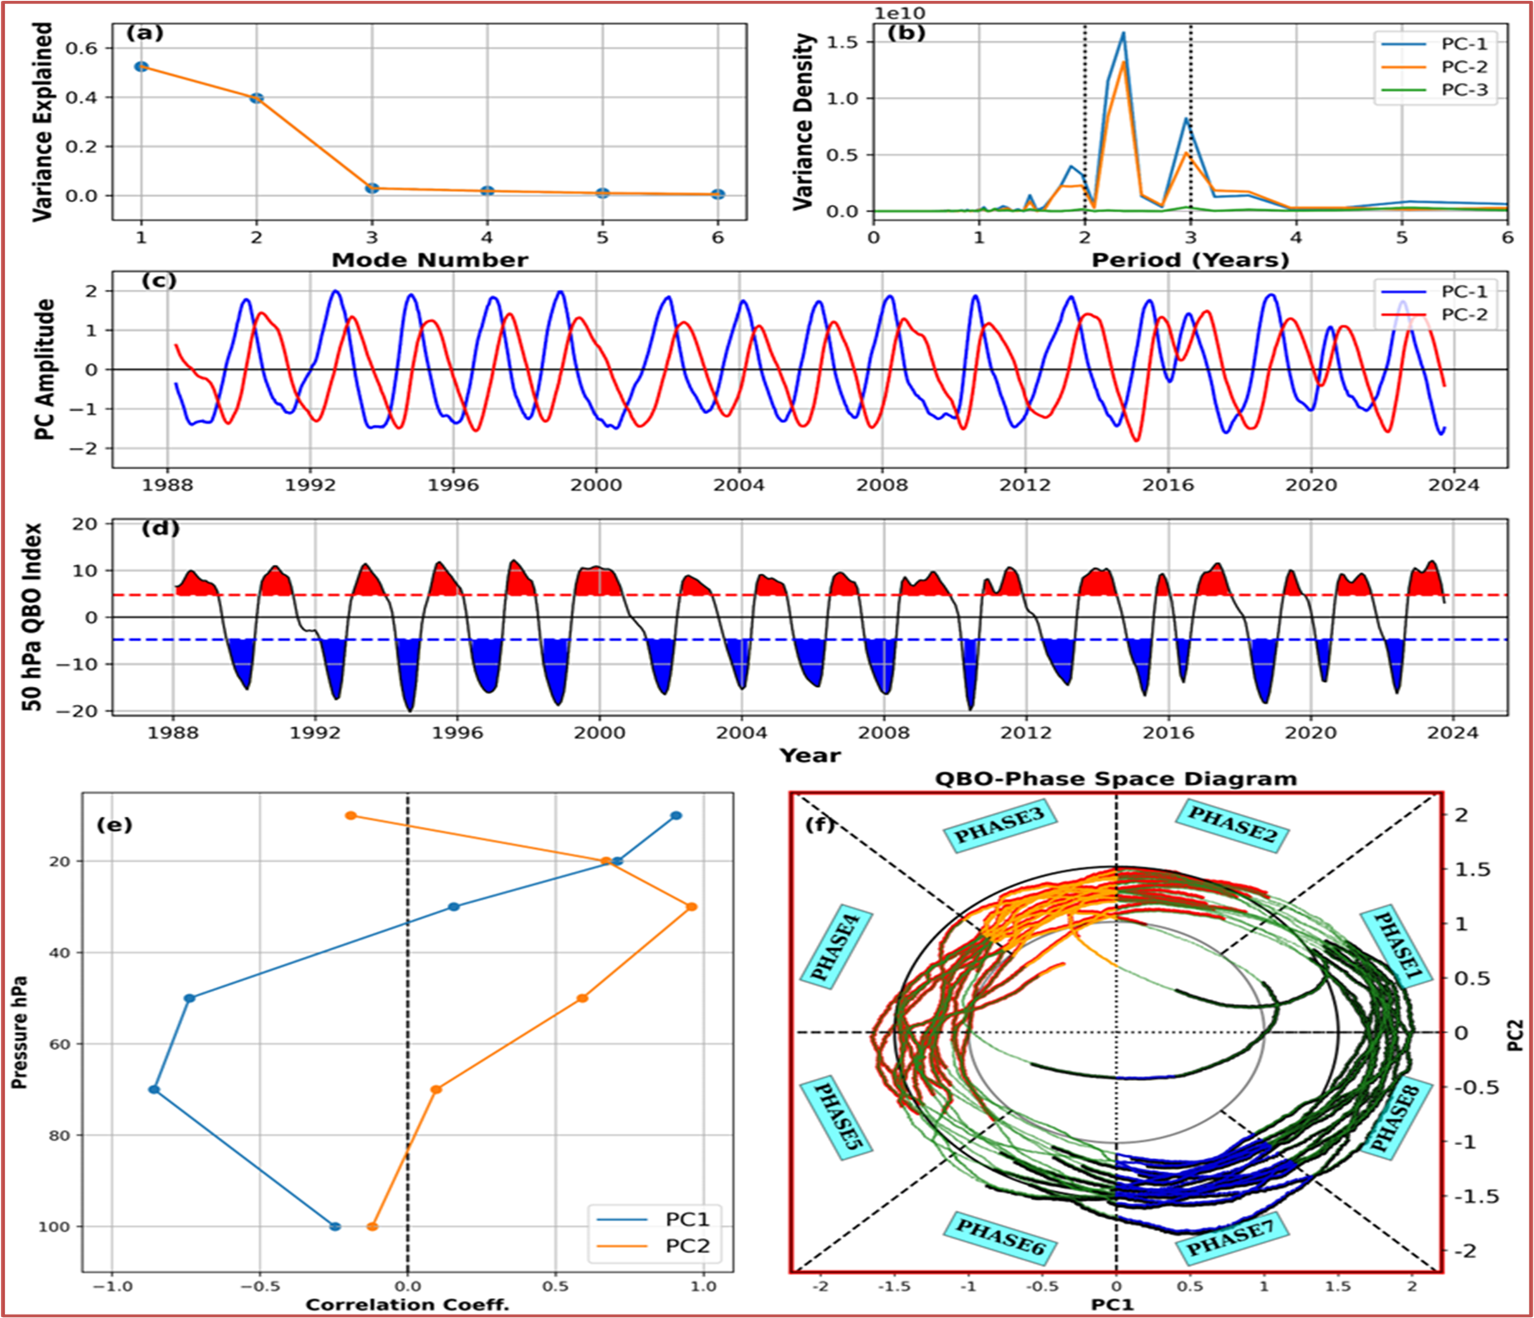
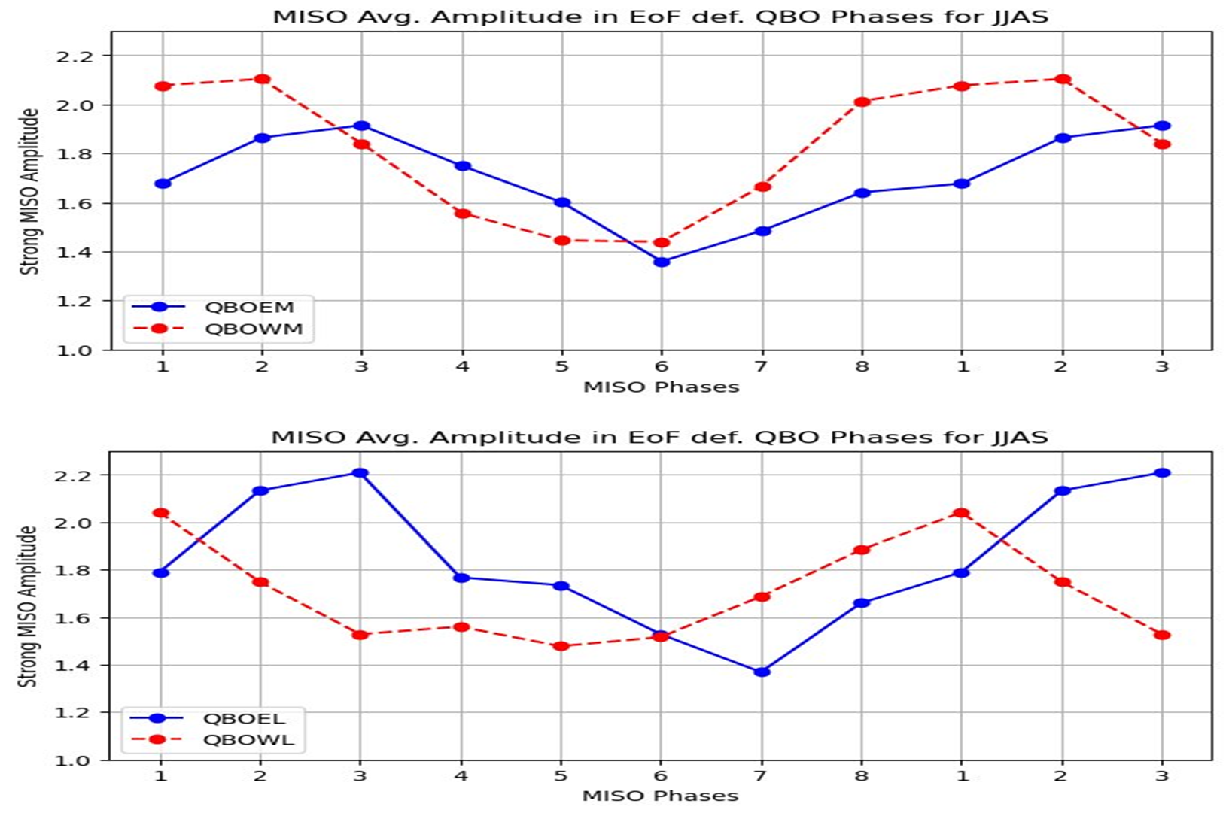
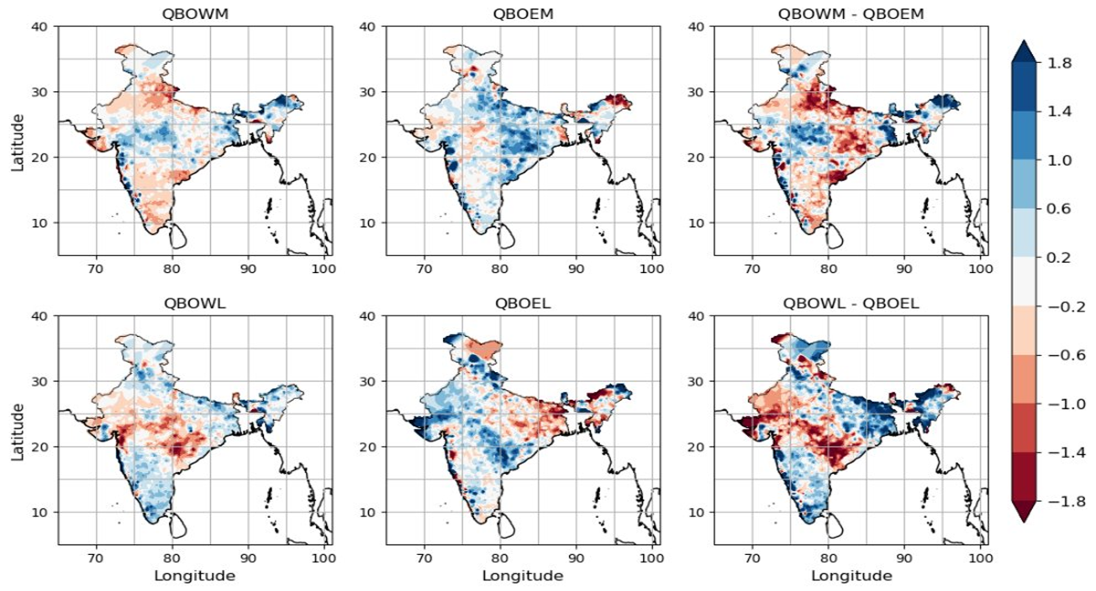
Fig.2 Average MISO amplitude in EOF defined QBO (a) Middle Phase (b) Lower Phase
Fig. 1: (a) Variance (b) Power Spectrum (c) amplitudes of PC1 and PC2. (d) QBO Index defined at 50 hPa (e) The correlation coefficient with primary timeseries (f) QBO phase-space diagram.
Fig.3 Average Rainfall anomaly (mm) over Indian subcontinent for different phases of the QBO defined by EOF criteria and their difference.

