Slide 1
Signatures of Tropical Recycling Ratio across Monsoon Hotspots
Saubhik Das¹, V. Venugopal^{2,3} and Jai Sukhatme^{2,3}
¹Interdisciplinary Centre for Water Research (ICWaR)
²Centre for Atmospheric And Oceanic Sciences
³Divecha Centre for Climate Change
Indian Institute of Science, Bangalore- 560012
saubhik100@gmail.com | saubhikdas@iisc.ac.in

Slide 2
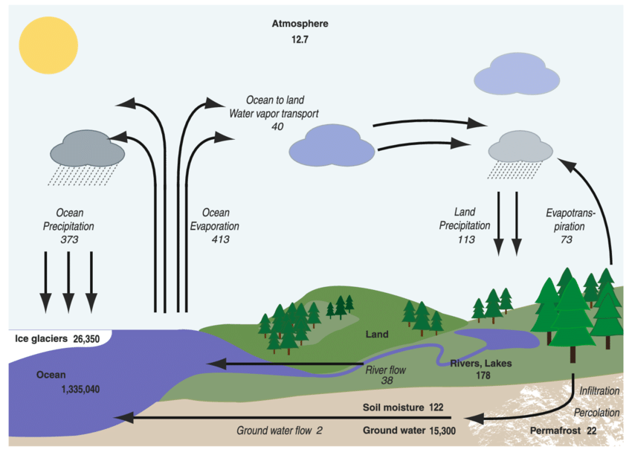
Introduction
Global average precipitation rate ≈ global mean evaporation rate ≈ 2.8 mm/day
[Xie and Arkin ( 1997)]
Global average rain rate when it is raining (45 mm/day) ≈ 16 x Global average precipitation rate (2.8 mm/day)
[Burlutskiy ( 2000) ; Dai ( 2001a)]
Conversion from areal to linear scale (√16 =4)
For a synoptic system of radius of 800 km, moisture comes from up to about 3200 km
Global Hydrologic Cycle
The reservoirs (in 10³ km³) are shown in bold and flows (10³ km³ /year) in italic (adapted from Launiainen et al. 2013)

Slide 3
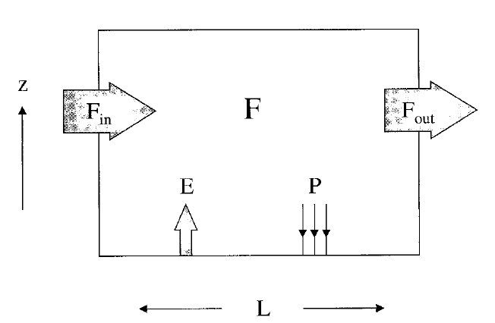
What is RECYCLING RATIO?
Recycling Ratio = $\frac{P_{e}}{P}$ x100%
P = $P_{a}$ + $P_{e}$
$P_{a}$ = Advective component of precipitation
$P_{e}$ = Component arising from local evaporation
RAINFALL
EVAPORATION
ADVECTION
Recycling Ratio (RR)$=$ $\frac{E∗L}{E∗L+2F_{in}}$x 100%
E = Total Evaporation
L = Length of domain aligned along the trajectory of the air (500KM for this study)
F = Average horizontal moisture flux entering the domain
= $\frac{1}{g}$ $\int_{0}^{P_{s}}{qv dp}$
(Trenberth 1999)

Slide 4
Objectives
1
2
Distinguish between the advective and evaporative components of the local precipitation and describe their interactions with natural drivers of climate variability
Identify the regions with considerable inter-annual and/or interseasonal variability of the precipitation components
$\frac{∂W}{∂t}$=E-P- $\frac{1}{g}$ 𝛁.$\int_{0}^{P_{s}}{qv dp}$
3
Investigate the changes related to the components of precipitation under a warming climate scenario

Slide 5
Methodology
FOCUS NEAR TROPICS:
Drivers of Natural Climate Variability
Seasonal Variabilities in Evaporative and Advective moisture
CAN RECYCLING RATIO DESCRIBE:
ENSO Signals?
Summer Monsoon Variations?
Drought Signals?
CATEGORIES:
El-Niño and drought in India (En + Dr)
El-Niño without drought in India (En + NDr)
No El-Niño but drought in India (NEn + Dr)

Slide 6
Datasets
ERA-20C (ECMWF Reanalysis): 1900-2010, daily, 1° gridded specific humidity, surface pressure, zonal and meridional winds, vimd, evaporation.
ERA-5 (ECMWF Reanalysis): 1940-2022, daily, 1° gridded specific humidity, surface pressure, zonal and meridional winds, vimd, evaporation.
GPCP (Global Precipitation Climatology Project): 1979–2010, monthly, 2.5° gridded mean rainfall.
Indian Meteorological Department (IMD): 1900-2010, daily, 1° gridded precipitation.
GPCC: 1900-2010, monthly, 0.5° gridded precipitation.
CMIP6: 1850-2014(Historical), 2015-2100(Future Projections), gridded ensembles of specific humidity, surface pressure, zonal and meridional winds, evaporation for SSP5-8.5 experiment.

Slide 7
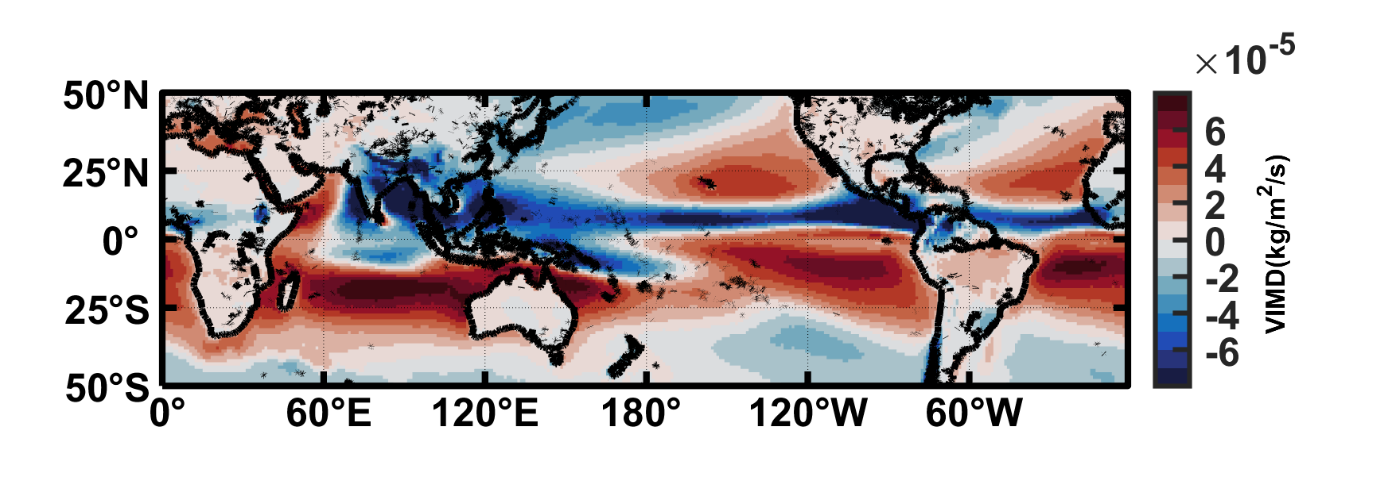
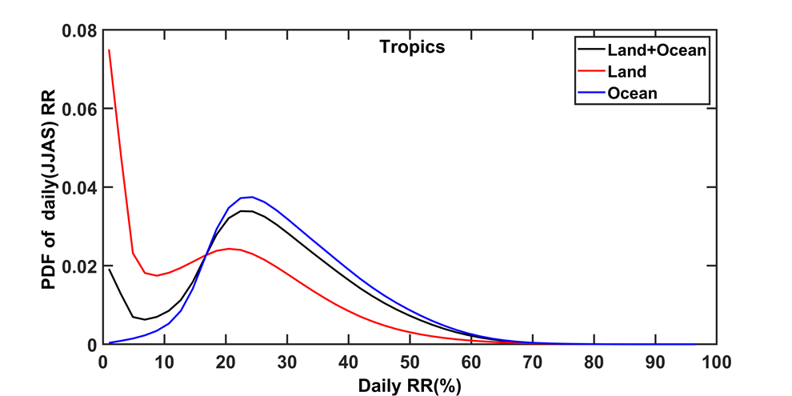
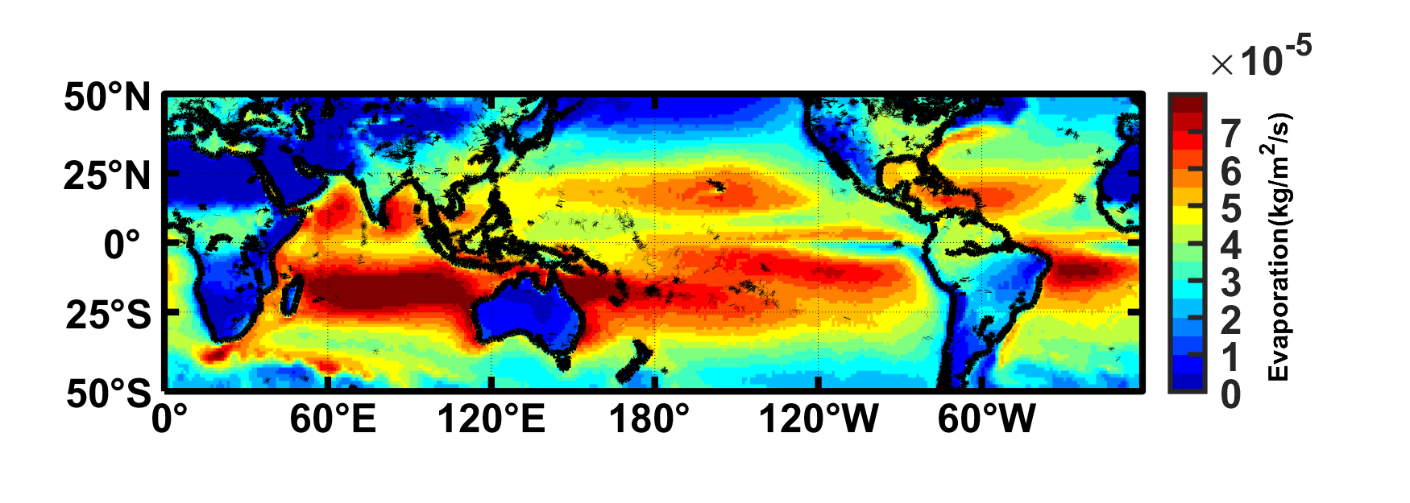
Characteristics of RR
Vertically Integrated Moisture Divergence (VIMD)
Recycling Ratio
VIMD = 𝛁. F = $\frac{1}{g}$ 𝛁.$\int_{0}^{P_{s}}{qv dp}$
JJAS: June through September;
Probability Density Function (PDF)
Evaporation
(ERA -20C :1900-2010)

Slide 8
Seasonal Variation (JJAS vs OND)
June – September (JJAS)
October – December (OND)
Precipitation
Recycling Ratio
(GPCP:1979-2020)
(ERA -20C: 1900-2010)

Slide 9
Sensitivity towards El Niño and Indian Monsoon Drought
Recycling Ratio Climatology
Inter-annual variation of Recycling Ratio
JJAS: June through September;
IAVSR: Inter-annual variation of seasonal(JJAS) Recycling Ratio
(El Niño + Drought) Recycling Ratio
Percentage Deviation [(EN + D)-climatology]
(ERA -20C :1900-2010)

Slide 10
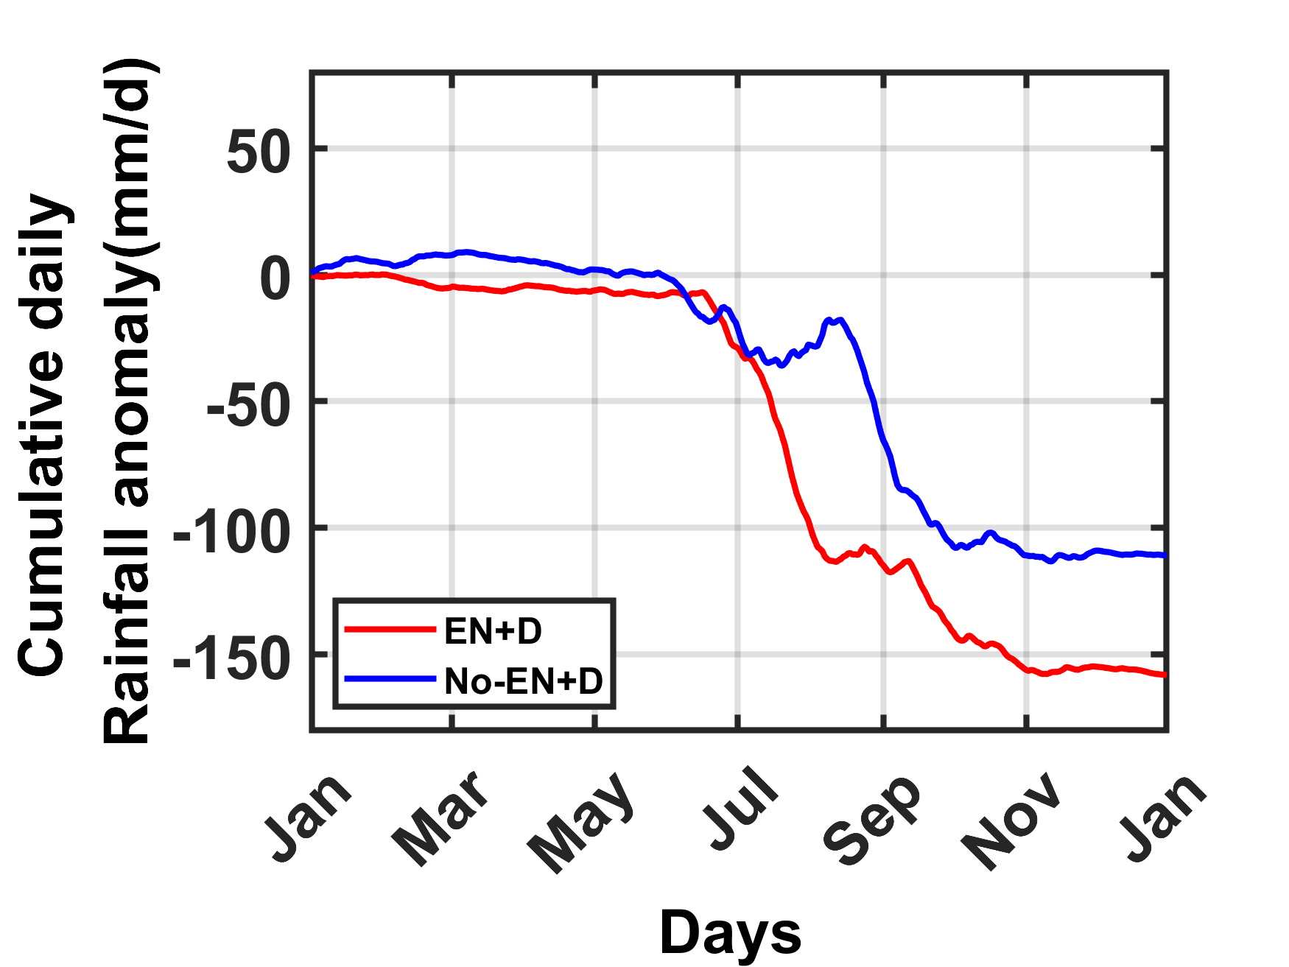
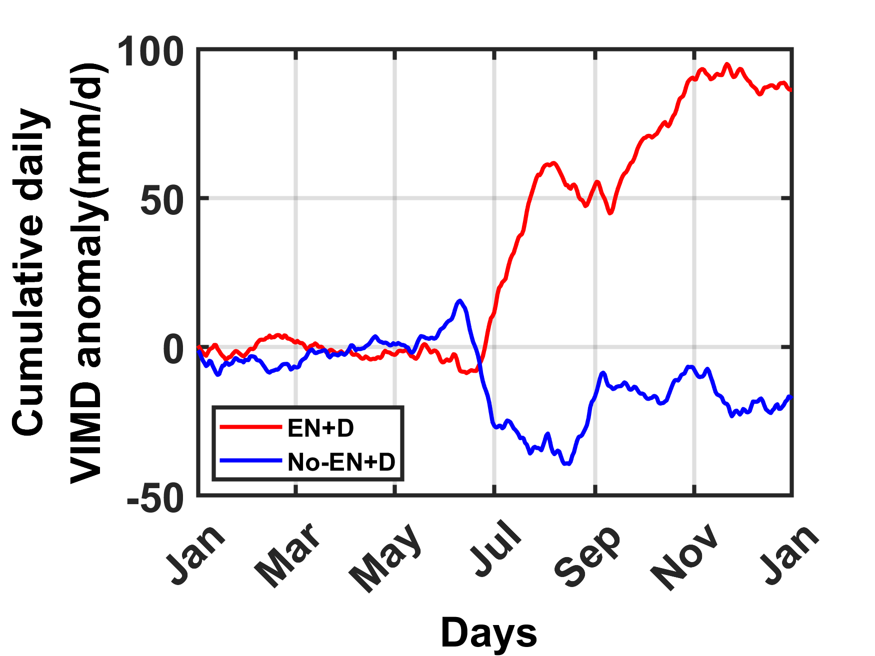
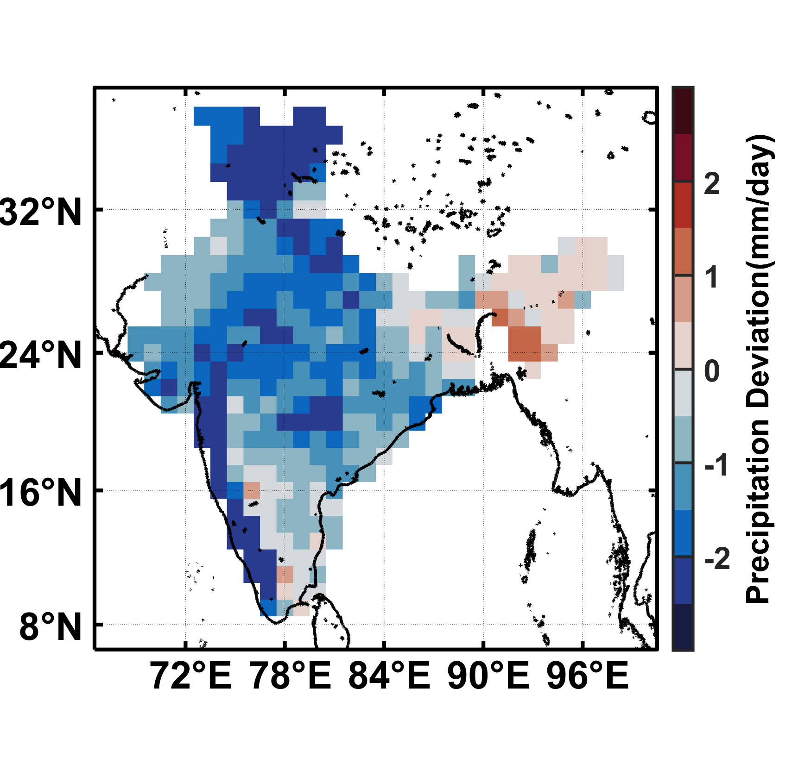
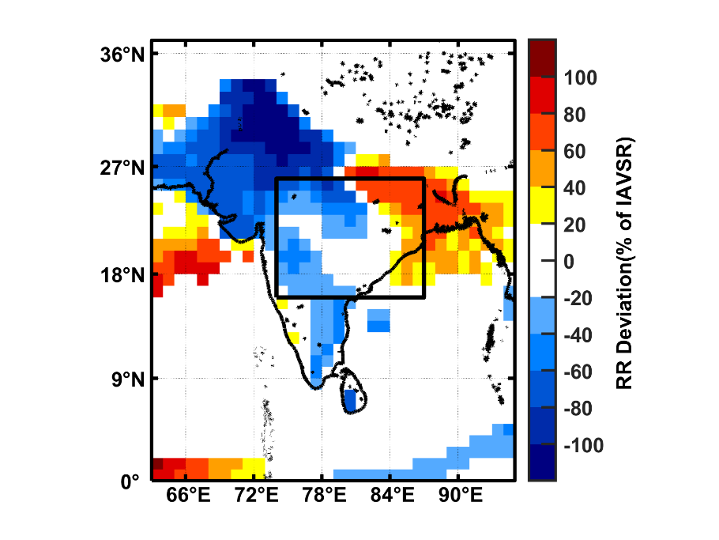
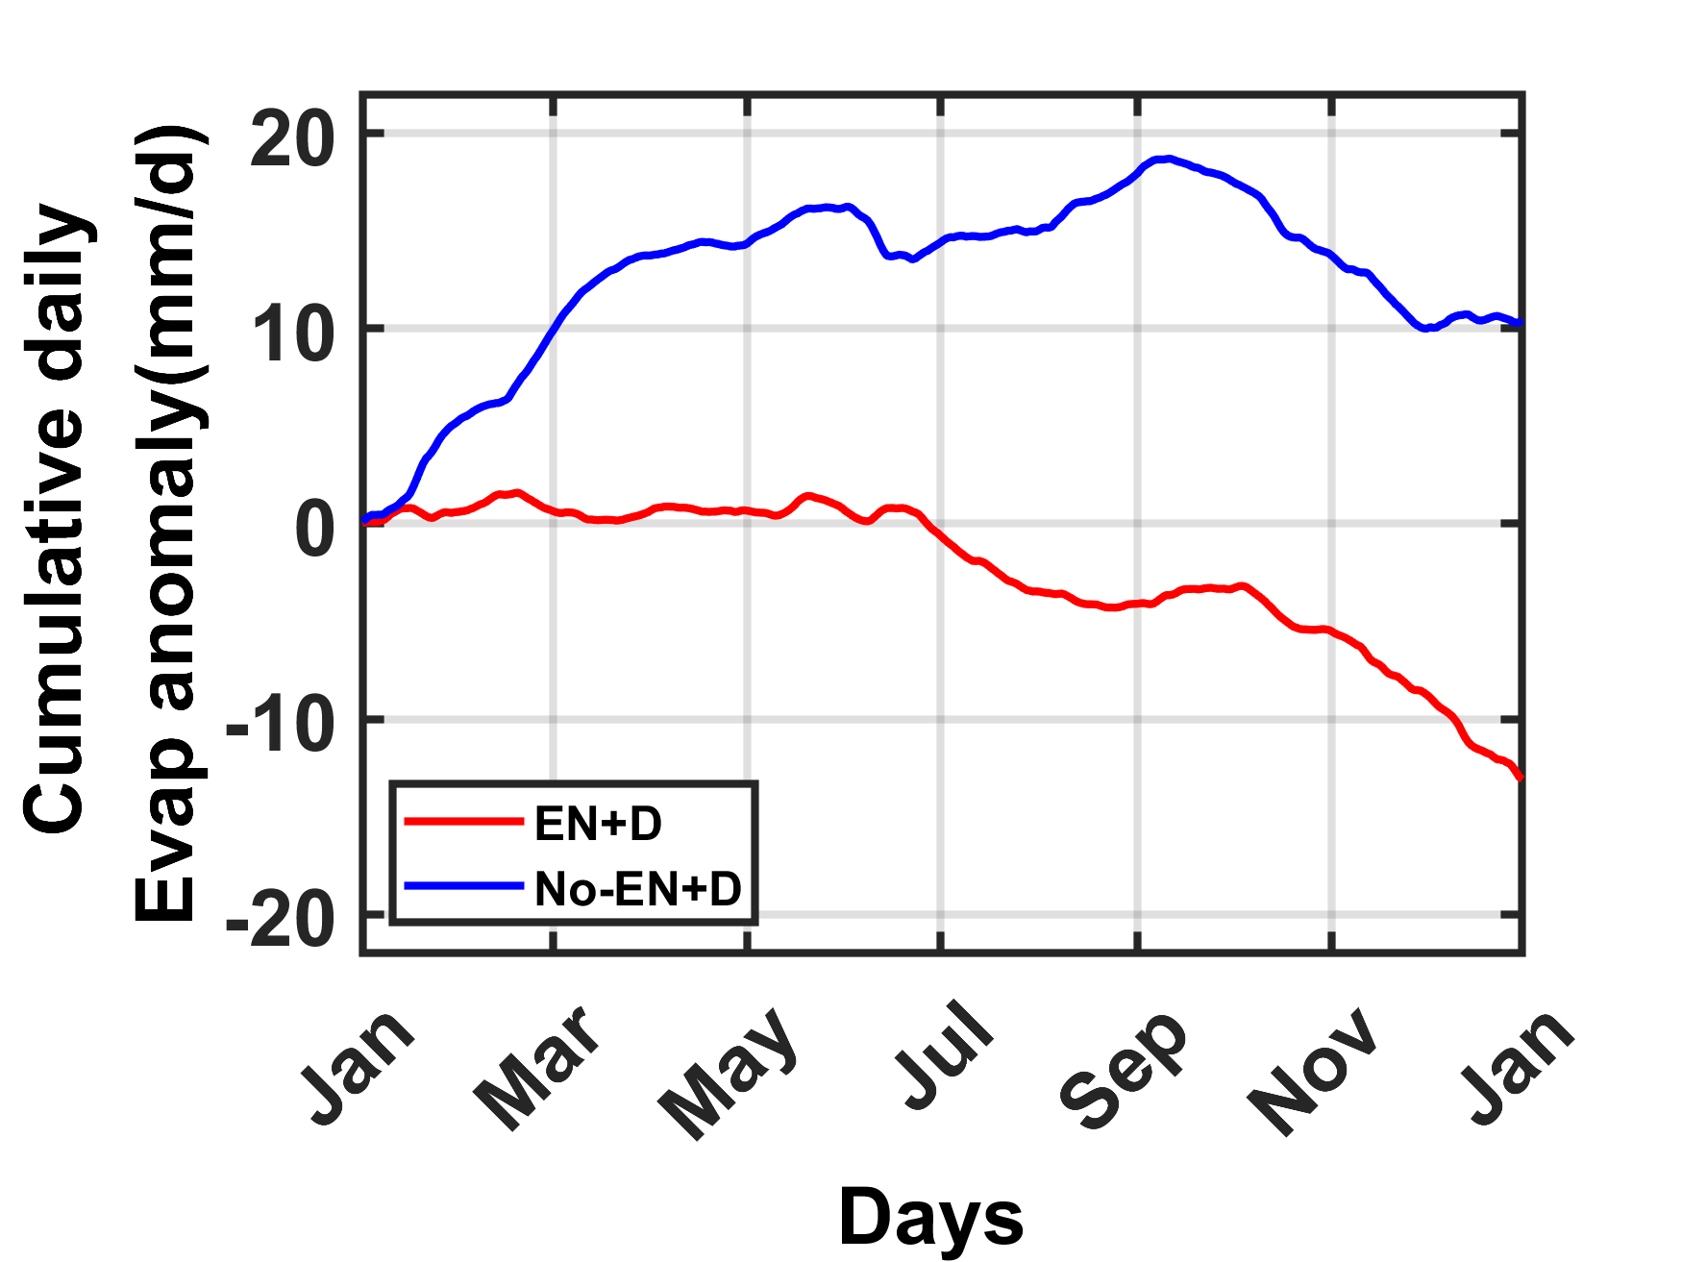
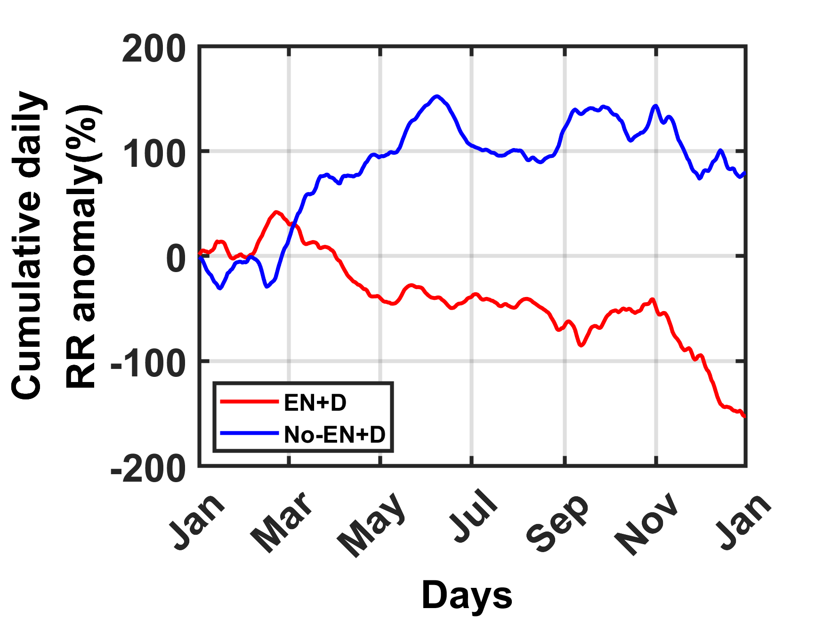
Comparison of Drought Signals over Central India
(IMD :1900-2010)
Central India(74°–87° E, 16°–26° N)
Positive Evaporation/ RR anomalies during No El Niño + Drought?
(ERA -20C :1900-2010)

Slide 11
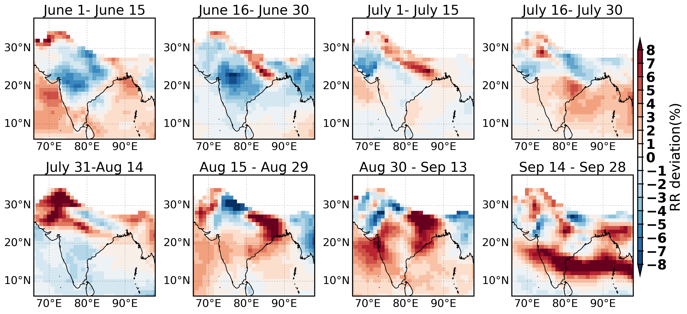
15-Daily RR(JJAS) anomalies during NEn-Dr
11
Increased RR during drought indicates cut-off in incoming monsoon moisture Flux
(ERA -20C :1958-2010)

Slide 12
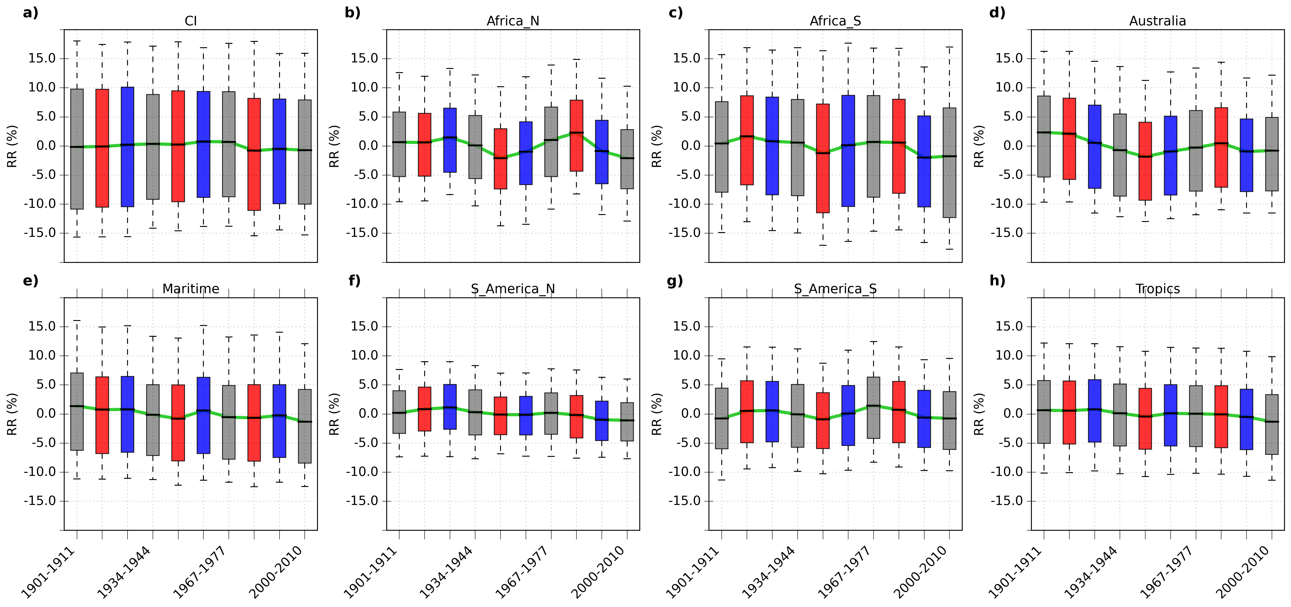
Multi-Decadal RR Anomalies across Monsoon Hotspots
12
(ERA -20C :1900-2010)

Slide 13
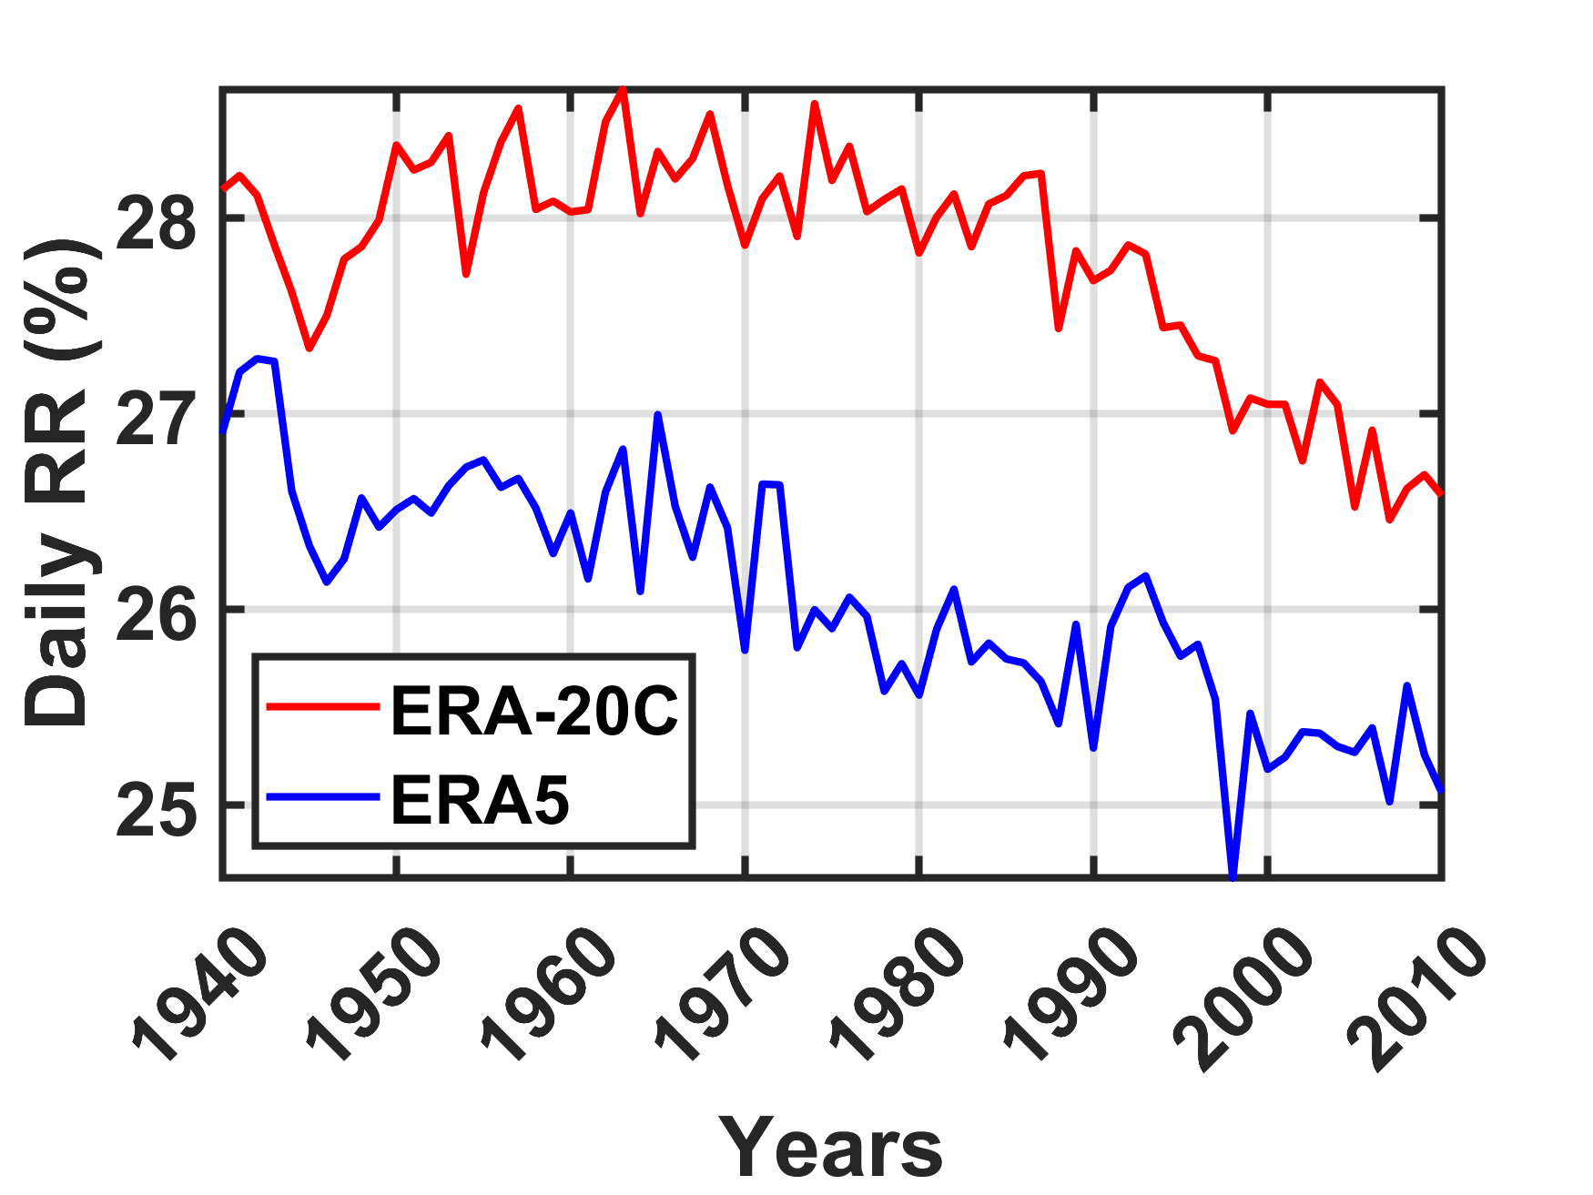
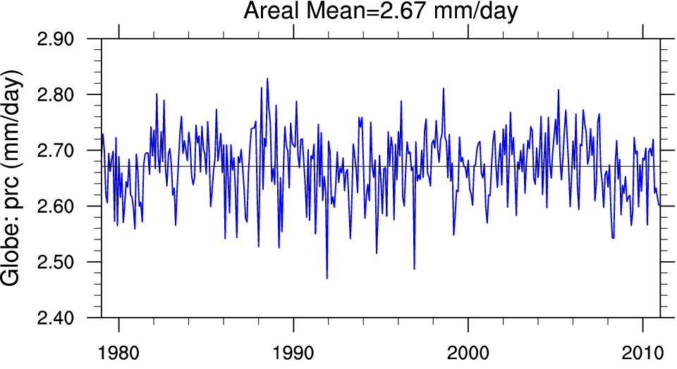
Trend near tropics (30S-30N)
13
(adapted from Climate Data Guide; D. Shea)
No trend in rainfall, but a down-trending RR . Physical implications?
(GPCP :1979-2010)
(ERA -20C :1940-2010 )
(ERA5:1940-2010)

Slide 14
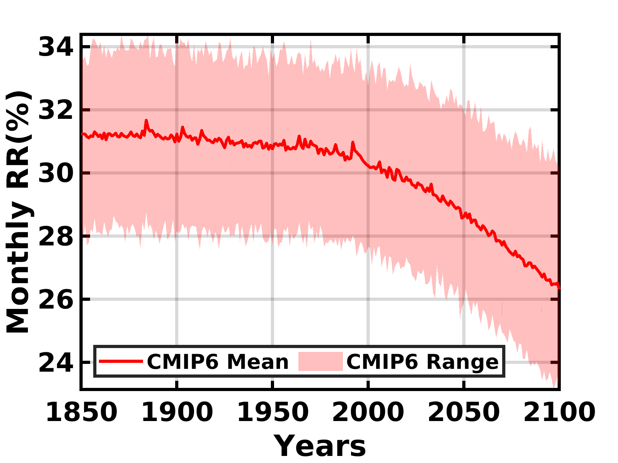
Future Projection near tropics (30S-30N)
14
(CMIP6: 1850-2014, 2015-2100 (SSP-8.5) )
(ERA -20C :1940-2010 )
(ERA5:1940-2010)

Slide 15
Summary
15
1
2
Seasonal and sub-seasonal variations of advective and evaporative components of rainfall are well explained by the RR
Sensitivity towards El-Niño signals and Drought signals
3
4
A multi-decadal pattern in Monsoon Hotspots
Dominance of advective moisture flux over evaporation under warming

Slide 16
Thank you
Saubhik das​
saubhik100@gmail.com | saubhikdas@iisc.ac.in

