Slide 1
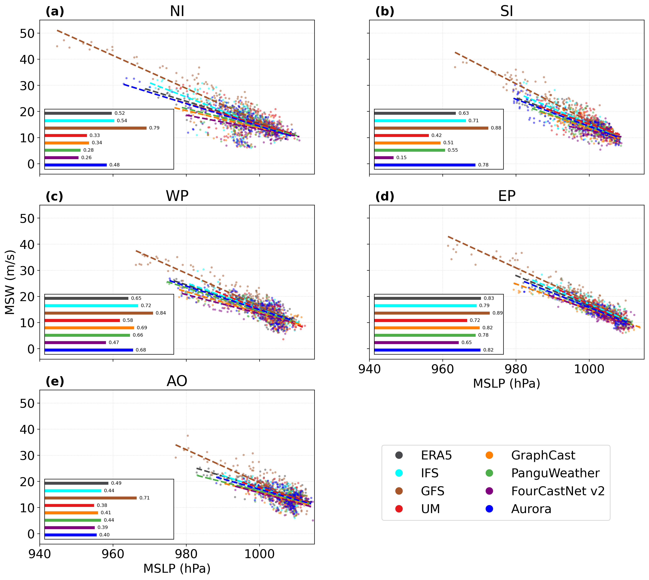
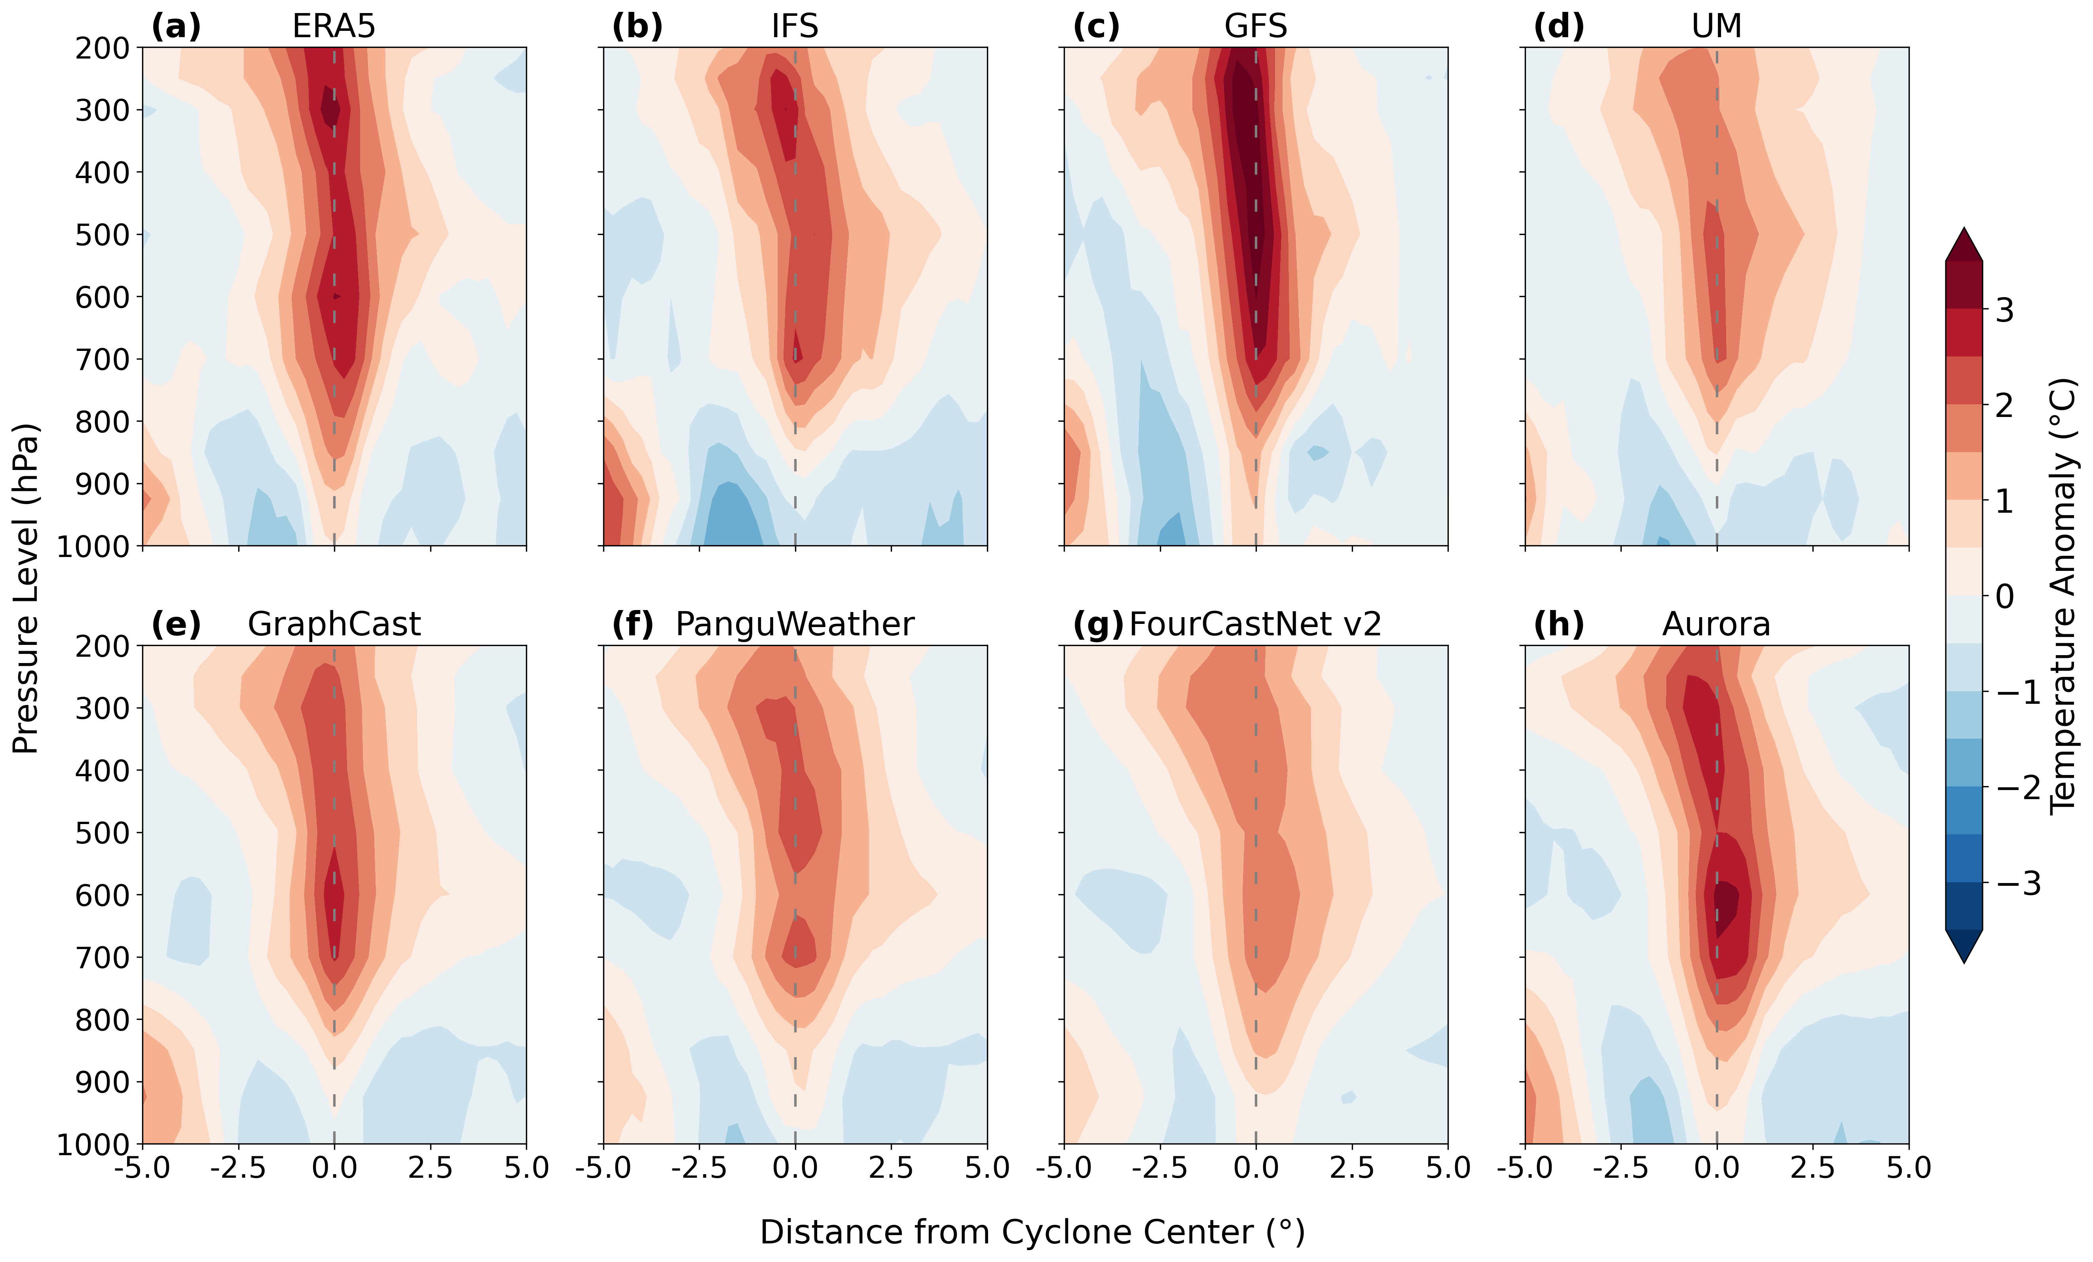
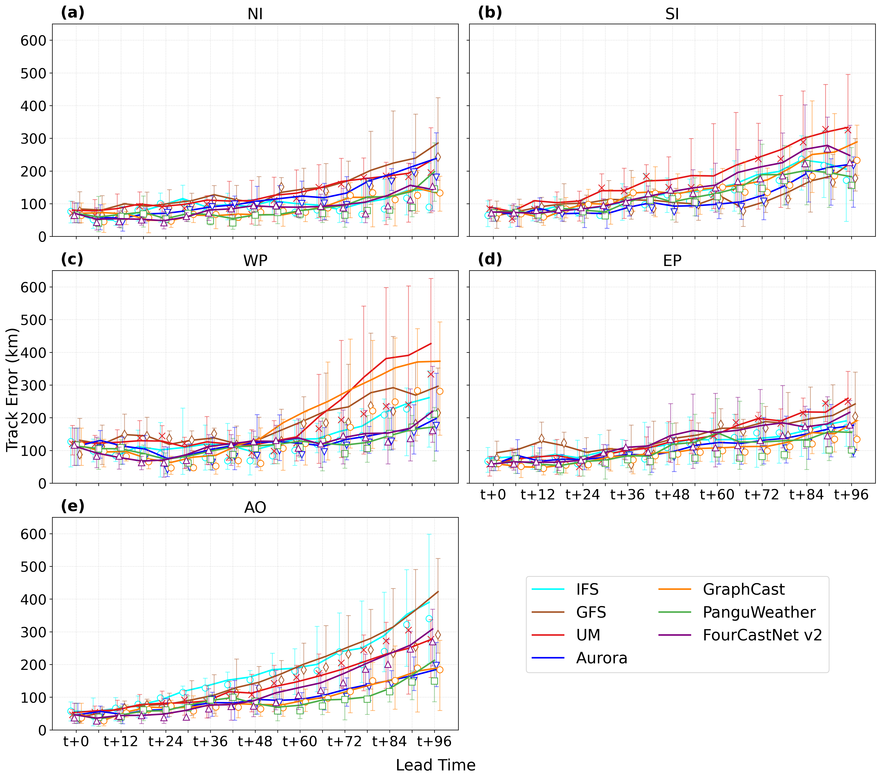
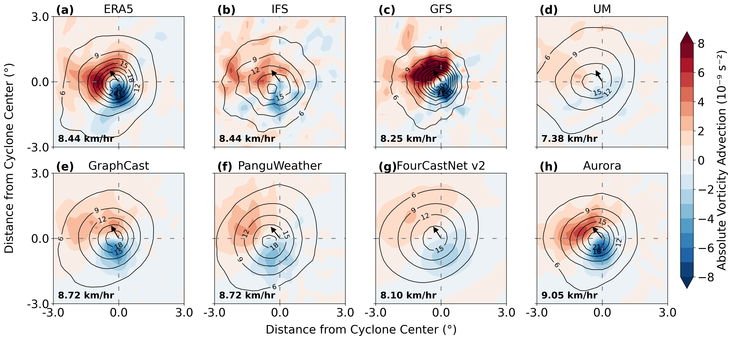
Strengths and Weaknesses of Global Machine Learning Weather Prediction Models in Forecasting Tropical Cyclones
Pankaj Lal Sahu ¹ Sukumaran Sandeep ^{1,2} Hariprasad Kodamana ^{2,3,4}
¹ Centre for Atmospheric Sciences, Indian Institute of Technology Delhi, New Delhi 110016, India. Email: asz238477@iitd.ac.in
² Yardi School of Artificial Intelligence, Indian Institute of Technology Delhi, New Delhi 110016, India
³ Indian Institute of Technology, Delhi-Abu Dhabi, Khalifa City, Abu Dhabi, UAE
⁴ Department of Chemical Engineering, Indian Institute of Technology Delhi, New Delhi 110016, India
Introduction
Wind-Pressure relationship
Thermal Structure
MLWP models like GraphCast, FourCastNet, Aurora, and Pangu-Weather offer fast, competitive TC forecasts but struggle with intensity prediction. ^{[1]}
This study assesses their ability to capture key storm dynamics, highlighting strengths, limitations, and areas for improvement.
Data and Methodology
Conclusions
Four MLWP models forecasted 50 TCs using ERA5 (0.25°). Outputs were compared with IBTrACS and NWP models. Tracks used MSLP minima; storm dynamics analyzed via vorticity, advection, and temperature anomalies.
1. ML-based weather models achieve low track errors, rivaling or surpassing NWP models.
2. All MLWP models tend to underpredict TC intensity.
3. Despite lacking explicit physics, MLWP models capture TC structures like pressure, vorticity, and warm-core anomalies.
Absolute vorticity
Track error
References
[1] Andrew J Charlton-Perez, Helen F Dacre, Simon Driscoll, Suzanne L Gray, Ben Harvey, Natalie J Harvey, Kieran MR Hunt, Robert W Lee, Ranjini Swaminathan, Remy Vandaele, et al. Do ai models produce better weather forecasts than physics-based models? a quantitative evaluation case study of storm ciarán. npj Climate and Atmospheric Science, 7(1):93, 2024.

