Slide 1
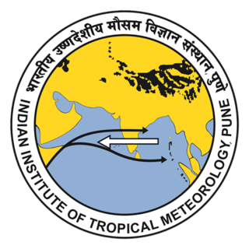
Influence of Oceanic Teleconnections on the Indian Summer Monsoon During the Holocene and Younger Dryas: Insights from Paleo Records and Modeling
Md Kaif^{1,2,*}, Sabin T. P.¹, R. Krishnan¹ and Naveen Gandhi¹
¹Centre for Climate Change Research, Indian Institute of Tropical meteorology, Pune
²Savitribai Phule Pune University, Pune
*md.kaif@tropmet.res.in
Th-4.27
IWM-8 workshop on
“Monsoons in a Changing Climate”
17th – 21st March 2025, IITM-Pune

Slide 2
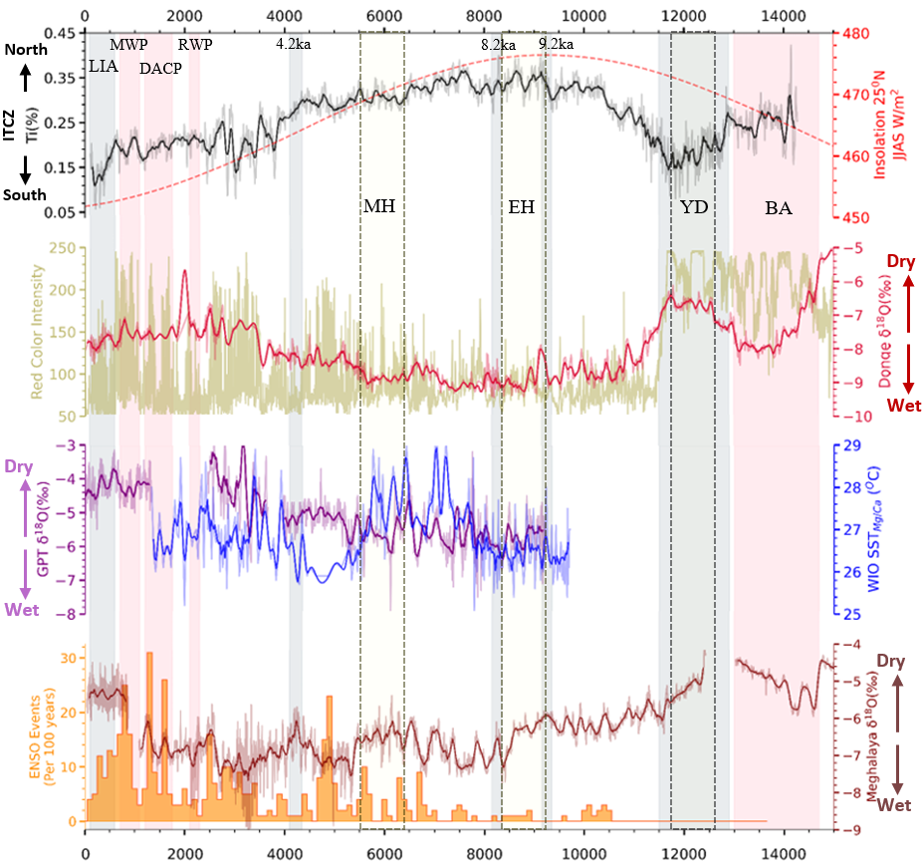
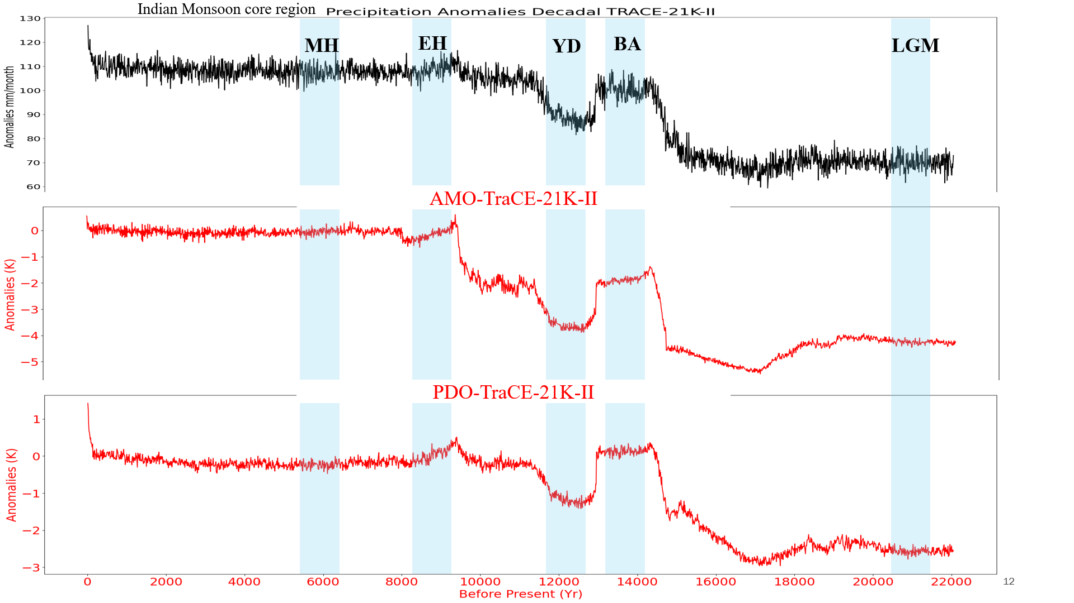
Introduction & Motivation
The Indian summer monsoons began to recover after the late Glacial Interstadial period, enhanced shortly after the Younger Dryas-YD (12.7-11.7Ky BP), and were gradually well-established in the mid-Holocene-MH (6.5-5.5Ky BP), and began to weaken thereafter, as evidenced by δ¹⁸O proxy data and model analysis.
These fluctuations are often associated with oceanic phenomena such as the Atlantic Multi-decadal Oscillation (AMO) and Pacific Decadal Oscillation (PDO), Pacific Nino, and Indian Ocean.
The study aims to understand the impact of oceanic conditions on the Indian Summer Monsoon across major paleo-epochs, including the Mid-Holocene, Early Holocene and Younger Dryas.
Fig: Comparison between MH, EH and YD climate reconstruction records from the Indian Summer Monsoon domain and surrounding regions.(A) Titanium (%) data from the anoxic Cariaco Basin, (B) Solar insolation for the 25 °N latitudes (Lasker et al., 2004) (C) Speleothem δ¹⁸O Dongge Cave (Dykoski et al., 2005), (D) Red color intensity from sediment cores in the Laguna Pallcacocha drainage basin (E) Gupteshwar Cave (GPT-5A, unpublished), (F) WIO SST (Mg/Ca) sediment data from the Pemba Channel (G) ENSO event frequency per 100 years, and (H) δ¹⁸O Mawmluh Cave, Cherrapunji Meghalaya.

Slide 3
Data & Methodology
Sea Surface Temperature - TraCE-21K-II
Longitude – 3.6º
Latitude- variable grid 1º to 1.5º, High resolution near tropic, coarser for extra-tropic and pole.
Precipitation(3.75º x 3.71º) – TraCE-21K-II
For paleo-reconstruction, data from the Meghalaya cave Meg-2 (25.25°N, 91.71°E), located near Cherrapunji in North-East (NE) India used.
The variability of oxygen isotopes (δ¹⁸O) in stalagmite samples, made use for the reconstruction.
To support our analysis of the South Asian monsoons, we incorporated reconstructed data from Dongge Cave (Wang et al., 2005) and Gupteshwar Cave (unpublished data).
In this study, four ocean basins were selected — the North Pacific, North Atlantic, Tropical Pacific, and North Indian Ocean — based on their potential influence on the Indian Summer Monsoon (ISM).
The following paleoclimate epochs were chosen for analysis: the Mid-Holocene (6500–5500 years Before Present, BP), Early Holocene (9330–8330 BP), and Younger Dryas (12700–11700 BP).
The EOF technique used to understand oceanic conditions such as the AMO, PDO, ENSO, and IOD. Additionally, regression and PCMCI+ analysis was performed to gain deeper insights into their teleconnection phases.

Slide 4
Results
Change in Precipitation
Fig: Change in Seasonal mean (JJAS) precipitation MH, EH & YD with respect to Pre-Industrial(PI)
The Indian monsoon was strong during the EH and moderately strong during the MH. In contrast, it weakened during the YD, as evidenced by δ¹⁸O proxy data and model analysis.

Slide 5
Oceanic conditions during MH, EH & YD
MH
EH
YD
North Atlantic
PDO
Tropical Pacific
North Indian Ocean

Slide 6
Regression Analysis
Fig: Regression between Precipitation and leading principal component (PC1) of the SST
The oceanic conditions during the MH were generally unfavourable for ISMR, except for the Indian.
In the EH, favourable conditions spanned most oceanic regions except the Indian Ocean.
In contrast, in the YD, favourable conditions were mainly limited to the North Pacific Ocean.

Slide 7
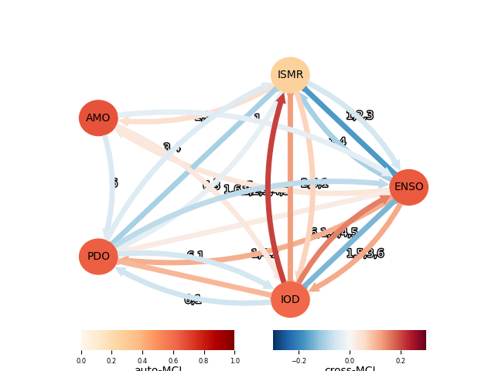
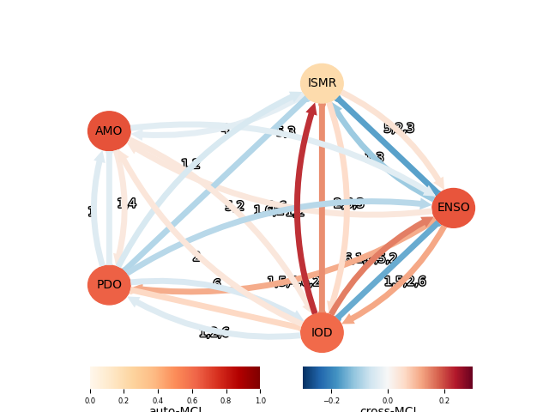
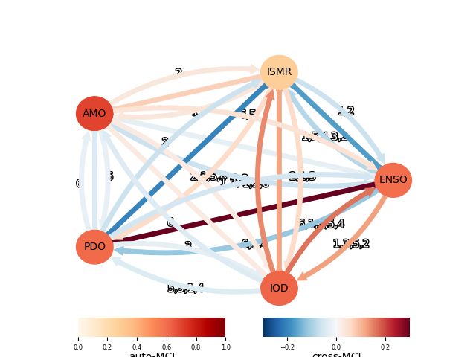
Inference from Causal analysis
a
b
c
Contemporaneous Link
Unoriented Contemporaneous adjacency
auto-MCI(nodes)
cross-MCI(arrows)
Lagged Link
Conflicting Contemporaneous adjacency
Causal links between the ISMR, AMO(NA), PDO, ENSO(Nino) and IOD on seasonal time-scales based on monthly anomalies of the indices for MJJASO season during the period, (a) MH, (b) EH and (c) YD obtained using the multivariate causal framework at 95% alpha level using the PCMCI+ causal inference algorithm.
The causal analysis, it is evident that the IOD positively influences ISMR, while ENSO and PDO have a negative impact across all three events.
However, AMO does not show a clear causal link with ISMR during the MH and EH, although it generally drives ISMR positively.

Slide 8
Conclusion
The Indian monsoon was strongest during the Early Holocene (EH), moderately strong during the Mid-Holocene (MH), and weakest during the Younger Dryas (YD), with variability influenced by oceanic drivers.
The MH experienced unfavorable conditions (negative AMO, positive PDO, and El Niño-like state), while the EH had a more favorable configuration except for the Indian Ocean. During the YD, the PDO was in a negative phase, which could have supported ISMR, but other oceanic influences were less favorable.
The IOD positively influences ISMR, whereas ENSO and PDO have a negative impact. AMO lacks a clear causal link during the MH and EH but generally drives ISMR positively with a lag.

Slide 9
Thank You☺

