Slide 1
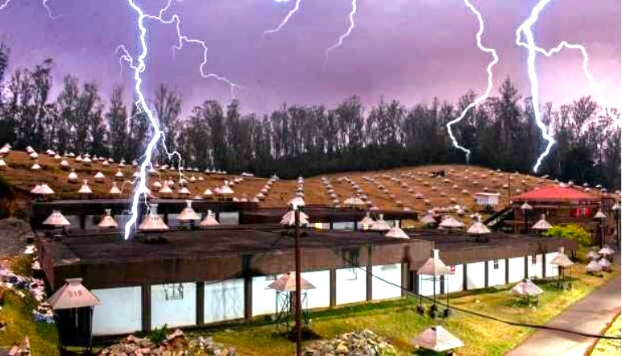
Long-Term Observations of Thunderstorm-Induced Muon Events at GRAPES-3 Experiment Using the Ooty Tracking Muon Telescope During Boreal Summers (2006–2024)
Pranaba K Nayak*
Tata Institute of Fundamental Research Mumbai
E-mail: pranaba@hotmail.com
*for GRAPES-3 Collaboration
8th WMO International Workshop on Monsoons (IWM(17-21 March 2025 at IITM Pune, India

Slide 2
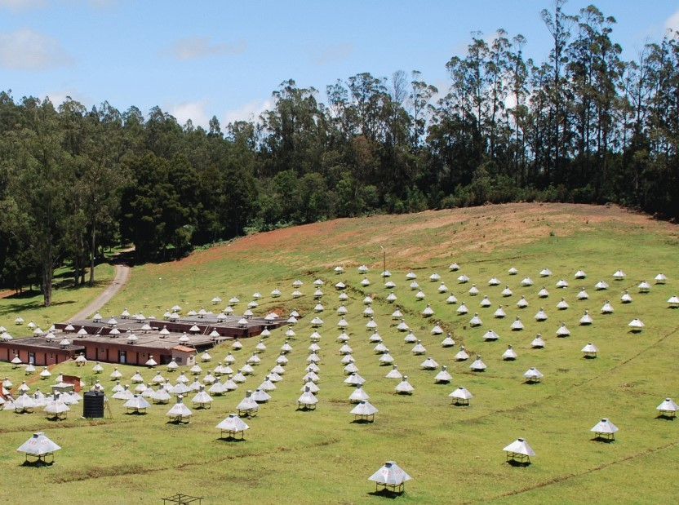
GRAPES-3 Experiment at Ooty
2
2

Slide 3
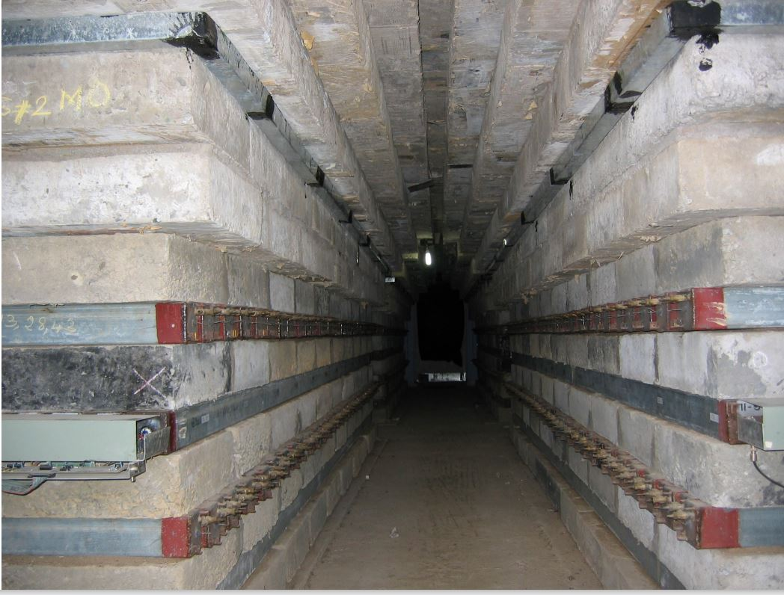
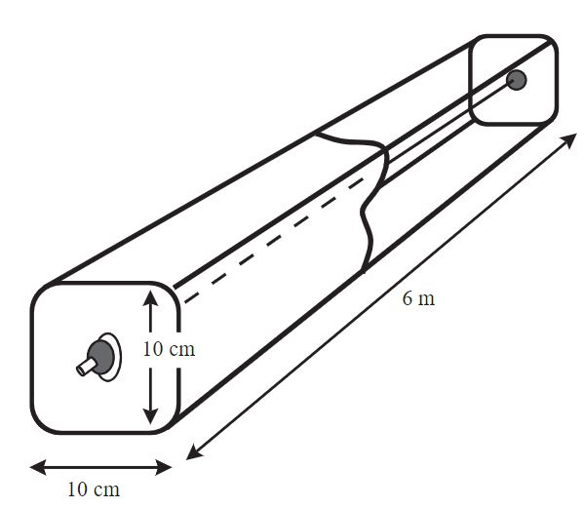
The four muon stations
Schematic of PRC
A module has 232 PRCs
Inverse pyramid structure
Inside view
of a station
Energy threshold ~ 1GeV
3

Slide 4
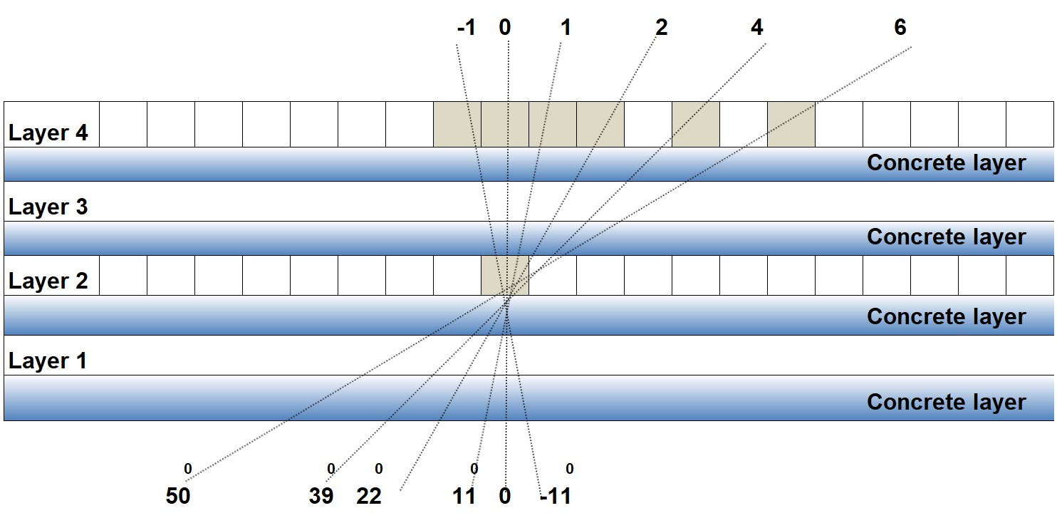
A projection for angle reconstruction
~3k muons s⁻¹ per module
4 billion (10⁹) muon day⁻¹
Accuracy ~0.1 % in 240s
4-layer configuration allows the reconstruction of each muon tracks in two mutually orthogonal planes.
50cm vertical separation between two PRC layers in the same projection plane, allows the muon track direction with an accuracy of less than 4° in each projected plane.
~550 g cm⁻² thick concrete absorbers for 1GeV energy threshold for vertical muons.
Arranged in an inverted pyramidal shape, with coverage up to 45° for incident muons.
4

Slide 5
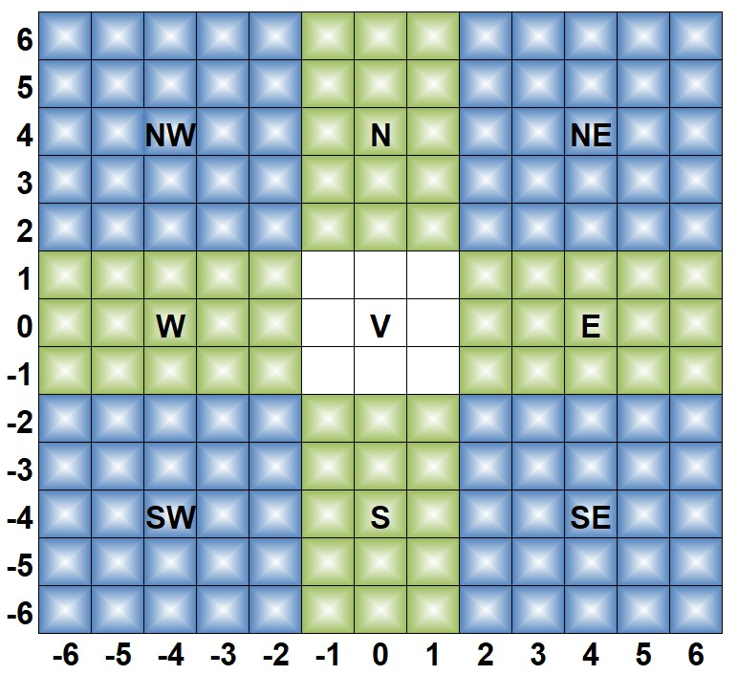
Arrival Direction of Muons
The arrival direction of a muon was determined for each triggered PRC in the lower layer by combining it with the one directly above (the central) and six on each side, resulting in a total of 13 different directions.
The directional binning of each of the two orthogonal projection planes resulted in a muon direction map of 169 solid angles (13 x 13), thereby generating a continuous record of the directional flux of muons in the sky.
The geographical cut-off rigidity at Ooty is 17 GV in vertical, varying from 15 to 24 GV across the field of view of the muon telescope. This results in dissimilarities in the number of muons recorded among the 169 directions, with comparatively larger fluxes of muons for the central (V) and cardinal directions compared to the ordinal directions.
The 169 directional information was combined into nine coarser orientations, resulting in reduced dissimilarity. The combination of the central 3 x 3 solid-angle bins resulted in the vertical direction (V). The cardinal directions in 3 x 5 solid-angle direction combinations, while the ordinal directions are combinations of 5 x 5 solid-angle bins.
5

Slide 6
Thunderstorm-induced Muon Events (TIMEs)
Muons undergo acceleration or deceleration based on their charge.
(i) In a downward-looking field: Positive muons accelerate; negative muons decelerate
(ii) For the upward-going field: It is reverse.
The thunderstorm-induced muon events (TIMEs) are observed when strong electric fields in thunderstorms modulate muon acceleration, resulting in an altered count rate at the observational level. These TIMEs exhibit latitude dependence, directional anisotropy, and temporal correlation with thunderstorms.
Characterized by:
i) Major direction
Duration
Intensity in that major direction
Specific features:
i) Non-uniformity
Event specificity
Confinement to narrow solid angle
We considered an event statistically significant if it exhibited a 0.3% variation (∼3σ significance level; decrease or increase) in muon flux at a major direction.
6

Slide 7
Muon rate variation observed on 17 April 2009
For module 2-4, 0.2 added, for above it, additional value in multiples of 0.4 added
For module 3-1, 0.2 subtracted, for below it, additional value in multiples of 0.4 deducted
The fluctuations in the rate for all modules increased significantly after 20:00 hours
7

Slide 8
And the Event ... Late evening... on 17 April 2009
Muon intensity in nine directions
Change in vertical direction is shown in orange
For directions above it, additional fixed value in multiples of 0.4
For directions below it, subtracted fixed value in multiples of 0.4
8

Slide 9
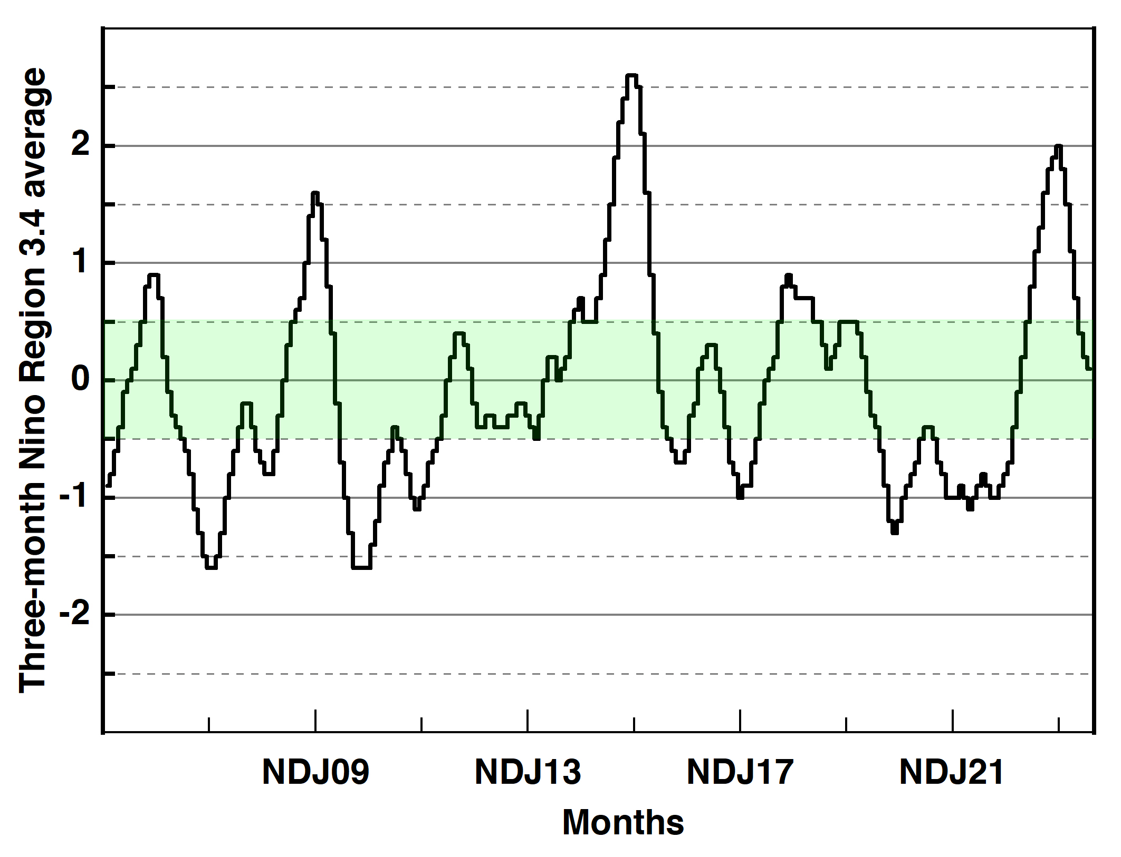
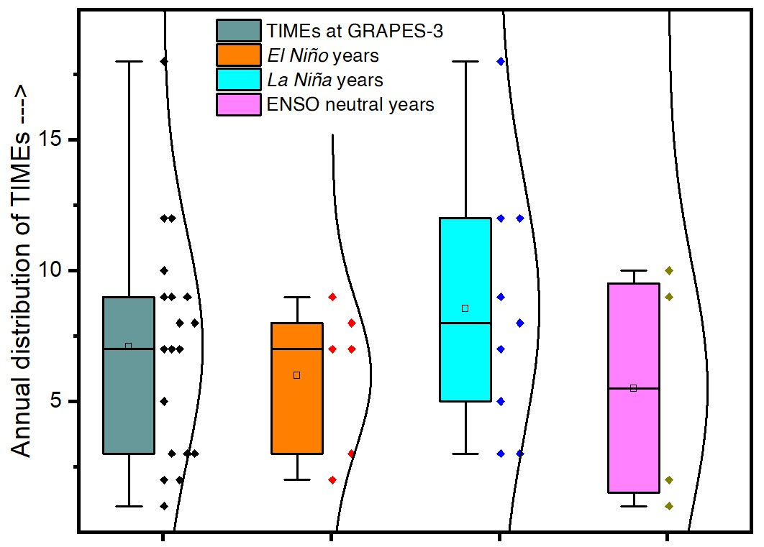
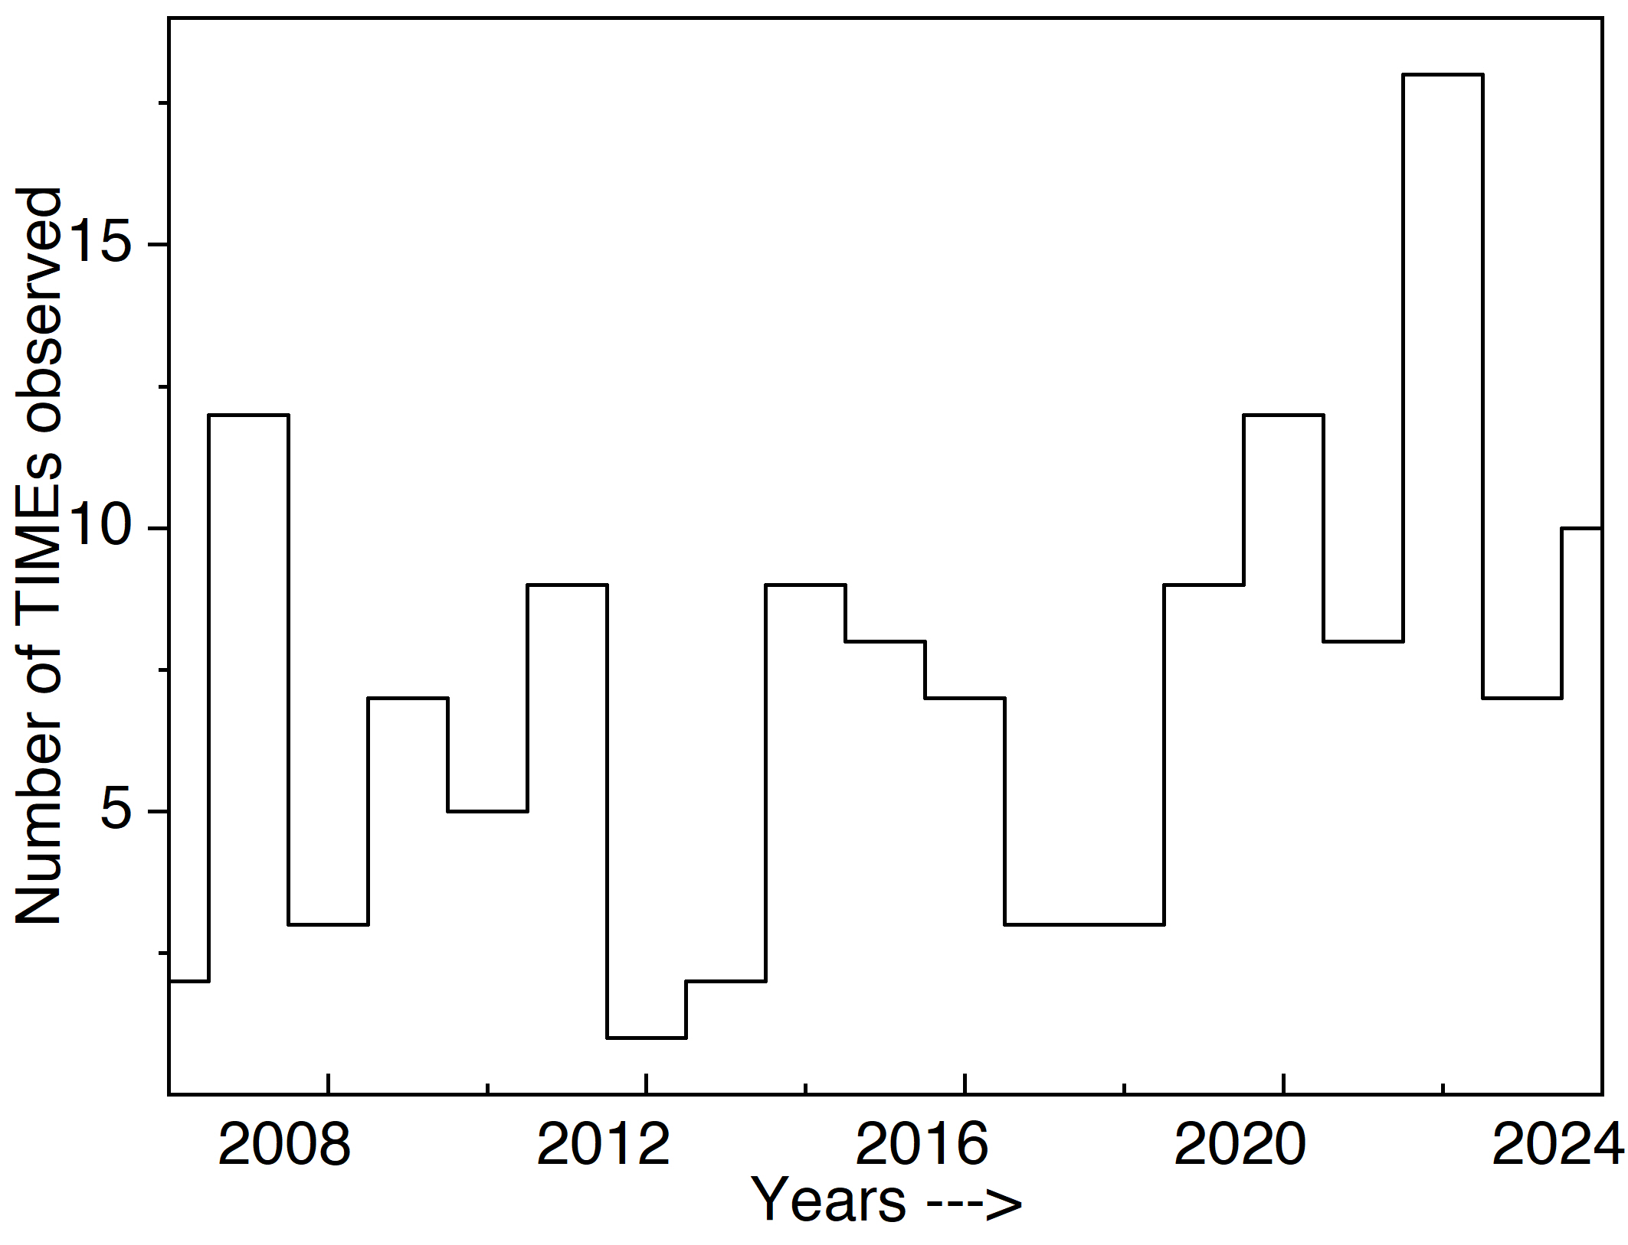
Long-Term Observations During Boreal Summers (2006–2024)
The boxplots represent the interquartile range (IQR), median, and whiskers (extending to 1.5 times the IQR), while the overlaid violin plots illustrate the probability density function of TIME occurrences
9

Slide 10
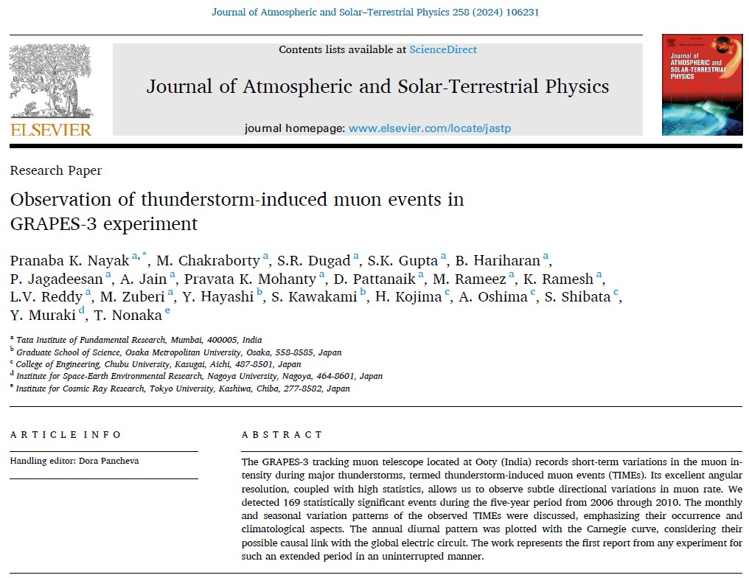
10

Slide 11
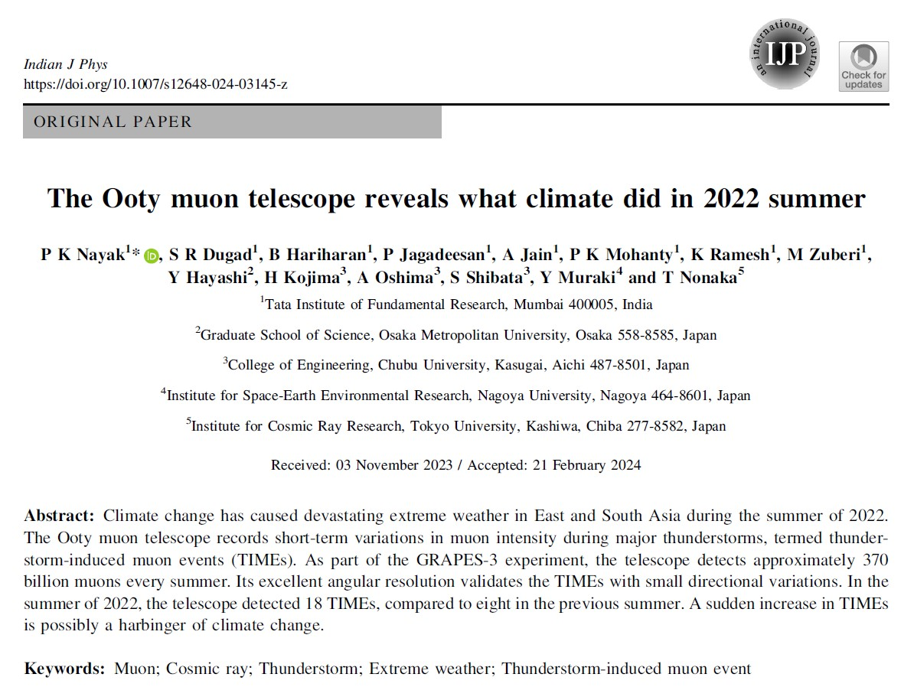
11

Slide 12
Further studies
1. P.K. Nayak* et al., Observation of thunderstorm-induced muon events in GRAPES-3 experiment, J. Atmos. Solar-Terr. Phys., 258 (2024) 106231.
2. P.K. Nayak* et al., The Ooty muon telescope reveals what climate did in 2022 summer, Ind. J. Phys. 98 (2024) 4239.
3. P.K. Nayak* et al., Seasonal variation of thuderstorm-induced muon events observed at GRAPES-3, Proc. of Sci. 444 (2023) 403.
4. P.K. Nayak* et al., Contemplating the observed relationship between the global electric circuit and GRAPES-3 thunderstorm-induced muon events, Proc. of Sci. 444 (2023) 404.
5. P.K. Nayak* et al., Summer Thunderstorm-Induced Muon Events (TIMEs) at GRAPES-3 Experiment: A detailed investigation, Proc. XXV DAE-BRNS HEP Symposium 2022, Mohali, Springer Proceedings in Physics, 304 (2024) 469.
6. P.K. Nayak*, R. Biswasharma et al., Exploring the 20 March 2020 thunderstorm-induced muon event: Insights from GRAPES-3 muon data, INSAT-3DR, and lightning observations, ICRC 2025 (submitted)
7. P.K. Nayak, et al.: Complementary Studies of Electric Field Measurements and Thunderstorm-Induced Muon Events at the GRAPES-3 Experiment, Proc. 9th ISLH2025, King Mongkut's University of Technology, Thailand (2025) 53-56.
8. P.K. Nayak, Biswasharma, et al.: Evolution of a Thunderstorm-Induced Muon Event: Insights from the Ooty Muon Telescope, Electric Field, and Lightning Observations, Proc. 26th DAE-BRNS HEP Symposium, BHU, Springer Proc. Phys. (submitted).
Thank you very much for your kind attention

