Slide 1
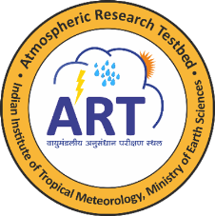
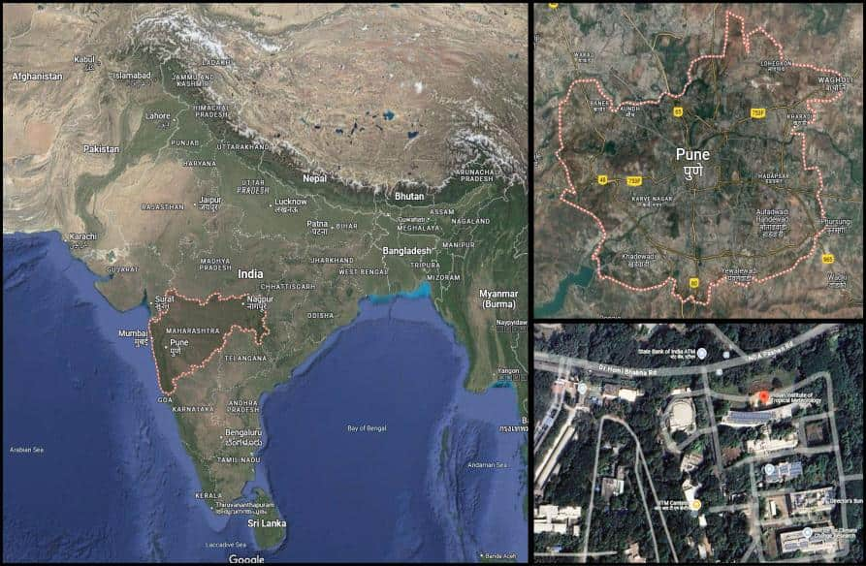
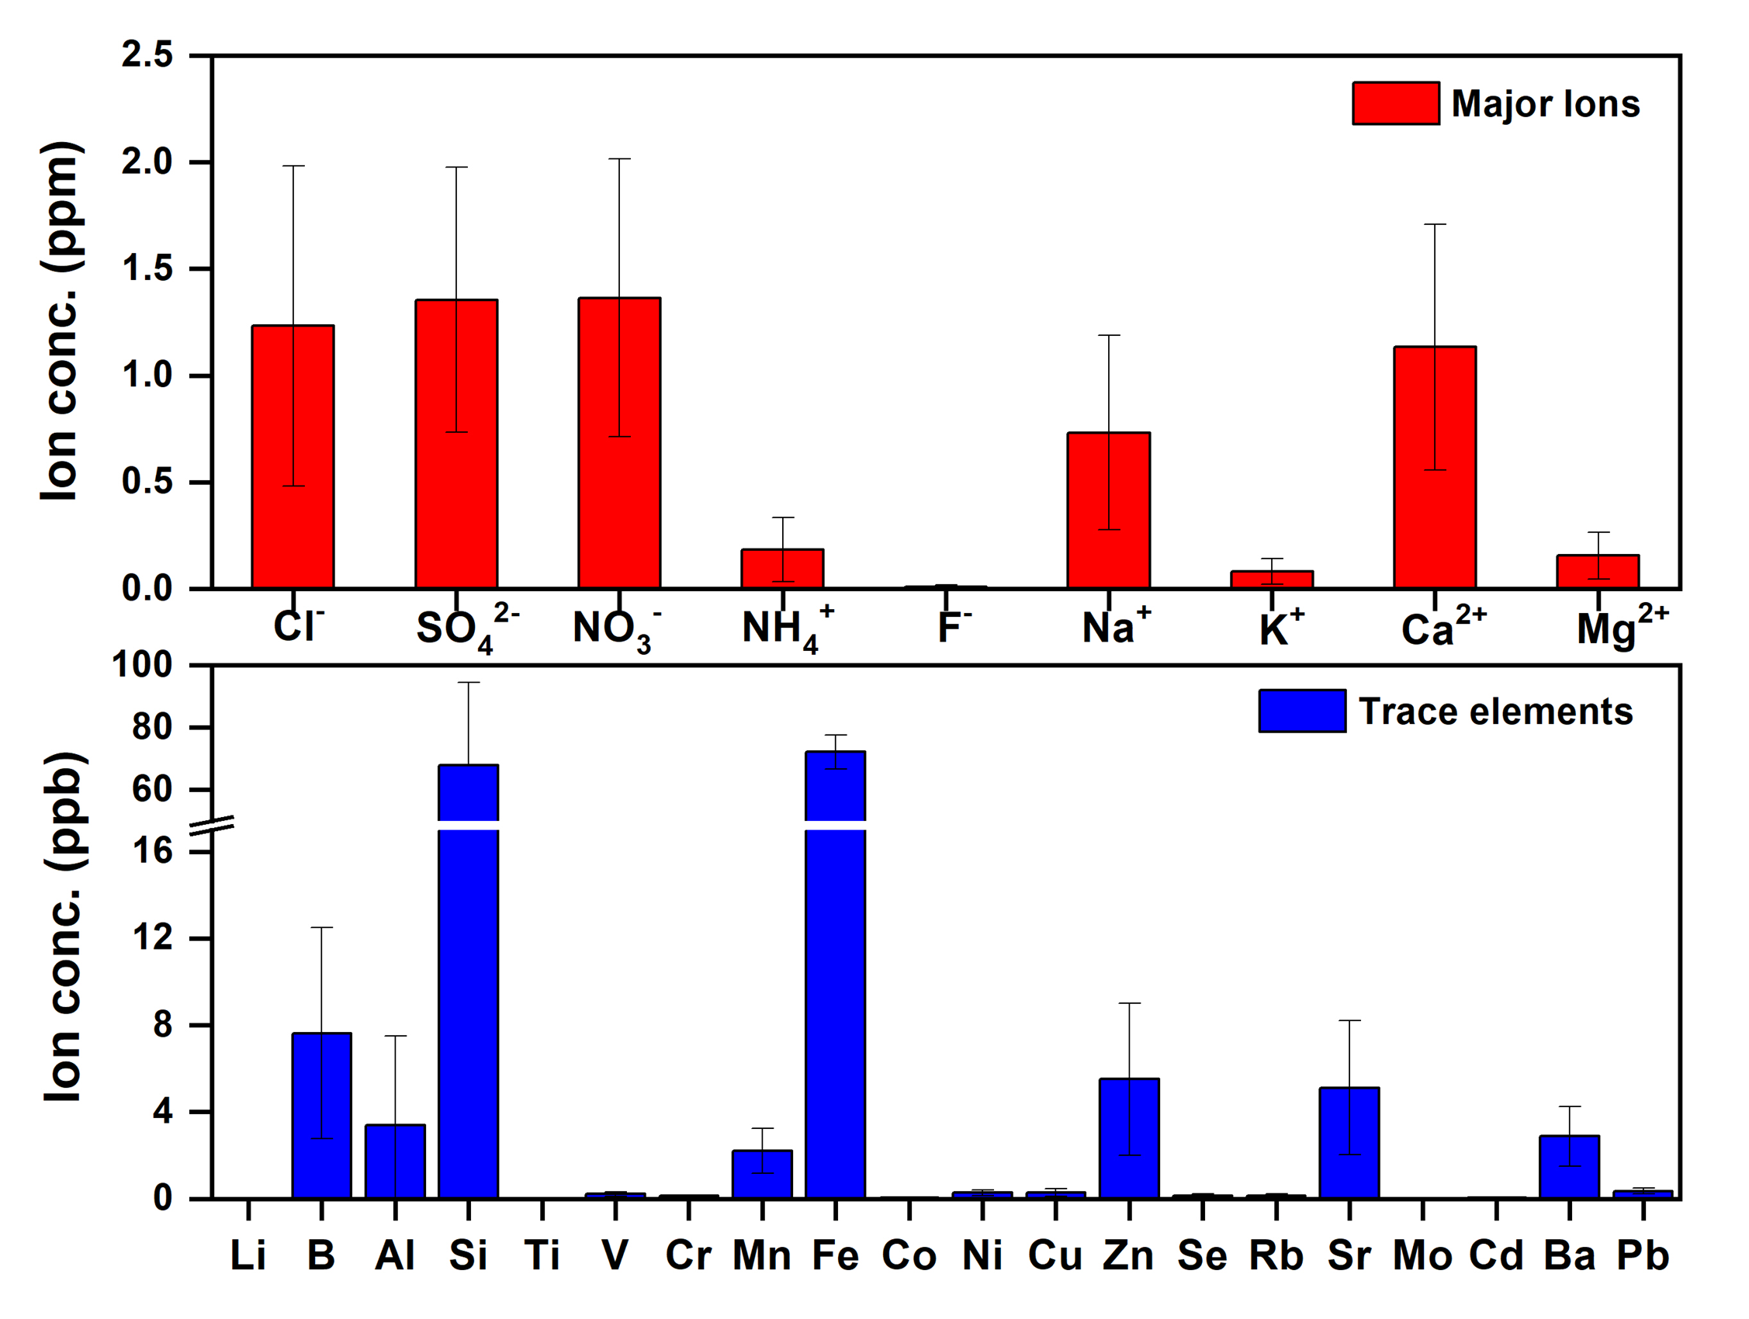
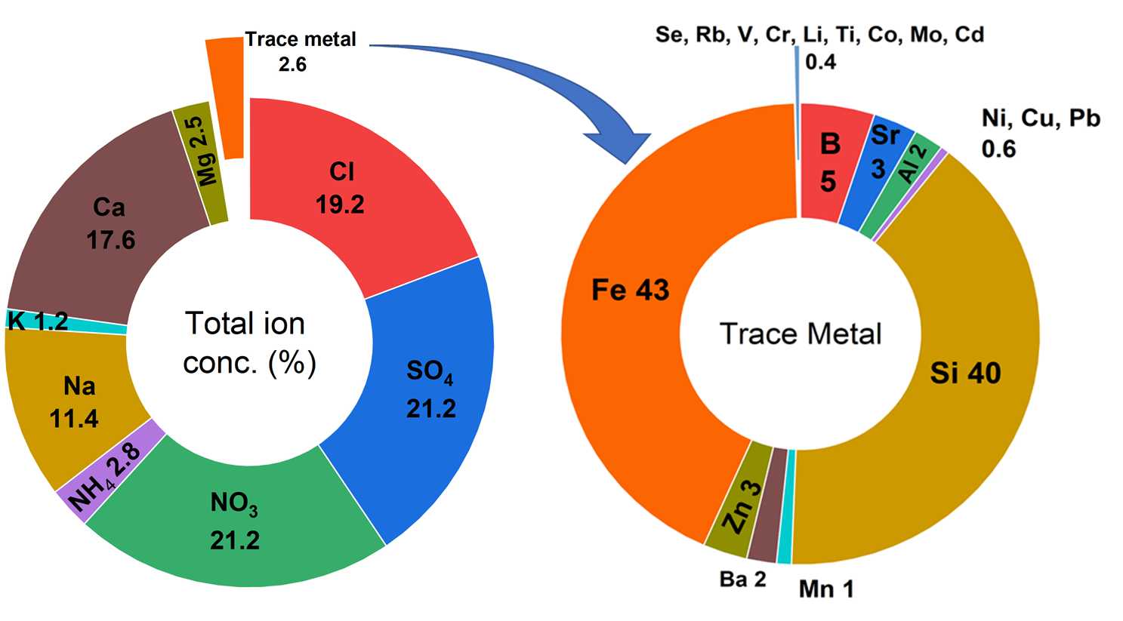
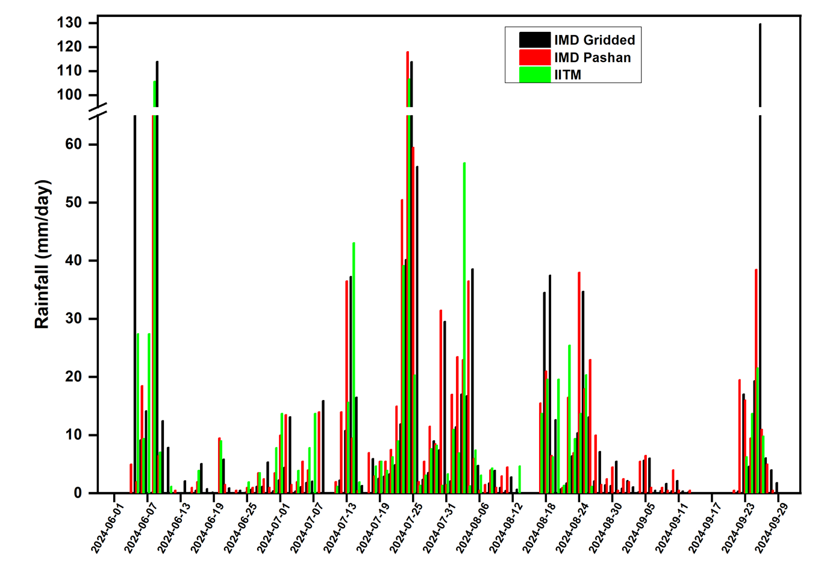
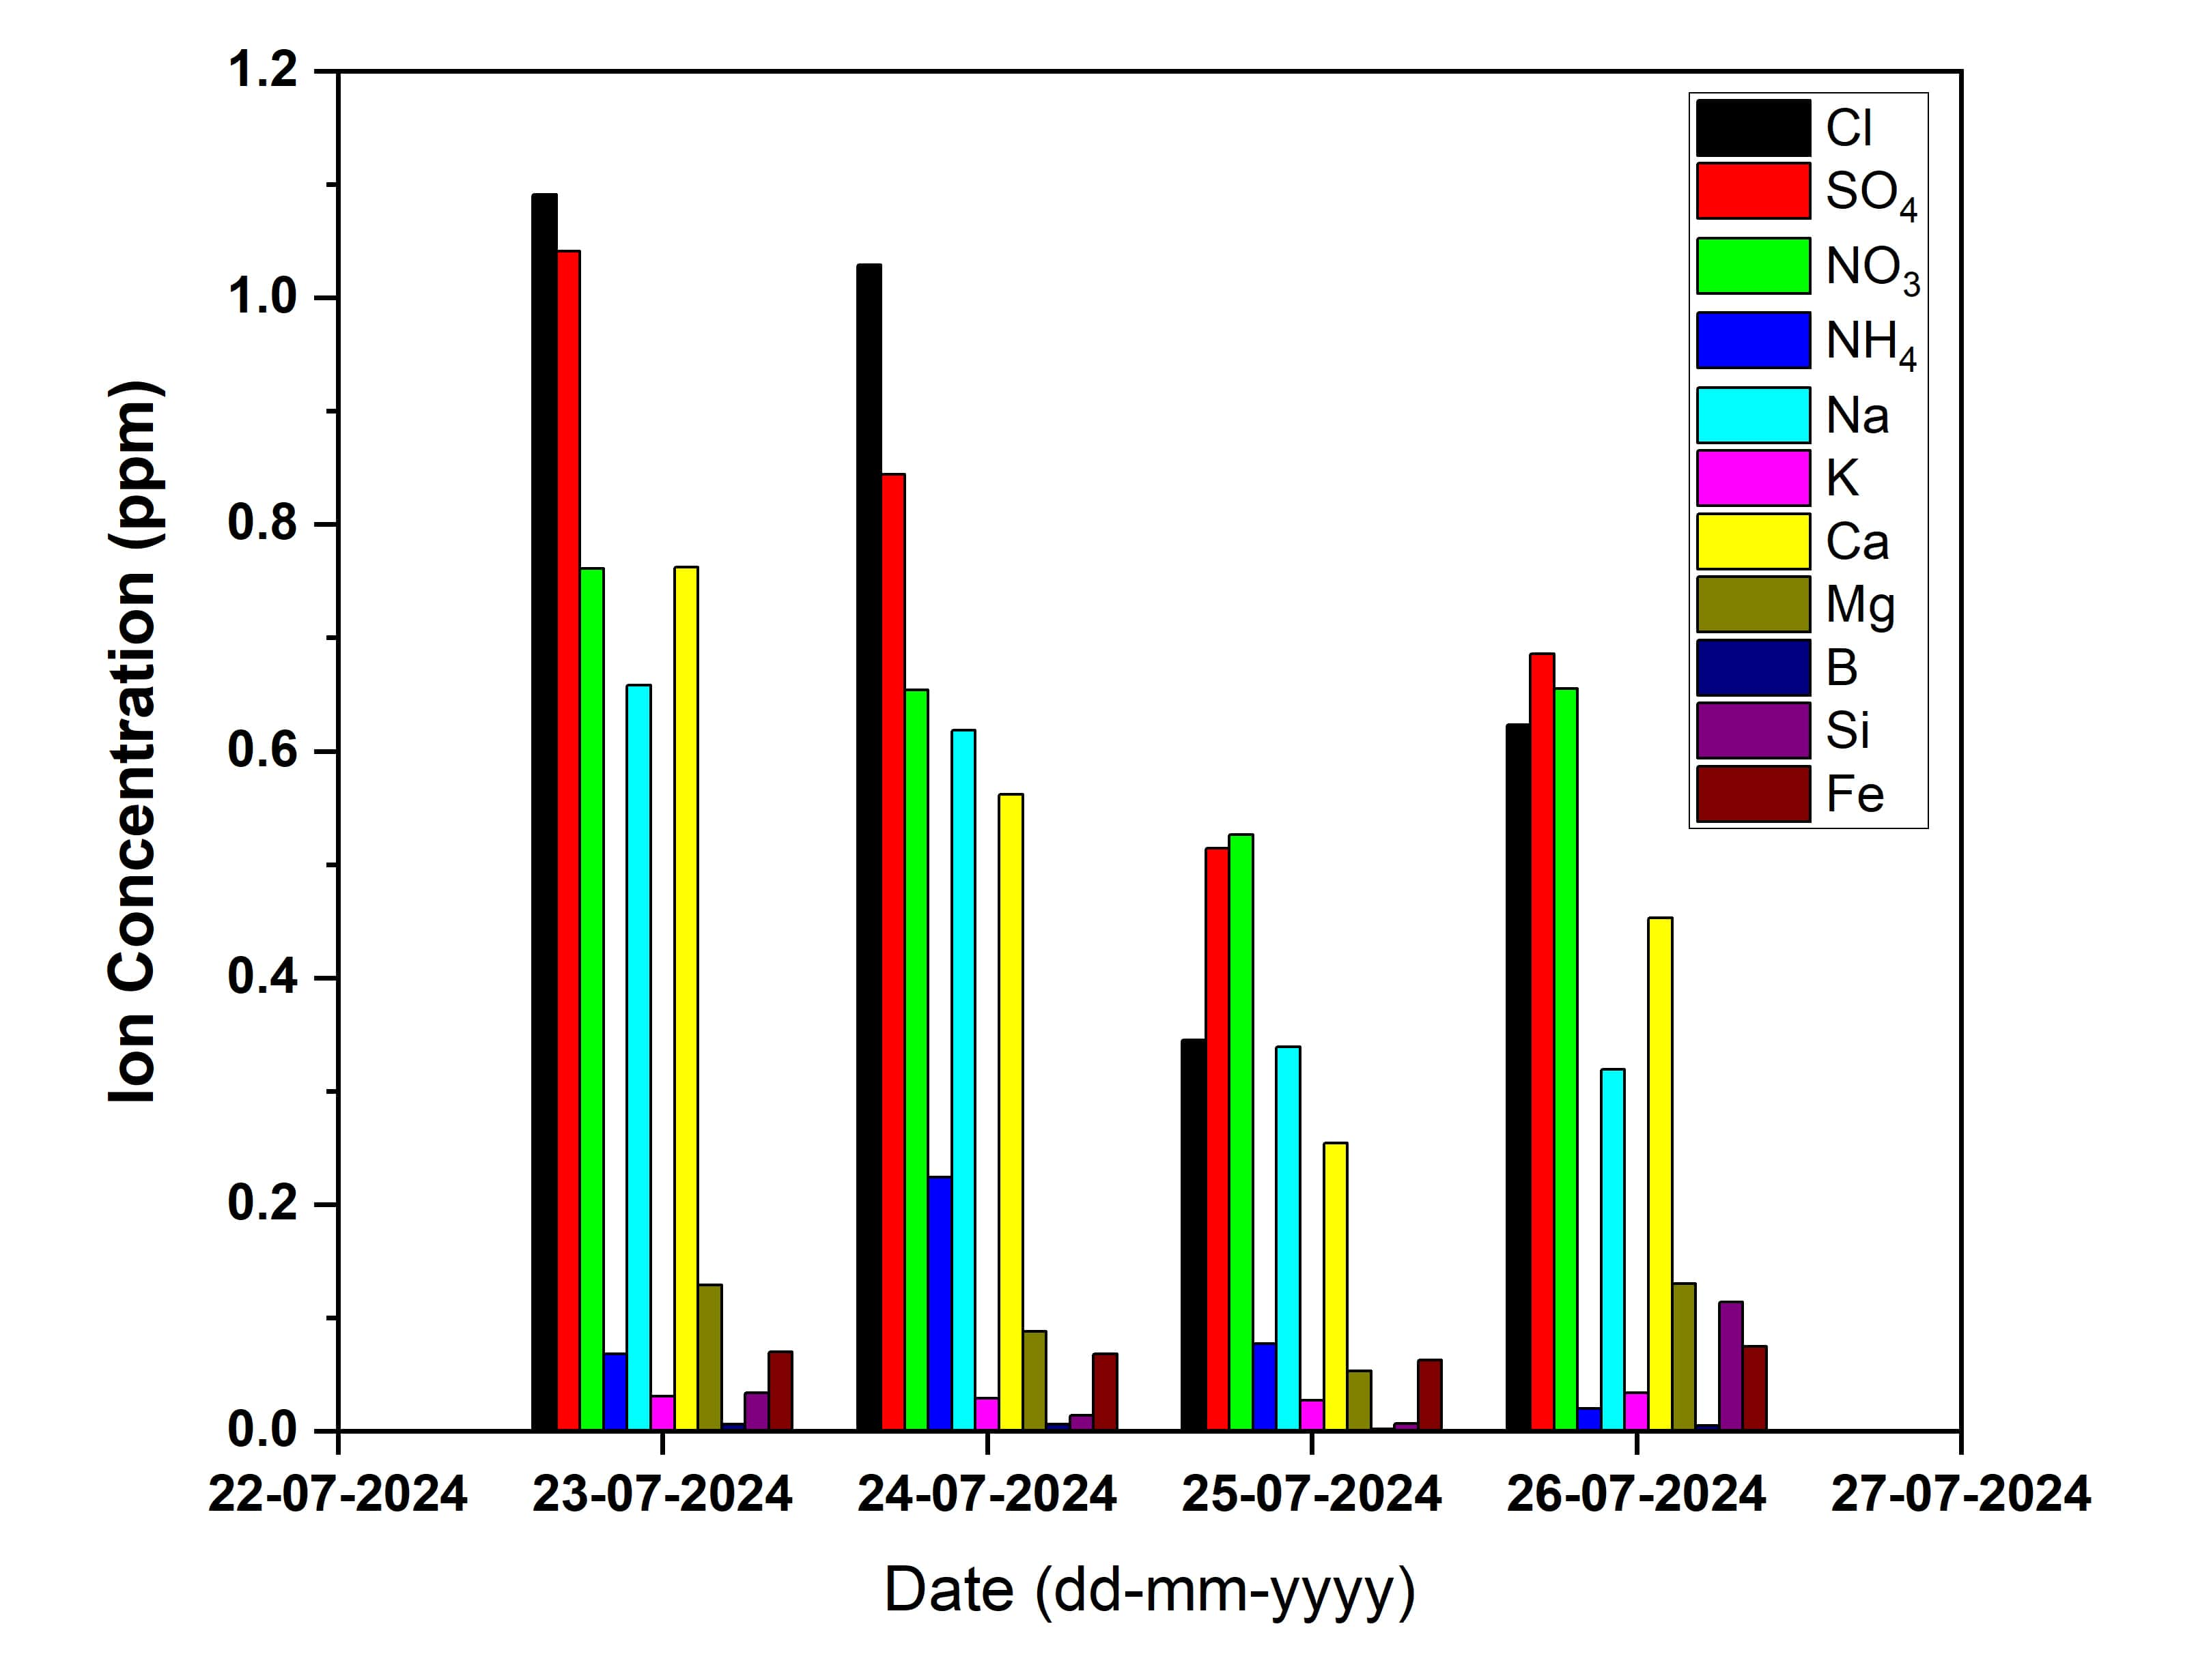
PRECIPITATION MEASUREMENTS DURING INDIAN SUMMER MONSOON
Ranjeeta D. Gawhane¹, B. Padmakumari¹, Damodararao Karri¹, Vinayak V. Waghmare¹,
K. Madan. M. Rao¹, Mahesh Nikam¹, Naveen Gandhi¹, G. Pandithurai¹, Krishnakant B. Budhavant^{2,3}
¹Indian Institute of Tropical Meteorology, Ministry of Earth Sciences, Pune-411008, India
²Divecha Centre for Climate Change, Indian Institute of Science, Bangalore-560012, India
³Maldives Climate Observatory-Hanimaadhoo, Maldives Meteorological Services, Hanimaadhoo – 02020, Maldives
ranjeeta@tropmet.res.in, padma@tropmet.res.in
INTRODUCTION
METHODOLOGY
The Indian monsoon is crucial for the economy and agriculture. It provides most of the country's annual rainfall, essential for irrigation, boost crop production, and replenish water sources.
Atmospheric pollutants originate from both natural occurrences and human activities. Chemical species in the atmosphere can migrate long distances before being eliminated through wet or dry deposition, ultimately affecting regional soil, vegetation, ecosystems, and water bodies.
Rain, the principal form of wet deposition, is shaped by various environmental factors. This study examines the chemistry of rainfall between June and September, focusing on how below-cloud scavenging influences chemical species. These species are vital for air quality and are crucial to environmental health and atmospheric chemistry.
Rainwater samples were collected during the southwest monsoon of 2024.
Fig. 1. Sampling location, Pune
Fig. 2. Instrumentation
RESULTS
Fig. 3. 10-day Air mass Back Trajectory analysis
Fig. 4. Ionic concentrations of elements in rain
Fig. 5. Percentage contribution of chemical species
CASE STUDY 23-26 July, 2024
Fig. 6. Comparison of IMD and IITM rainfall
Fig. 7. ERA5- Total Column Cloud water (top row), GPM Precipitation (middle row) and IMD Rainfall (bottom row)
Fig. 8. Variation in Ionic concentrations
KEY FINDINGS
DISCUSSION AND CONCLUSION
pH ranged from 4.9 to 7.1; samples were alkaline primarily due to high concentrations of neutralizing ions that neutralize acids and their precursors.
In major ions, high concentrations of SO₄²⁻ and NO₃⁻ observed are due to anthropogenic fossil/ biomass burning and vehicular activities, high concentration of Ca²⁺ can be attributed to construction activities, dust etc.
20 trace elements were measured in RW, which accounted for 3% of the total analysed ions. Fe (43%) and Si (40%) were the major contributors to atmospheric dust, soil, sand, and dissolution of rocks and minerals.
Case study - On 24 July 2024, the Pashan site received the highest rainfall of the season (118mm), causing a drastic drop in the concentration of the chemical species. However, the next day, a decrease in rainfall enhanced secondary formation and accumulation of pollutants.
This revealed that the scavenging rates of chemical species significantly increased with an increase in rainfall intensity and duration.
Oceanic air masses that are minimally influenced by human activity tend to be less polluted. However, the chemistry of rain is influenced by various factors, including meteorological conditions, the amount of precipitation, topography, geography, and importantly, the type and sources of aerosols and pollution.
Heavy rainfall significantly enhances air quality by removing most chemical species from the atmosphere.
Measuring precipitation chemistry during different weather systems is crucial for better understanding the underlying chemical processes and for evaluating weather and climate models.
ACKNOWLEDGEMENT
We thank the director, IITM and LARUS team for support. We acknowledge the rainfall data sources from IMD, GPM and ERA5 and NOAA's HYSPLIT atmospheric transport and dispersion modeling system for trajectories.
Eighth WMO International Workshop on Monsoons (IWM-8) 17-21 March 2025, Pune, India

