Slide 1
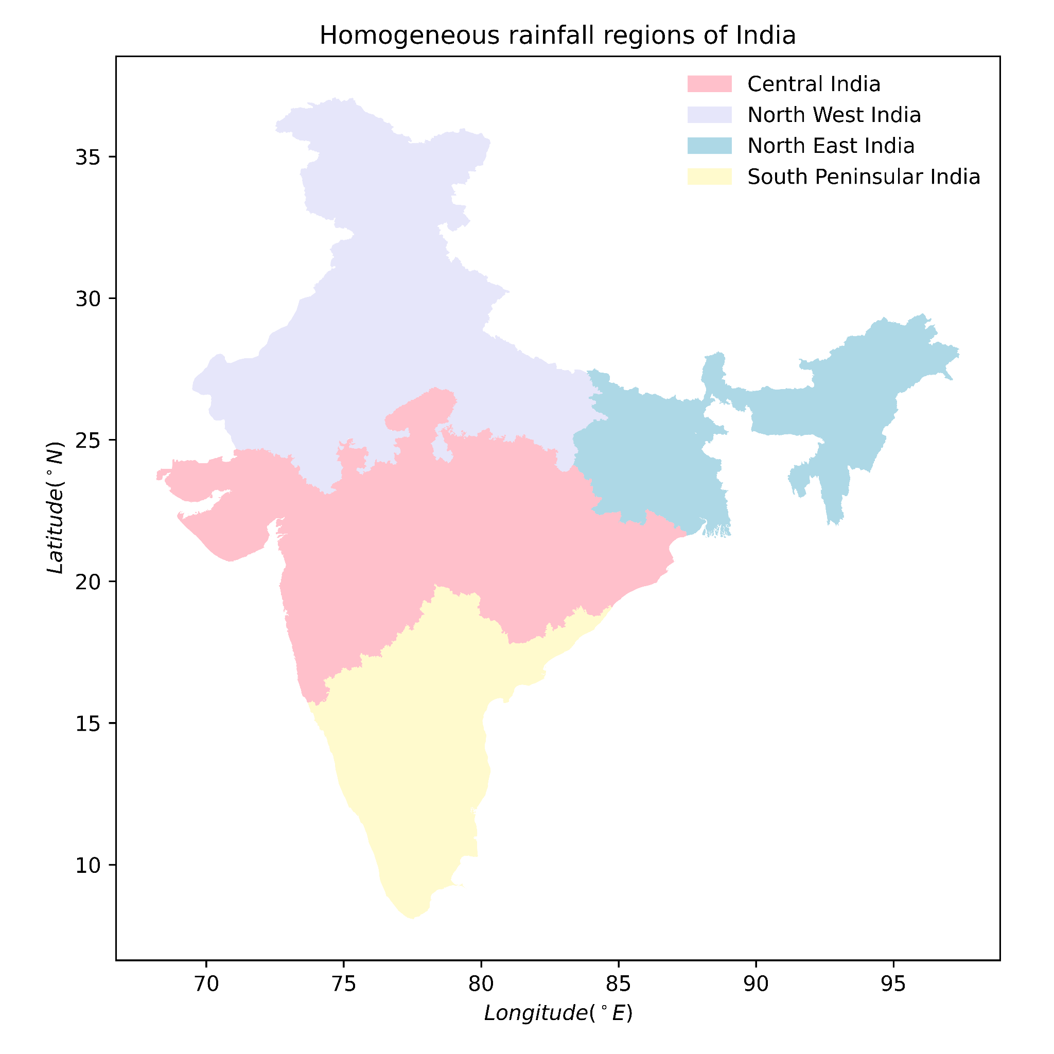
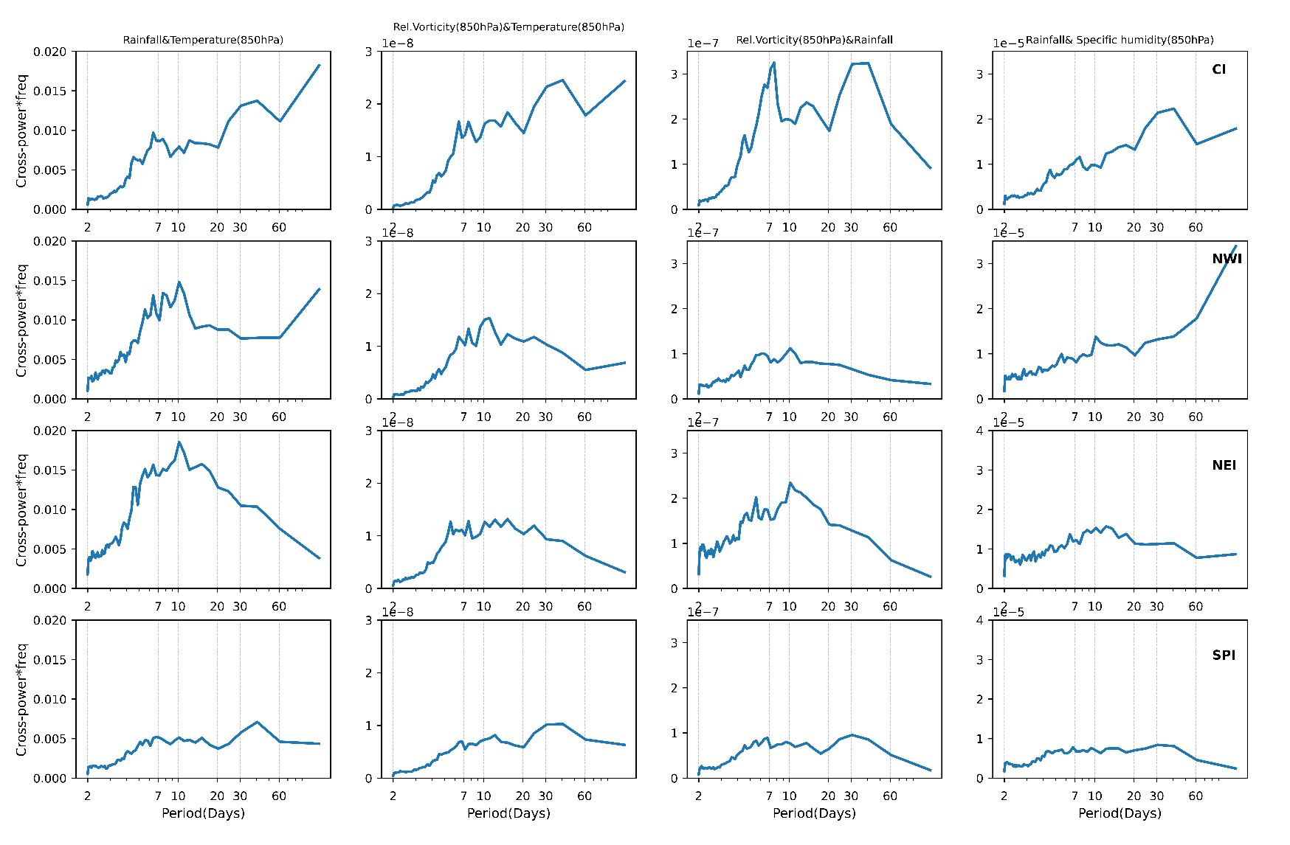
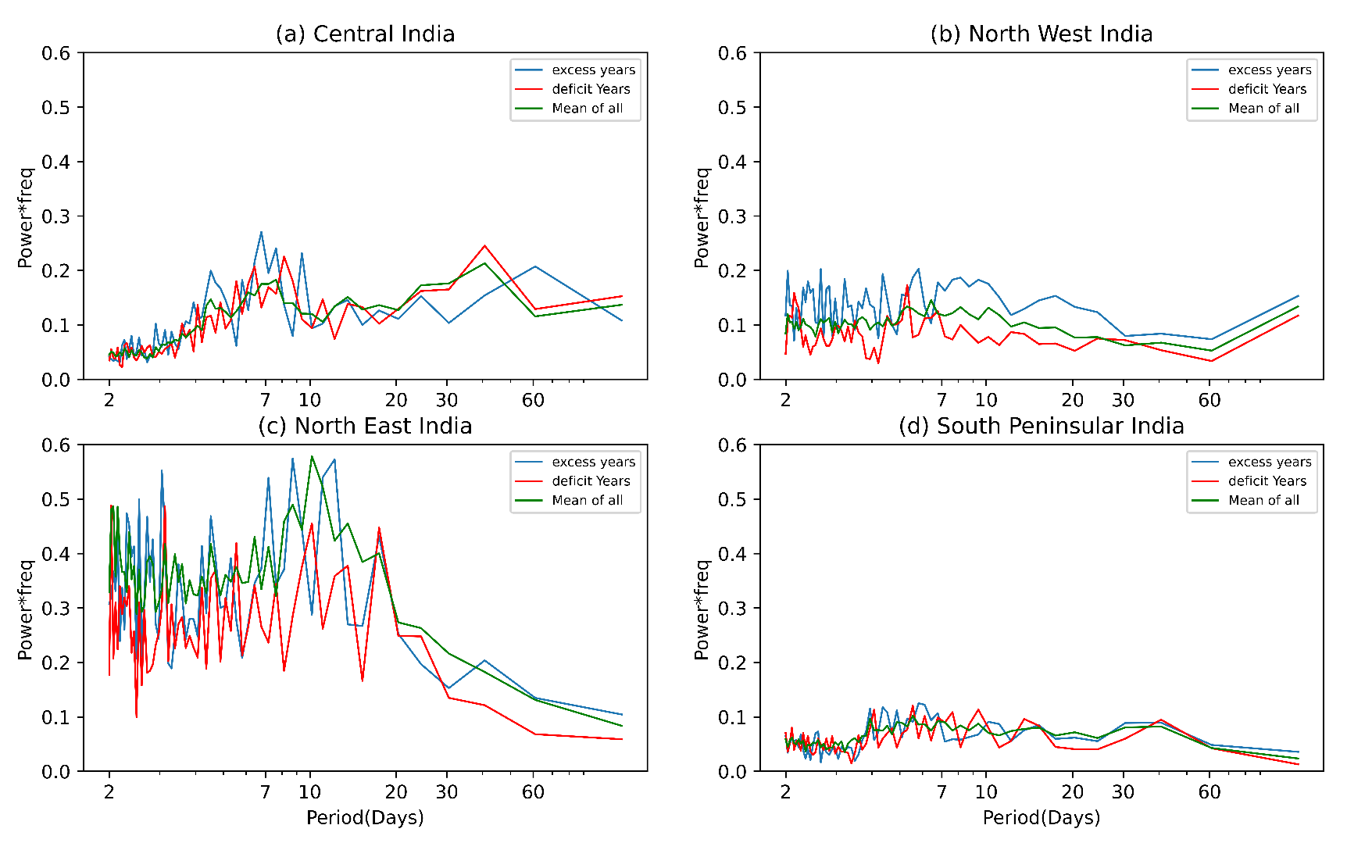
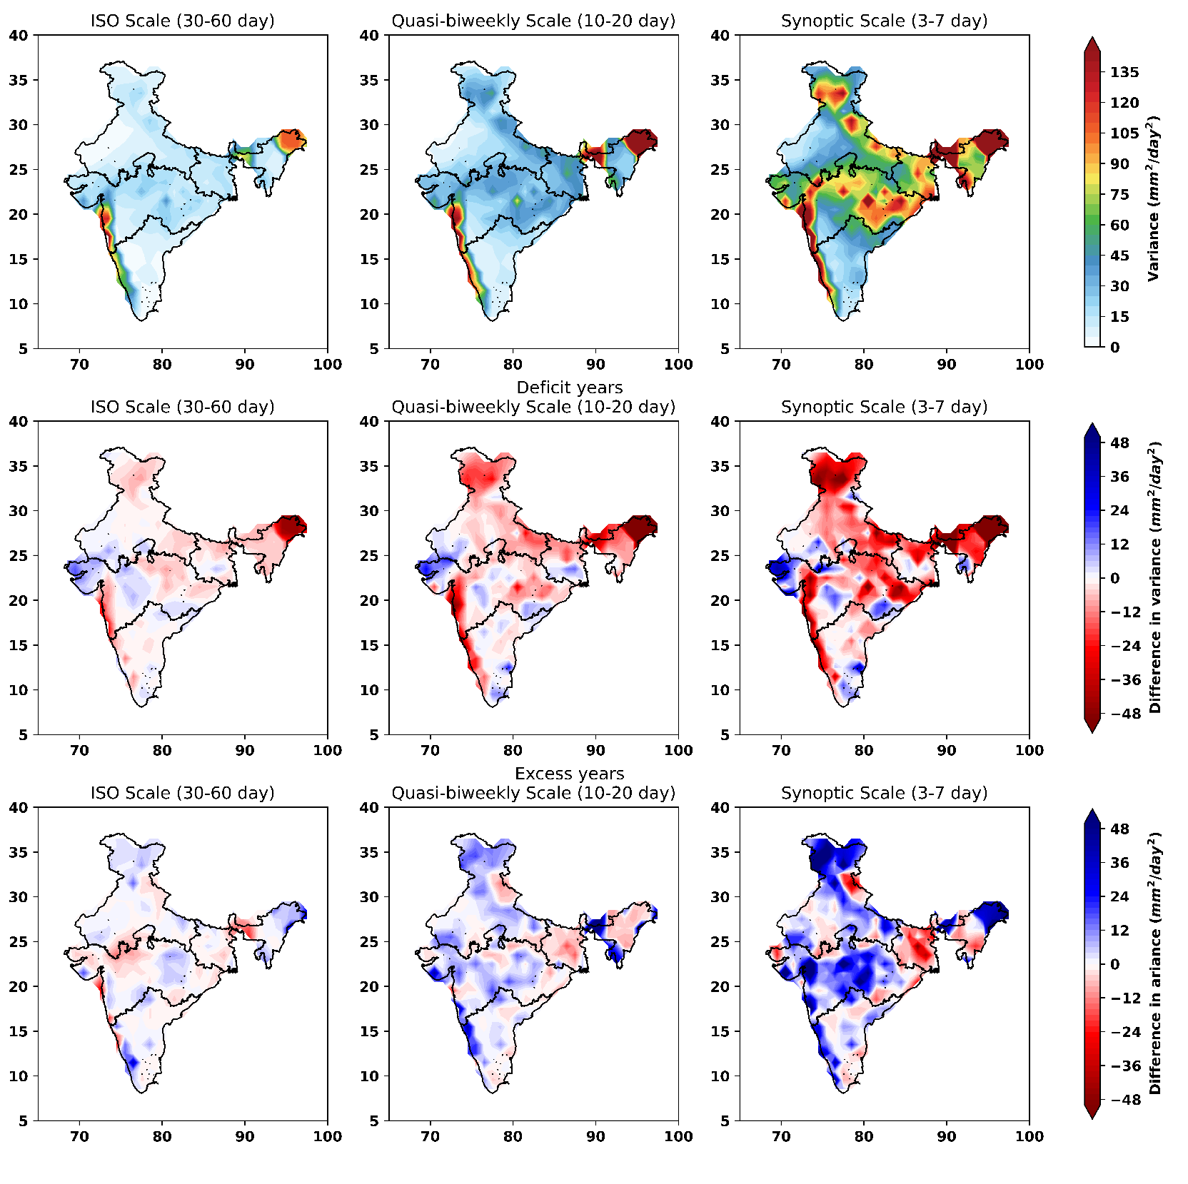
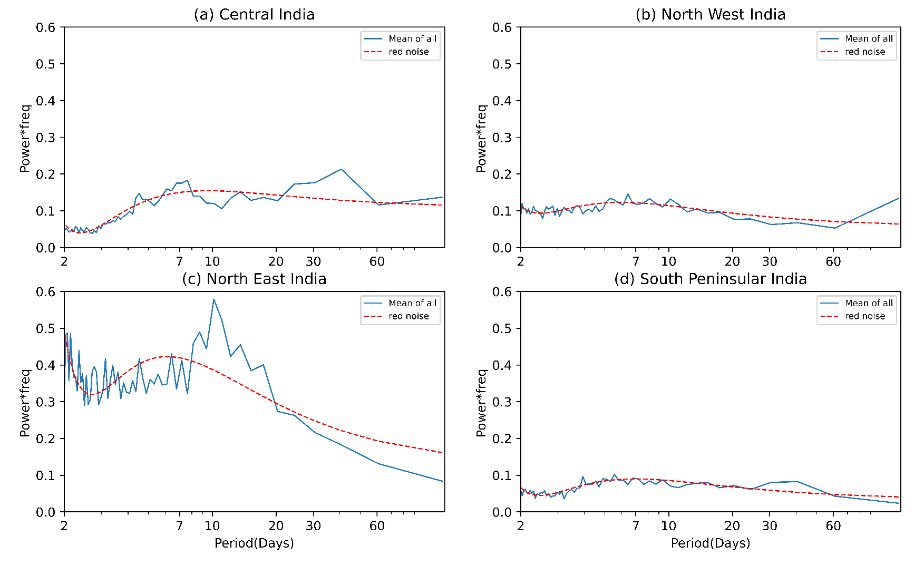
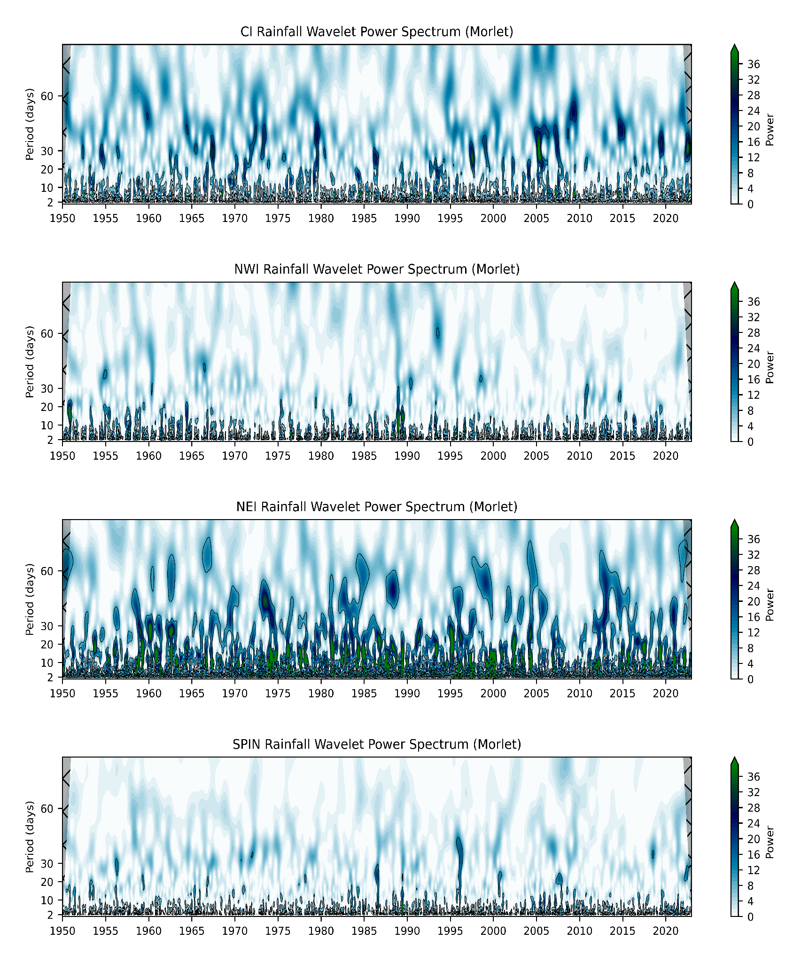
Dominant Modes of Indian Summer Monsoon Variability over
Homogeneous Rainfall Regions
PJ Alice Jeeva¹, Sukumaran Sandeep¹ and Sarvesh Dubey¹
¹Centre for Atmospheric Science, IIT Delhi, New Delhi, 110016, India Email: asz228434@cas.iitd.ac.in
Introduction
Results
ISM exhibits significant variability on various spatial and temporal scales; the temporal scales of variability typically range from sub-seasonal to interdecadal scale
Cross spectral analysis on multiple variables
Figure 4. Domain averaged cross power times frequency along periods
Subseasonal variability of ISM
Synoptic scale
(2-7 days)
Monsoon Low Pressure Systems (LPSs)
Intra-seasonal scale
(30-60 days)
Monsoon Intraseasonal Oscillation (MISO)
The cross spectral peaks represents the mutual resonance of variables
The periods of cross spectral peaks coincides with the dominant periods identified in the rainfall spectral analysis
Regional studies of the ISM rainfall are vital for several purposes in agriculture and water management. Where those provide significant contributions to the Indian economy.
ISM domain can be divided into multiple sub-domains based on the homogeneity of rainfall distribution.
The processes driving spatial and temporal variabilities of ISM can be different for these sub-domains
Figure 1. IMD defined homogeneous rainfall regions of India used for the study
Background
Difference in spectral characteristics during contrasting monsoons
The daily variability in ISM rainfall is linked to a hierarchy of quasi-periodic oscillations, with periodicities of 2–7, 10–20, and 30–60 days.
Changes in the frequency of these quasi-periodic oscillations can lead to a deficit or excess seasonal rainfall conditions
Their are contradictory studies on the role of subseasonal processes in causing changes in the seasonal rainfall
Research gap
The dominant periodicities over the ISM homogeneous rainfall regions is not yet explored, past studies only focusing the monsoon core zone or smaller spatial domains of ISM
A multivariable approach could have validate the identified dominant periodicities
Figure 5. All India summer monsoon rainfall departure (%) from 1950 to 2022. 10 excess (blue) and 11 deficit (red) years found during the study period
Data and Methodology
Peak shift in dominant ISOs (30-60 day) observed over CI and SPIN
The seasonal rainfall variability during excess and deficit years significantly differ over NWI (p-value = 3x10⁻¹³) and NEI (p-value = 0.0008), meanwhile the significance is less over CI (p-value = 0.4) and SPIN (p-value = 0.49) although the shift in periods observed
IMD daily gridded (1°x 1°) rainfall data from 1950 to 2022 during June - September months
Daily values of air temperature, specific humidity, zonal and meridional wind (0.25°x 0.25°) ECMWF Reanalysis v5 (ERA5) data at 850 hPa pressure level
Spectral analysis, using Fast Fourier Transform (FFT), converts signals into its spectral components and thereby provides frequency information of the signal
Wavelet analysis, using Continuous Wavelet Transform (CWT) to determine both the dominant time scales of variability and its variation with time
Cross spectral analysis, using FFT on cross correlation function of two signals, the similarities present in two signals frequency domain will be emphasised
Figure 6. The domain averaged power spectra of monsoon rainfall for excess, deficit, and normal years during 1950-2022
Results
The variance contributed by dominant synoptic scale is much higher compared to other periodicities
Deficit (excess) years shows lesser (higher) variance on all periodicities
A less intense dipole kind of pattern in variance is observed over CI in ISO scale
Figure 2. The domain averaged power spectra of summer monsoon rainfall(blue solid line) during 1950-2022. Red dashed line represents the red noise
Intraseasonal scale
The dominant scales present over the four regions are the synoptic(2-7d), quasi-biweekly(10-20d),& ISO(25-90d) scales, with characteristic changes in its power
The red noise spectra gives the significance of the observed rainfall spectra
Figure 7. spatial distribution of variance of bandpass filtered daily rainfall anomalies in dominant periods, mean variance (top panel), difference in variance during deficit (middle panel) and excess (bottom panel) monsoons with respect to the mean variance respectively.
Quasi-biweekly scale
Summary
Synoptic scale
The presence of multiple scales with significant variations in its power over the four regions validates the homogeneity of seasonal rainfall
over CI and SPIN , synoptic as well as ISO scales are shown to be dominant, both synoptic and quasi-biweekly scales significantly dominate over NEI region, and over NWI only the synoptic scale shows dominance while other scales are weaker
We identified differences in periodicities of dominant scales during excess and deficit monsoons
The dominant ISO scale is faster in drought years while it is slower in excess monsoons over CI
The CI, NWI, and SPIN wavelet spectral characteristics are significantly consistent with the power spectral analysis
Significant inconsistency in the wavelet characteristics is observed over NEI with respect to the power spectra
Over SPIN the presence of ISO activity is very limited with 95% significance during the period of study
References
Kripalani, R. H., Kulkarni, A., Sabade, S. S., Revadekar, J. V., Patwardhan, S. K., & Kulkarni, J. R. (2004). Intra-seasonal oscillations during monsoon 2002 and 2003. Current Science, 325-331
K. Kikuchi. (2021). The boreal summer intraseasonal oscillation (bsiso): A review. Journal of the Meteorological Society of Japan. Ser. II, 99(4):933–972
Suhas, E., Neena, J., and Goswami, B. (2012). Interannual variability of indian summer monsoon arising from interactions between seasonal mean and intraseasonal oscillations. Journal of the Atmospheric Sciences, 69(6):1761–1774
Krishnamurti, T. N., & Bhalme, H. (1976). Oscillations of a monsoon system. part i. observational aspects. Journal of Atmospheric Sciences, 33 (10), 1937–1954
Figure 4. The domain averaged wavelet spectra of summer monsoon rainfall from 1950-2022. Black contours shows 95% significance
Acknowledgement
PJ Alice Jeeva acknowledges the Ph.D. fellowship from the Indian Institute of Technology Delhi, through the Ministry of Education (MoE).
IWM-8

