Slide 1
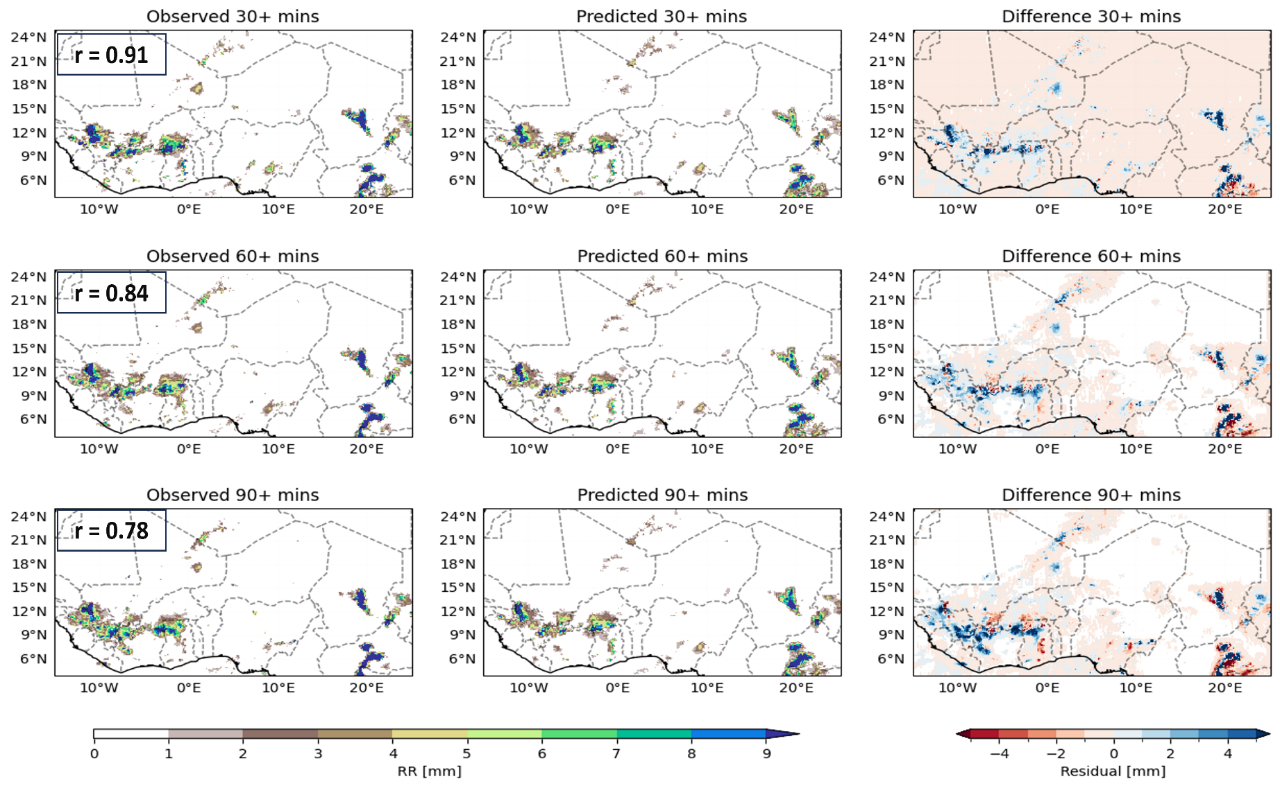
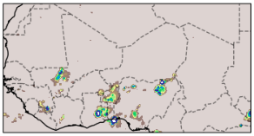
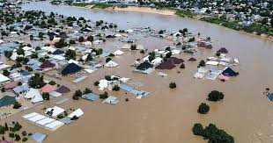
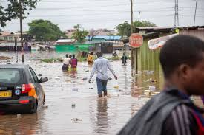
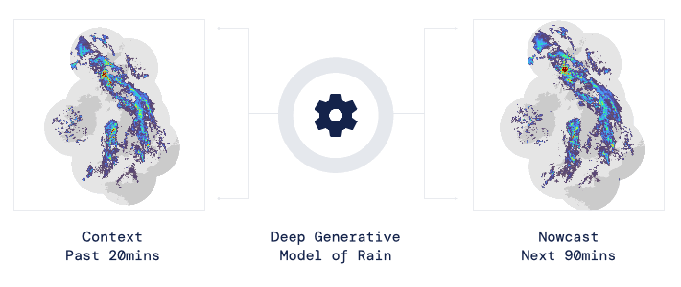
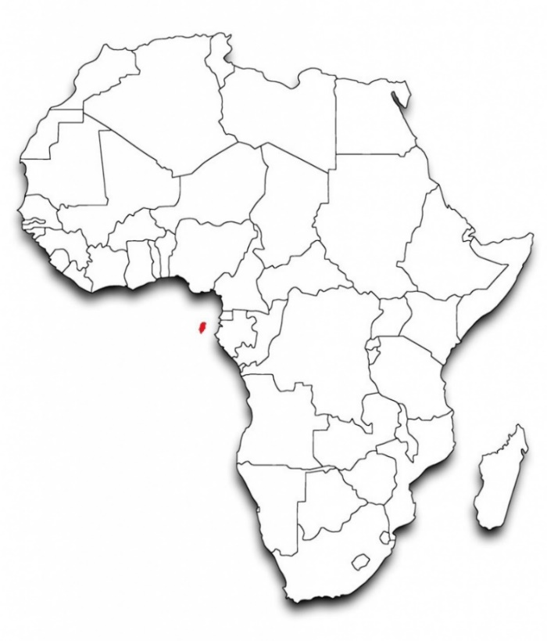
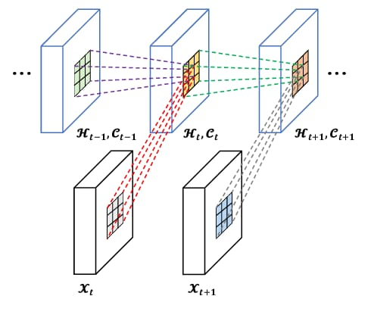
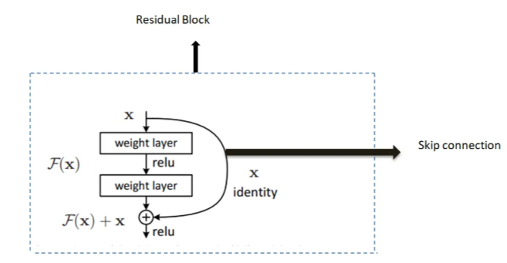
Advancing Nowcasting with Deep Learning Techniques in West Africa (ANDeL) Department of Meteorology and Climate Science, COS, KNUST
Aryee, J. N. A.¹, Afful, S. K. ¹ , Boateng, D. ², Baidu, M. ³, Arthur, F. ⁴, Osei, M. A. ^{1, 5}
FPCS, College of Science, Kwame Nkrumah University of Science and Technology, Kumasi, Ghana
Department of Geosciences, University of Tübingen, Germany
Institute of Climate and Atmospheric Science, School of Earth and Environment, University of Leeds, United Kingdom
Department of Natural Sciences and Environmental Health, University of South-Eastern Norway, Bø, Norway
UK Center for Ecology and Hydrology (CEH), United Kingdom
Email: jnaaryee@knust.edu.gh
ABSTRACT
RESULTS AND DISCUSSION
Precipitation nowcasting has become important in modern meteorology due to its ability to provide short-term forecasts with high accuracy, which is crucial for mitigating the impacts of severe weather events such as flash floods. Recently, recurrent networks have outperformed traditional numerical models such as the optical flow algorithm for precipitation nowcasting due to their ability to capture rapidly changing weather conditions. In this work we applied variants of Convolutional Long Short-Term Memory (CONVLSTM) architecture since precipitation nowcasting is a spatio-temporal variation problem. The models were trained on the Global Precipitation Measurement (GPM) Integrated Multi-satellitE Retrievals for GPM (IMERG) precipitation data with a regional focus on West Africa. Using 9 input timesteps we forecast up to a lead time of 1.5 hours (i.e 3 timesteps). The CONVLSTM-both class which integrates a residual network and CONVLSTM had the best performing accuracy. With the first, second and third timestep achieving a correlation coefficient (R) of 0.91 ,0.84 and 0.78 respectively.
.
Able to track various location of system relatively well.
At a longer lead time accuracy tend to decrease
Largely underestimates the intensity of the precipitation
INTRODUCTION
West Africa experiences increased frequency and severity of extreme weather events.
Widespread flooding in West Africa has affected about 4 million people (World Health Organization, 2024), causing varying damages to humans and property
Nowcasting offers a vital solution, providing timely and accurate forecasts to inform early warning systems
Figure 2: Sample ANDeL Nowcast at +0.5h, +1hr and +1.5h respectively, and the residual between observed and modelled.
CONCLUSION
Deep learning model demonstrates a promising understanding of precipitation dynamics, yet a decline in accuracy is observed with increasing timesteps. This limitation emphasizes the need for more advanced methodologies in precipitation nowcasting. The complexity of rapidly evolving precipitation systems characterized by shifts in intensity, shape, and direction poses a challenge for accurate forecasting, especially in predicting convective cores. To overcome these challenges and improve the long-term reliability of forecasts, further development of deep learning models tailored for these dynamic and nonlinear processes is essential.
FUTURE WORKS
Domain 3
Context past
DeepL (CNN-RNN, GANs),
Optical flow (pySteps, rainmotion)
Nowcast next 90 mins
OBJECTIVE
Domain 2
To produce first-hand rainfall nowcasts using of deep learning techniques in West Africa.
Assess the ANDeL nowcast performance
Translate the findings into effective EW and Nowcast tool for West Africa.
Domain 1
METHODOLOGY
Dataset
Integrated Multi-satellitE Retrievals for Global Precipitation Measurement (IMERG) Early Run
Temporal Resolution : 30 minutes
Spatial Resolution: 0.1° X 0.1 °
Data Preprocessing
Data Preparation: Extracted West Africa precipitation data, split into 12-time step sequences (9+3) for sequence-to-sequence modeling.
Data Filtering: Applied threshold filtering to remove sequences with precipitation values ≤ 1
- Train-Validation Split: Divided preprocessed data into 80% training and 20% validation sets
9 timesteps input
Preprocessing
AI models monitoring
3 timesteps output
Figure 1: ANDeL Modelling pipeline.
Fig. 4: 15-day dry spells across Africa
Fig. 5: 20-day dry spells across Africa
Figure 3: Map of Study Area with current working domain (Domain 1) bounded by green box, and potential future ANDeL product application coverage (Domains 2 and 3) shown in red and blue.
MODEL ARCHITECTURE
REFERENCES
The number of convolutional filter decreases with the depth of network
Rectified Linear Units(ReLU) used as activation function
AdAM algorithm for optimization
Mean square error (MSE) used for loss calculation
World Health Organization. (2023, October 13). Devastating West and Central Africa floods affect over 4 million people, raise health risks. WHO Regional Office for Africa. https://www.afro.who.int/news/devastating-west-and-central-africa-floods-affect-over-4-million-people-raise-health-risks
IMERG data
ACKNOWLEDGEMENTS
Fig.6: Dry spell frequency across the various
parts of Africa
Fig. 7: Yearly variations of different dry spells
lengths across Africa
IMERG data
Figure 2: Generalized Structure of Convolution Long Short-Term Memory (CONVLSTM) -RESIDUAL architecture

