Slide 1
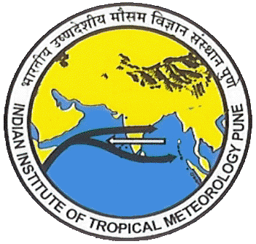
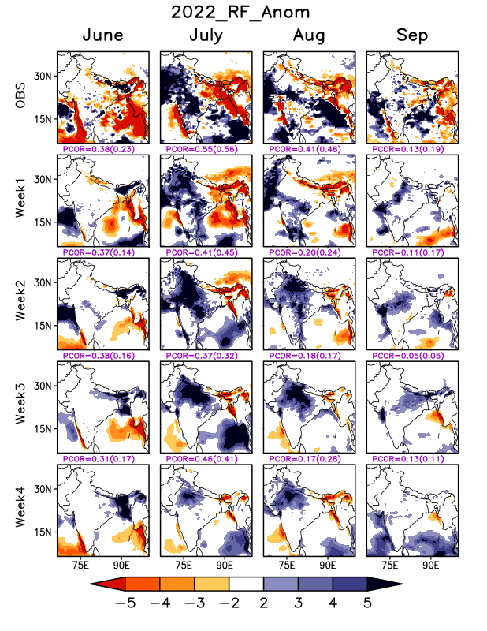
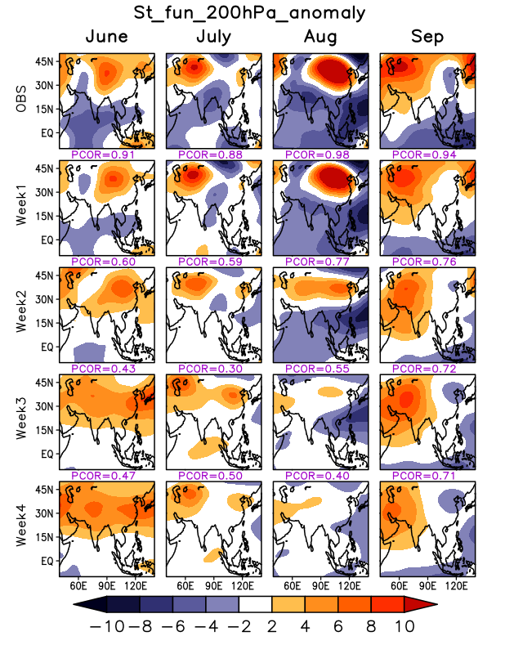
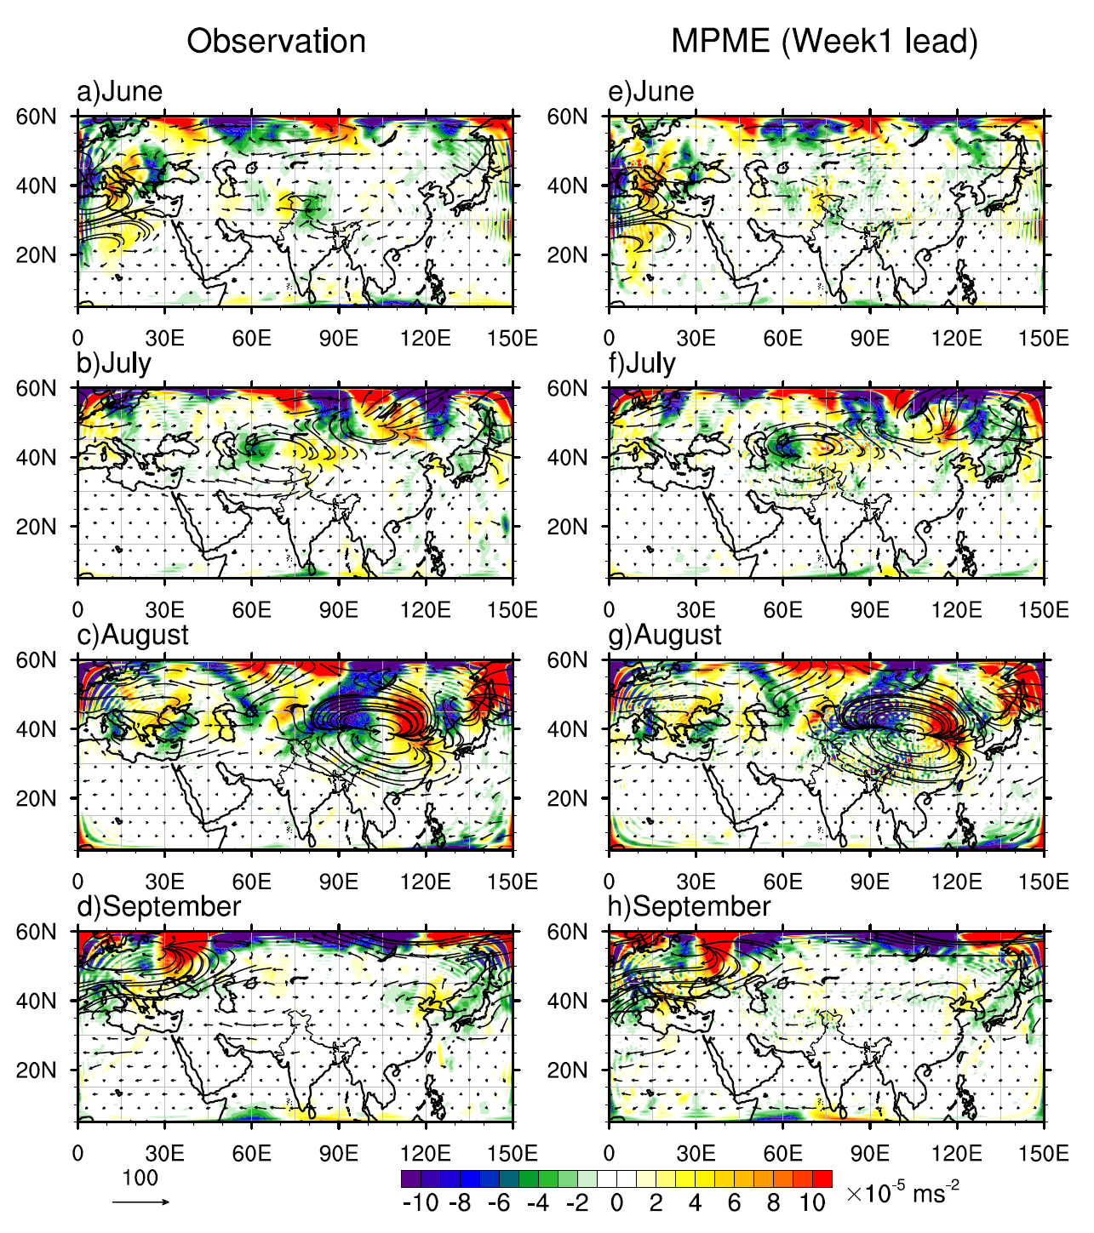
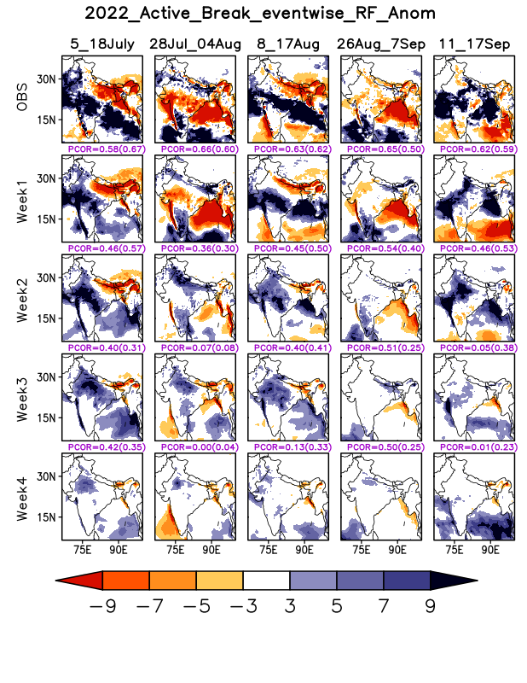
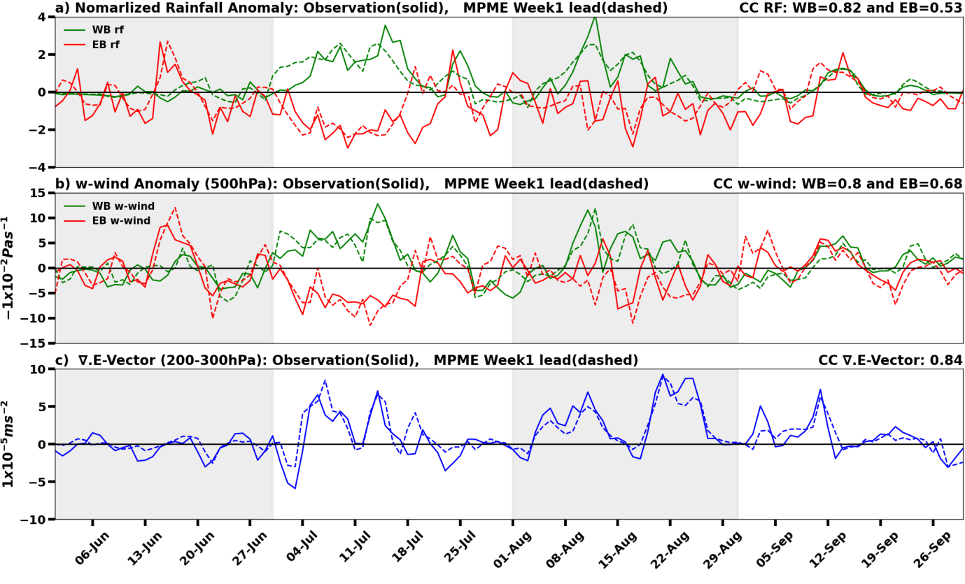
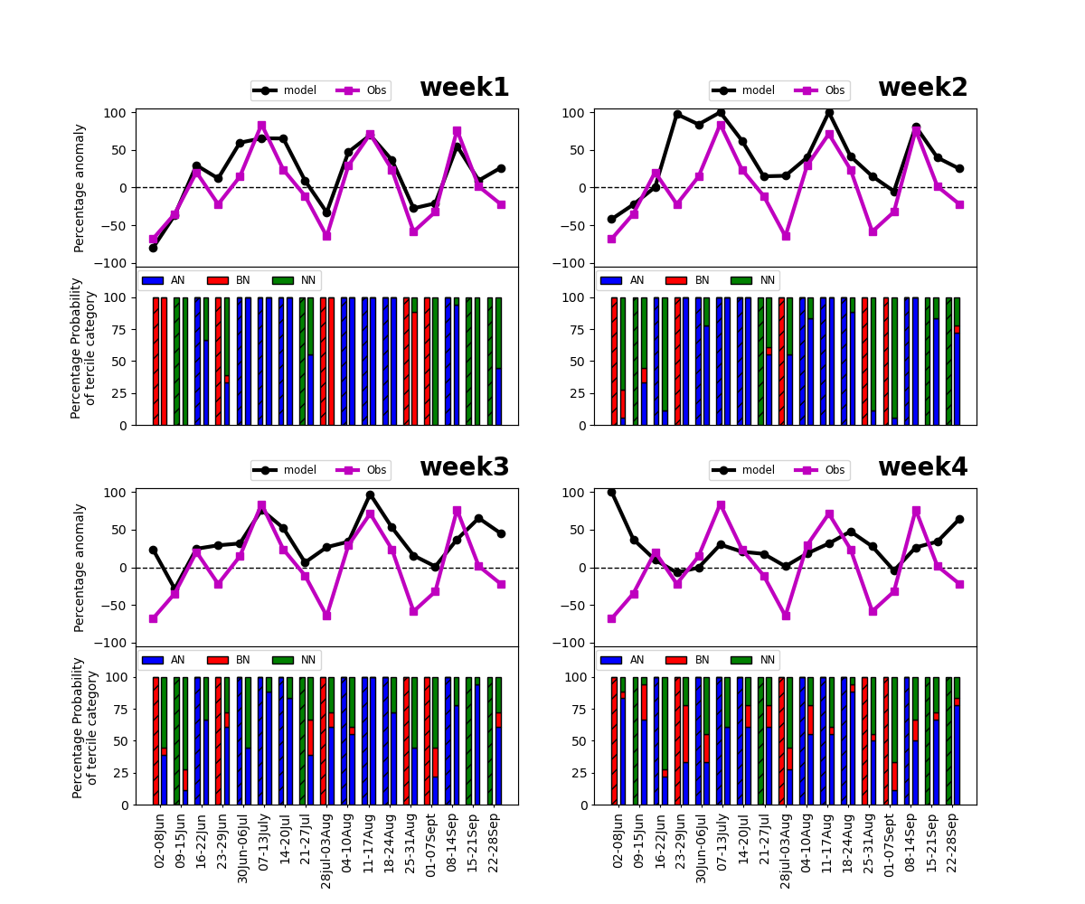
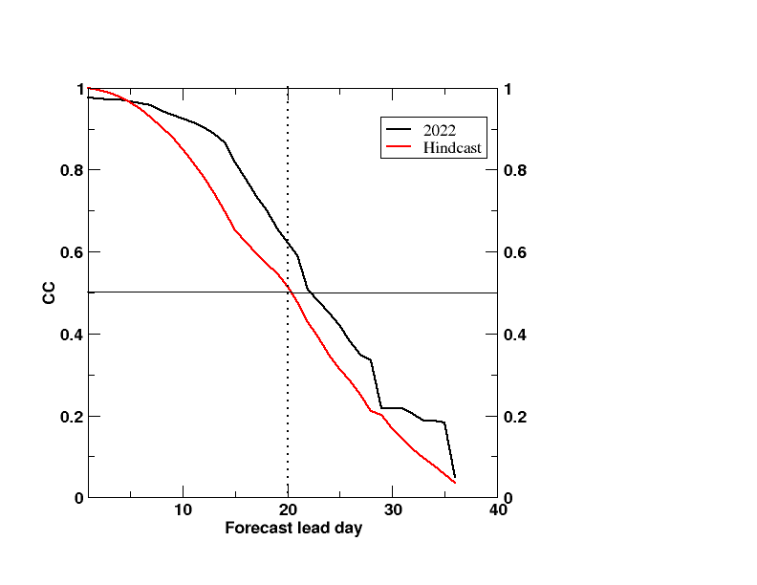
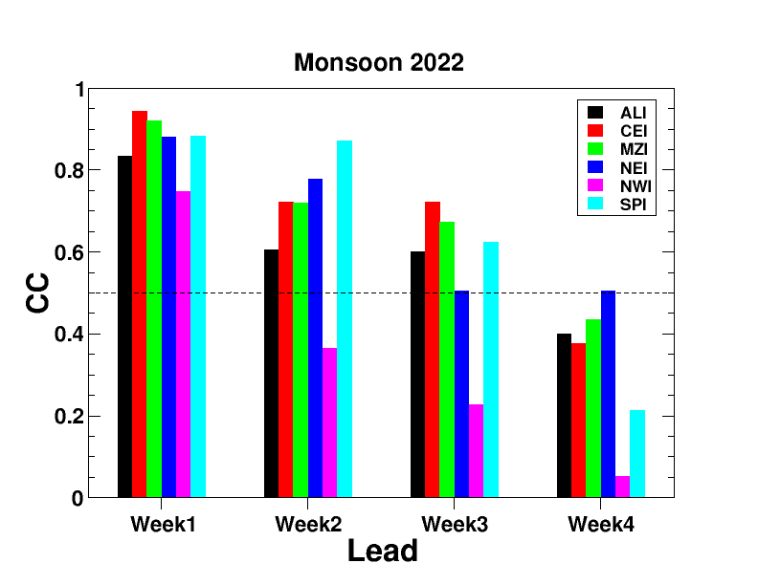
Real-time subseasonal prediction of 2022 monsoon with an emphasis on east-west rainfall asymmetry Avijit Dey^{1*}, Mahesh P. Kalshetti¹, S. Joseph¹, R. Mandal¹, M. Kaur^{1,2},R. Phani¹, A. K. Sahai¹ ¹Indian Institute of Tropical Meteorology, Pune-411008, India ²The Nature Conservancy, Arlington, VA 22203, USA *Corresponding Author’s details: Dr. Avijit Dey, Scientist, IITM, Pune, India Email: avijit@tropmet.res.in
Objectives
The accurate subseasonal prediction of the spatio-temporal rainfall variability of the Indian summer monsoon holds immense socio-economic importance. During the 2022 monsoon season, slightly above-normal rainfall was recorded across most regions of India, while below-normal precipitation was observed in the eastern parts, particularly over the Indo-Gangetic plains. The asymmetric rainfall distribution, characterized by a robust positive pattern over north-western regions and a strong negative pattern over eastern and north-eastern India was strong in July and August. In this study, the real-time performance of a recently developed multi-physics multi-ensemble (MPME) subseasonal prediction system is evaluated for its ability to predict the spatio-temporal rainfall variability during the 2022 monsoon.
Data and Methodology
A high-resolution (0.25°x0.25°) rain gauge-satellite merged daily rainfall dataset (Mitra et al. 2009) are used. The ERA5 reanalysis (0.25°x0.25°) datasets (Hersbach et al. 2020) are utilized for dynamical fields. The model data from the multi-physics multi-ensemble version of the IITM extended range prediction system is used. All data sets for JJAS of 2022 are used and climatology are computation for the base period 2003-2018 as the model on-the-fly hindcast is available for the same period.
Results
Fig.1: Monthly rainfall anomalies (mm/day). The 1st row is for observation, and the 2nd-5th rows are for model prediction at week1-week4 lead, respectively. Pattern correlation values are also mentioned. The values in the parenthesis indicate the pattern correlation when considering only Indian land.
Fig.2: Same as Fig.1 except for stream function anomalies at 200hPa (1x10⁶ m2/s)
Fig.3: Monthly anomalies of divergence of E-vector (∇.E, shading; 1x10⁻⁵ m/s²) and E-vector (vector; m²/s²) averaged over 200-300hPa from June to September of 2022. The Left panel (a-d) is for observation and right panel (e-h) is for model predicted field at week1 lead.
Fig.4: Correlation coefficient between observed and model predicted rainfall over various meteorological subdivisions of India during 2022 monsoon for week1-4 lead.
Fig.8: Model’s MISO prediction skill.
Fig.6: (a) Time series of normalized rainfall anomalies for observation (solid) and for model prediction at week1 lead (dashed) during the 2022 monsoon over the west box (63°-79°E, 20°-30°N; green) and east box (82°-98°E, 20°-30°N; red). (b) Same as (a), but for w-wind anomaly at 500hPa (-1x10⁻² Pas⁻¹). (c) ∇.E-vector [(65°-90°E, 30°-45°N, 300-200hPa); (1x10⁻⁵m/s²] for observation (solid) and model forecast at first-week lead (dashed).
Fig.7: The weekly mean deterministic and probabilistic rainfall over the MZI. The upper panel in each sub-plot displays the weekly mean percentage rainfall anomaly for observation (pink) and for model forecast (black). Lower panels represent percentage probabilities for observation (hatched bar) and model forecast (regular bar) for above normal (AN; blue bar), near normal (NN; green bar), and below normal (BN; red bar) categories.
Fig.5: Similar to Fig.1 except averaged over an active/break spell as mentioned in the subheading.
Fig.9: Correlation coefficient over homogeneous region of India during 2022 monsoon for week1-4 lead.
Summary
The model predicted the east-west rainfall asymmetry during July up to week2 lead. However, there are spatial shifts, and rainfall amount is under-estimated over the west and south-west of India and over-estimated over north-central India at longer leads (week3-week4).
The east–west rainfall asymmetry was also observed in August, though anomalies were weaker than in July. The model could replicate the observed pattern during August at week1 lead. However, model predicted anomalies shifted towards north India at week2 and beyond lead.
The asymmetric rainfall over the east and west boxes during July-August could be associated with the contrasting vertical movement of w-wind at 500hPa; ascending motion over western India whereas descending motion over the eastern India.
During all five active and break spells, the MPME system could predict the rainfall up to week2 lead.
The model demonstrated better MISO prediction skill (~23 days) in 2022 compared to the hindcast skill (~20-21 days), reflecting the dominance of the ISO scale.
The model indicated useful forecast skill during the 2022 season up to week3 lead (CC>0.5) across all homogenous regions of India, except for the northwest India.
The MPME system showed a useful skill up to week2 lead over most of the meteorological subdivisions except for a few.
Acknowledgement
The IITM, Pune, is a research institute under the Ministry of Earth Sciences (MoES), Government of India. We sincerely thank MoES, Government of India, for fully supporting the research work carried out at IITM.
We sincerely thank IMD and ECMWF for providing data. We thankfully acknowledge NCMRWF and INCOIS for providing the Initial conditions.

