Slide 1
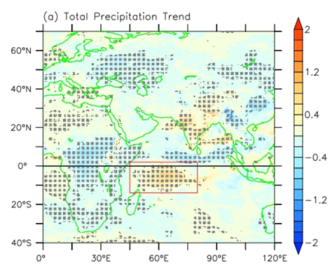
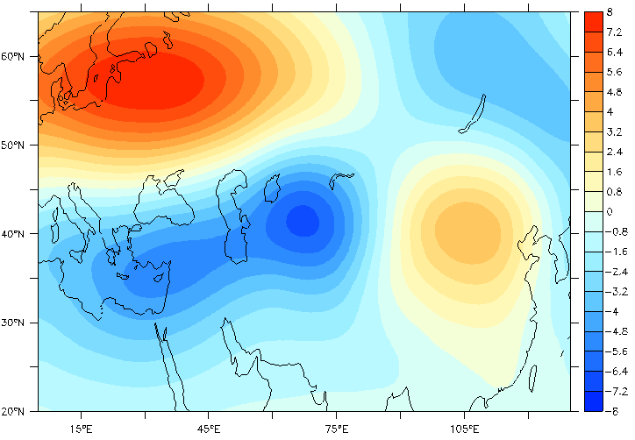
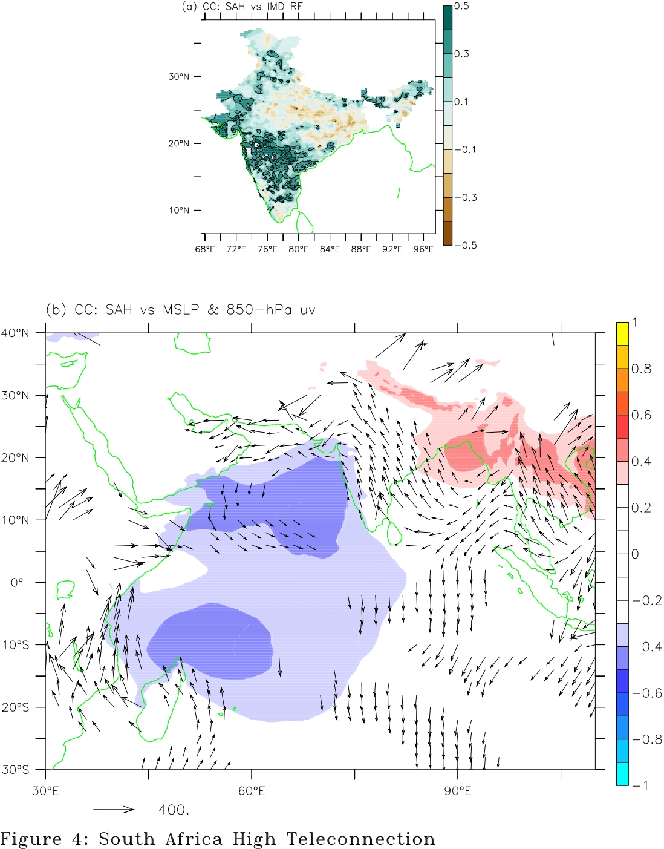
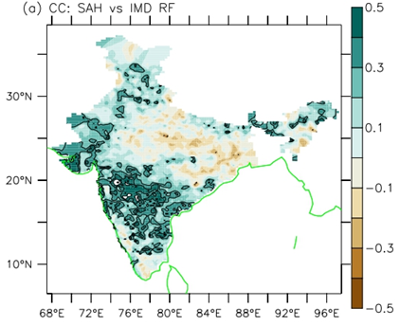
The recent trends in the Indian summer monsoon rainfall
Ramesh Kumar Yadav¹
¹Indian Institute of Tropical Meteorology, Pashan, Pune-411008, Maharashtra, INDIA
E-Mail:
yadav@tropmet.res.in
The spatial pattern of Indian summer monsoon rainfall (ISMR) trends shows a statistically significant increase/decrease in western/eastern India in the last four. Simultaneously, the warming of the equatorial Indian Ocean (IO) has increased the in-situ convection south of the equatorial IO, whose subsidising Hadley’s branches has increased the upper-tropospheric GPH in northern Europe and southern Africa.
JJAS Trend analyses
for Indian rainfall north India, surface temperature and MSLP for the period 1979–2020. Areas of 95% significance level are shaded by tiny grey dots
for b Total precipitation, c Height-Latitude Omega plot averaged between Longitude 40°–70° E, d 200-hPa GPH, e Moisture flux speed, f 850-hPa moist static energy. Year-to-year variation of south Africa and Europe 200-hPa GPH, and central-west equatorial Indian Ocean SST indexes.
shift in north ISMR reasons
a The second leading EOF of JJAS 200-hPa GPH anomalies over Eurasian region (shaded), correlation of PC2 with b MSLP (shaded).
Correlation of 200-hPa GPH data averaged over the box 0°-55°E,17°S-33°S with (a) rainfall, (b) MSLP and regression of 850-hPa winds onto GPH box (black vectors).
The North Europe GPH is associated with the Eurasian wave, with a trough east of the Caspian Sea. The penetration of this trough towards the Indian landmass creates favourable conditions for deep convection. Besides, the southern African GPH increases the cross-equatorial flow, which interacts with the mid-tropospheric trough over the Arabian Sea, increasing the moisture flow/convergence over western India. The interaction of the cross-equatorial flow with the upper-tropospheric penetrated trough through the Indian landmass increases the moist static energy, which results in heavy rainfall over west India and causes a shift of monsoon westward.

