Slide 1
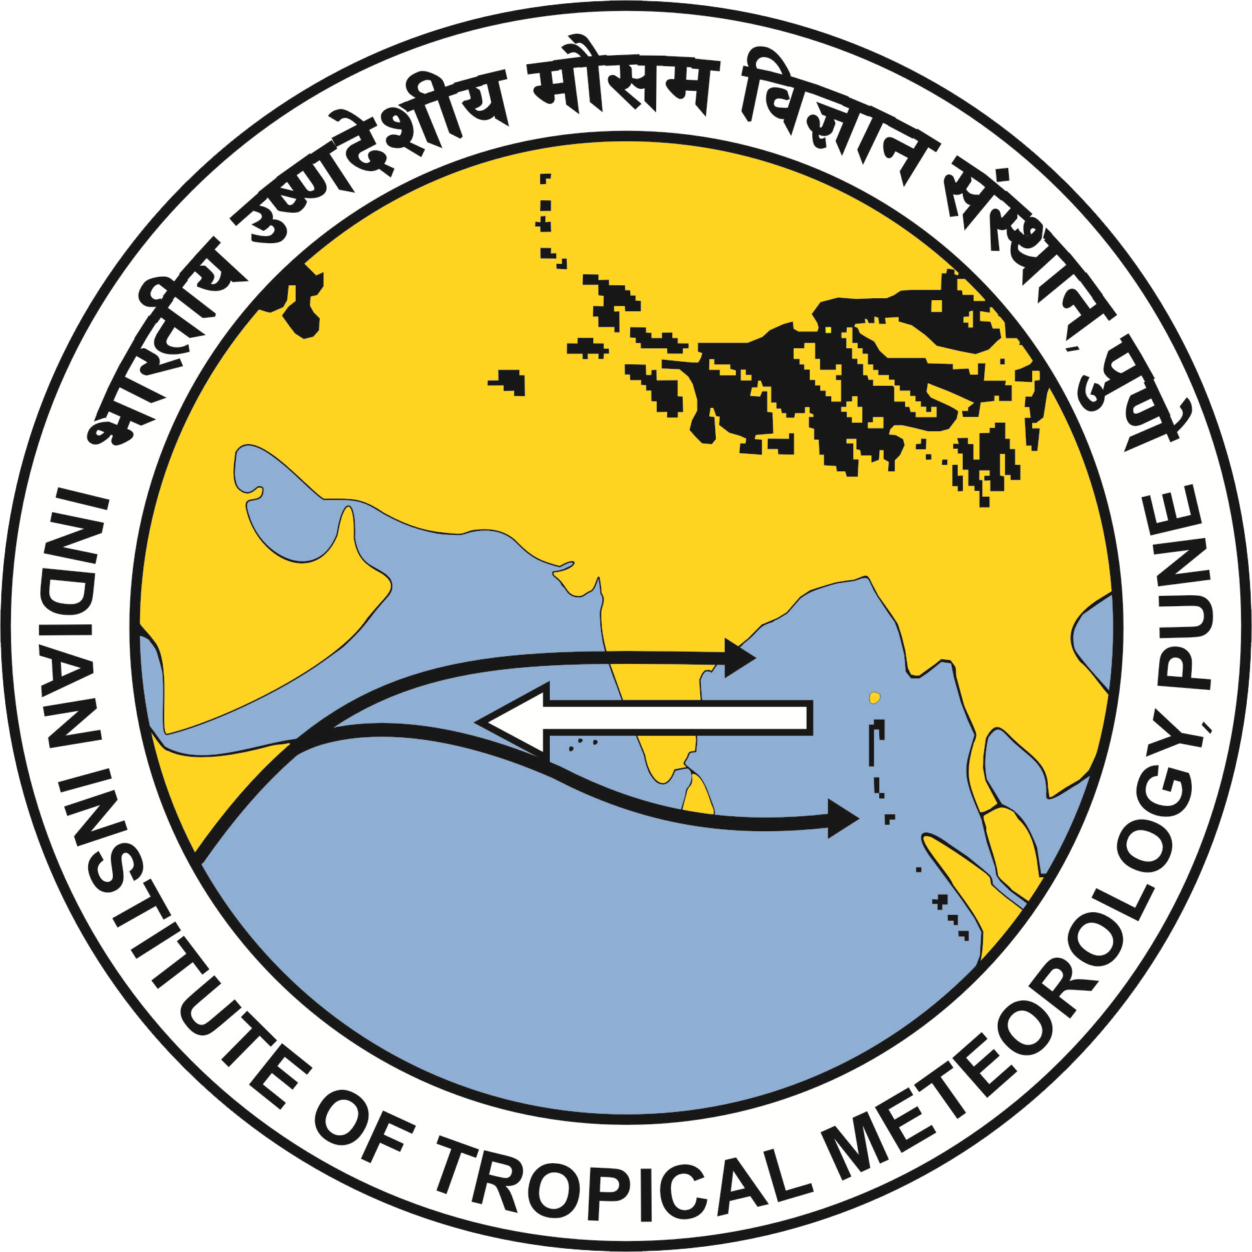
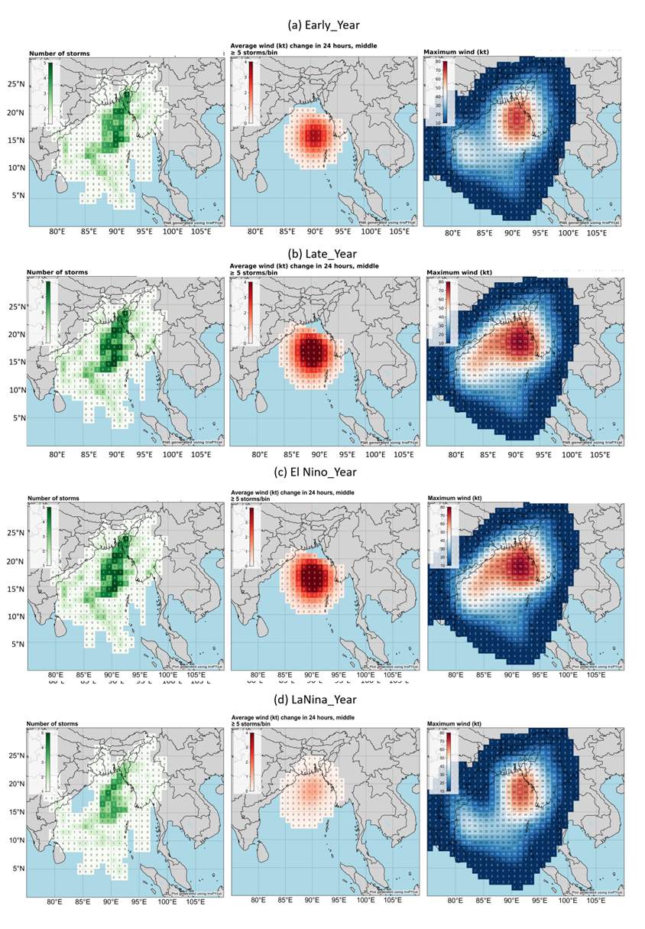
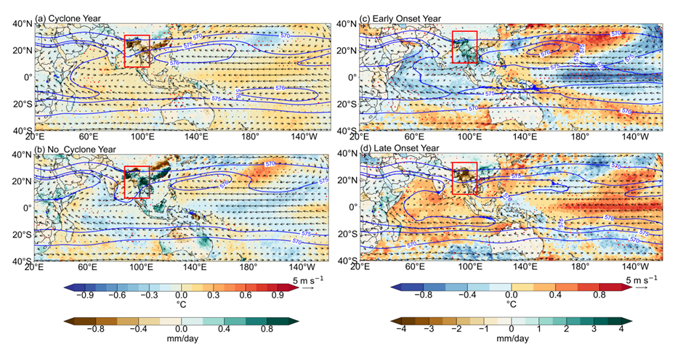
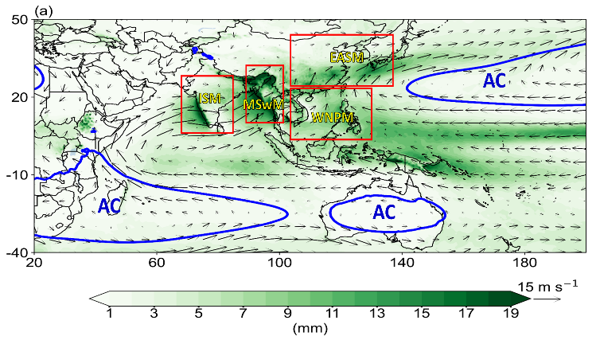
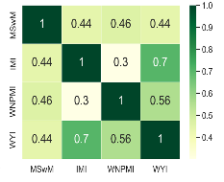
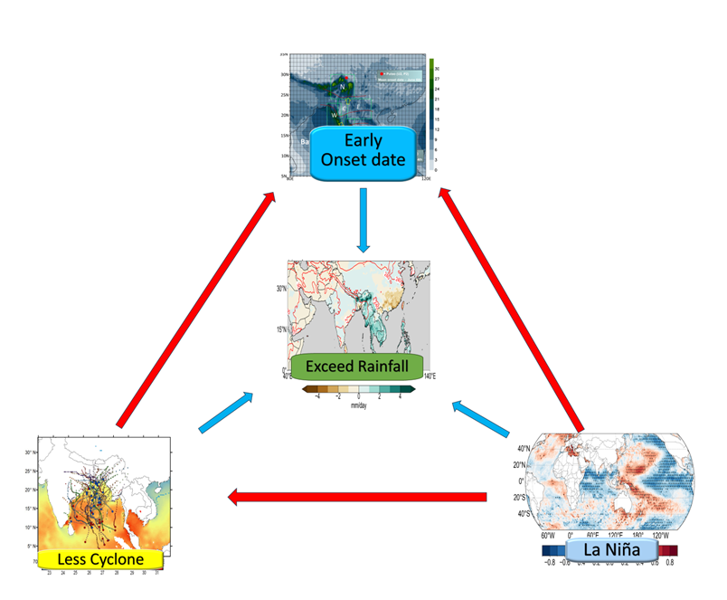
THE DYNAMICAL LINK BETWEEN MAINLAND-INDOCHINA SOUTHWEST MONSOON ONSET DATES AND CYCLONES OVER THE BAY OF BENGAL BASIN
IWM8
Kyaw Than Oo ^{1,} ²*, Haishan Chen, Yinshuo Dong, Kazora Jonah
¹School of Atmospheric Sciences, Nanjing University of Information Science & Technology, Nanjing, 210044, China
²Aviation Weather Services, Yangon, Myanmar
*Corresponding author: kyawthanoo34@outlook.com, https://orcid.org/0000-0003-1727-3462
Abstract
Result and Discussion
This study delves into the intricate connection between Mainland Indochina Southwest Monsoon (MSWM) onset dates and tropical cyclones (TCs) over the Bay of Bengal (BOB) and Arabian Sea (ABMS). Utilizing datasets like International Best Track Archive for Climate Stewardship (IBTrACS), European Centre for Medium-Range Weather Forecasts Reanalysis data version 5 (ERA5), and Climate Hazards Group Infrared Precipitation with Station data (CHIRPS) daily rainfall data, the research highlights the influence of TCs on monsoon onset, emphasizing sea surface temperatures and rainfall intensity. The bimodal distribution of cyclones during early and late onset years is noted, during MSWM onset month May. Significant correlations emerge between cyclone frequency, monsoon onset dates, SST, and rainfall patterns. Employing a robust methodology, the study reveals a complex relationship between TCs and monsoon onset, with late-onset years experiencing higher TC numbers. Additionally, the research explores the influence of El Niño–Southern Oscillation (ENSO), associating positive phases with late monsoon onset and negative phases with early onset and increased rainfall. However, interestingly ENSO has less influence than the TCs over the monsoon onset process. And TCs dynamic may influence cut-out monsoon flow from formal circulation. The findings underscore TCs' multifaceted role in shaping the monsoon, offering insights into intricate climate variables and cyclone dynamics in the northern Indian Ocean.
Table 1 Cyclone and Non-Cyclone years over BoB. The red text represents ENSO positive years and blue for negative years.
Number of Storm
Early Onset
Max: Wind Speed
No_Cyclone |  |  | Cyclone
1981 | 2006 |  | 1982 | 1997 | 2014
1983 | 2011 |  | 1985 | 1998 | 2016
1984 | 2012 |  | 1987 | 2002 | 2017
1986 | 2015 |  | 1989 | 2003 | 2018
1988 |  |  | 1990 | 2004 | 2019
1993 |  |  | 1991 | 2007 | 2020
1999 |  |  | 1992 | 2008
2000 |  |  | 1994 | 2009
2001 |  |  | 1995 | 2010
2005 |  |  | 1996 | 2013
Average Wind Speed
Late Onset
The study categorized monsoon onset into early and late years, with 8 definite early onset years and 4 exact late years investigated. The study found 9 tropical cyclones before and during early-onset years and 5 cyclones during late onset years. The maximum wind strength in early-onset years was weaker than in late-onset years, but the average sea surface temperature was cooler.
El Niño year
Introduction
La Niña year
Early Onset
Late Onset
Fig. 5 The climatology gridded (1°x1°) frequency distribution of a number of storms (first column), average wind changes in 24 hours (knots, second column), and Maximum wind speed (knots, third column) for (a) early onset years, (b) late onset years, (c) El Niño Years and (d) La Niña years.
Early Onset
Late Onset
Early Onset
Late Onset
Fig. 1 (a) The climatology onset date of MSWM by region (red contour line) with climatology rainfall (June-September) (mm/day) (shaded) over the study region. N, W, C, E, and S show the rainfall homogeneous region (Lwin, 2000; K. T. Oo, 2023). (b) Observed moving paths of TCs over the BOB during 1981-2020 (only April- June) with climatology SST of the same period (shaded). (Red circle points mean cyclone-starting point, which generates early onset, and blue for late onset.
Data and Method
Early Onset
Late Onset
Early Onset
Late Onset
Data For Monsoon
CPC Rainfall (2.5 x 2.5)
ERA5 (0.25 x 0.25)
NCEP Reanalysis 2 (2.5 x 2.5)
IBTrACS: cyclone best track data
Statistics Methods
Mean
Anomalies
EOF
Correlation
Regression
Composite Analysis
Fig. 6 The composite map of total May cyclones tracks and climatology SST (°C, shaded) for (a) early onset years and (b) late onset years during 1981-2020. (c,d) Similar with (a,b) but for anomaly mean sea level pressure (hPa, shaded) and 500 hPa geopotential height (gpm, contour) and (e,f) anomaly total precipitation (mm/day, shaded) with OLR(W m-2, contour)
Fig. 7 The composite map of May sea level pressure (shaded, hPa) with 500 hPa level geopotential high (contour, m2 s-2) (above) and the daily rainfall (mm, shaded) with OLR value (W m-2, contour) (below) of (a) (c) cyclone years and (b) (d) no cyclone years respectively.
Cyclone Years
Early Onset
Fig. 2 (a) Dynamic and (b) thermodynamic components of intraseasonal variability by Changepoint MSWM index. Green and red vertical dotted lines indicate the mean onset and withdrawal dates over the study area.
$$\overline{P}−\overline{E}=MFC= − \int_{surface}^{100}{∇_{p}∙\left(\overline{uq}\right)\frac{dp}{g}}$$
No Cyclone Years
Late Onset
$$δ\left(uq\right)= \overline{u} δq+ \overline{q} δu+ δu δq$$
$$MSwM \left(CPI\right) = \frac{1}{5} ∗\left(D\left(U1−U2\right)+ D\left(P1−P2\right)+D\left(MFC\right)+D\left(TPnet\right)+ D\left(OLR\right)\right)$$
Fig. 8 The anomaly composite map of climatology May 850 hPa wind (m/s, vector), 500 hPa geopotential (gpm, contour), rainfall (mm/day, shaded over land) and SST (°C, shaded over ocean) of (a) cyclogenesis years and (b) non-cyclogenesis years over BoB with (c) early onset year and (d) late onset year (Red dots denoted the 95% confident level).
Fig. 4(a) Four sub-regions of Asian-Pacific monsoon adopted from (Wang & Ho, 2002). ISM, MSWM, and WNPSM are tropical monsoon regions and the subtropical monsoon, EASM by shaded daily rainfall (mm/day) with 850 hPa level wind (m/s) and 15000-gpm geopotential contour blue line. And their correlation heatmap.
Conclusion
The study reveals that over a 40-year period, 53 cyclogenesis events were recorded, with wind speed weaker during early-onset years (May) compared to late onset years. The study also found that tropical cyclones (TCs) have the potential to increase convective rainfall, but only in the southern region. The warm phase of ENSO (El Niño) could result in a delayed onset to the monsoon with lower rainfall anomalies, while the cool phase of ENSO (La Niña) could exceed rainfall anomalies accompanied by early onset. The research also found that TCs and warm SSTs influence monsoon onset timing and rainfall distribution. Future research should explore the monsoon-cyclone relationship, considering climate variability and change.
The monsoon season in South Asia is influenced by spatial seasonal variation of index parameters, such as daily rainfall, 850 hPa wind, and geopotential high. The meridional shifting of rain belts is attributed to seasonal wind changes, with cyclones and anti-cyclones dominating the entire monsoon system. The onset of the monsoon season aligns with the minimum point in the Mainland Indochina Southwest Monsoon (MSWM) time series. The monsoon season runs from June to September, with four distinct rainfall peaks.
Fig. 3 Climatology seasonal variation of daily rainfall (mm, shaded), 850 hPa wind (m/s, vector), and geopotential height (gpm, contour by 1500 for blue and 1300 for red). Magenta box denoted the study area.

