Slide 1
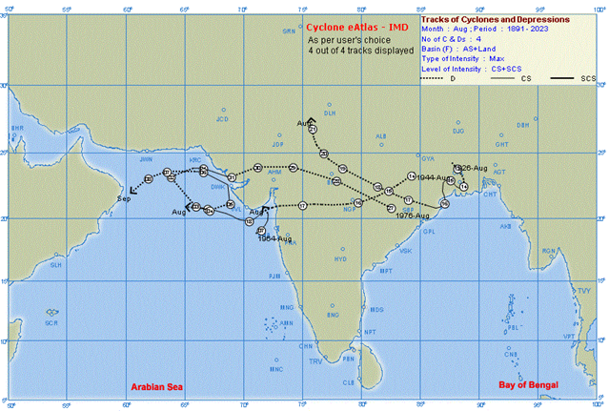
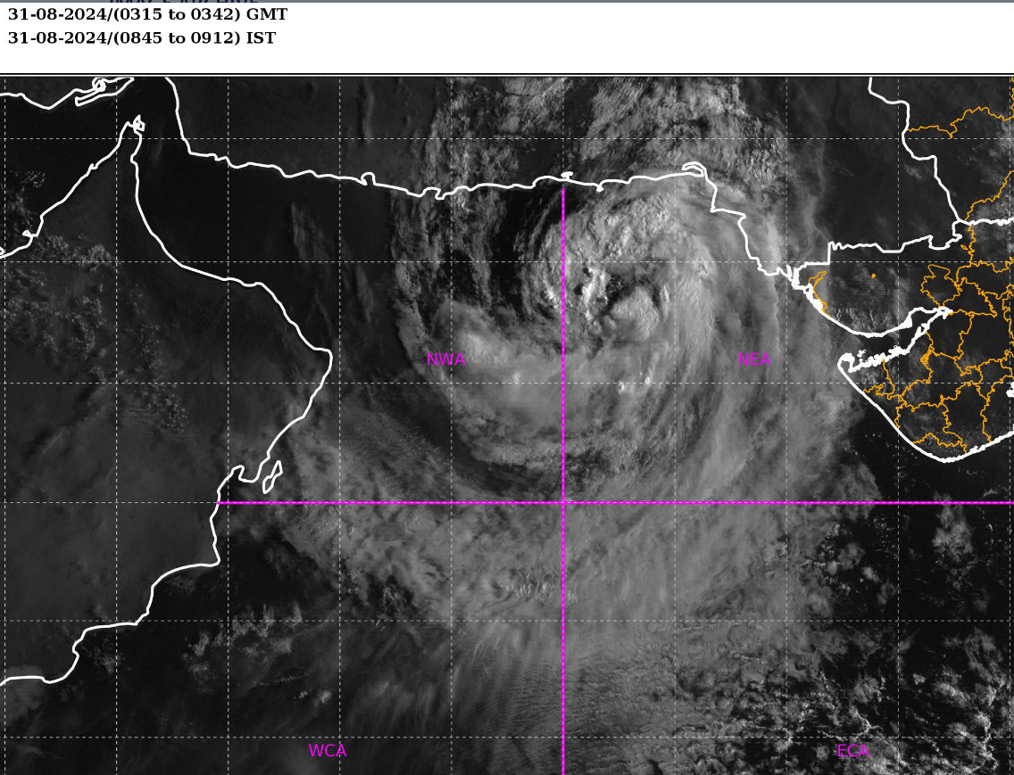
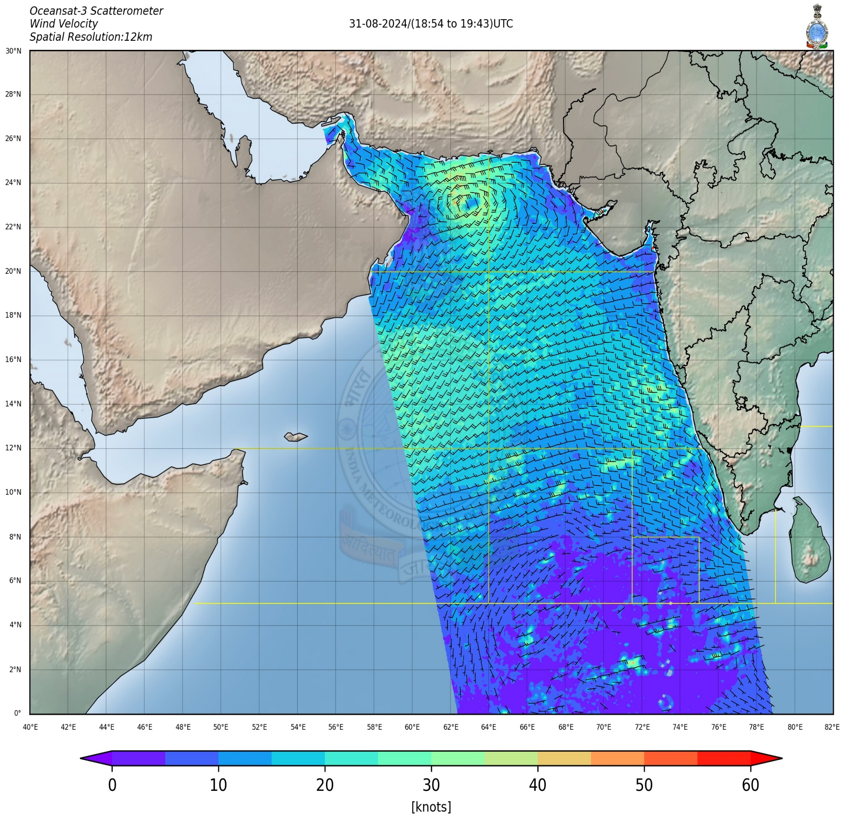
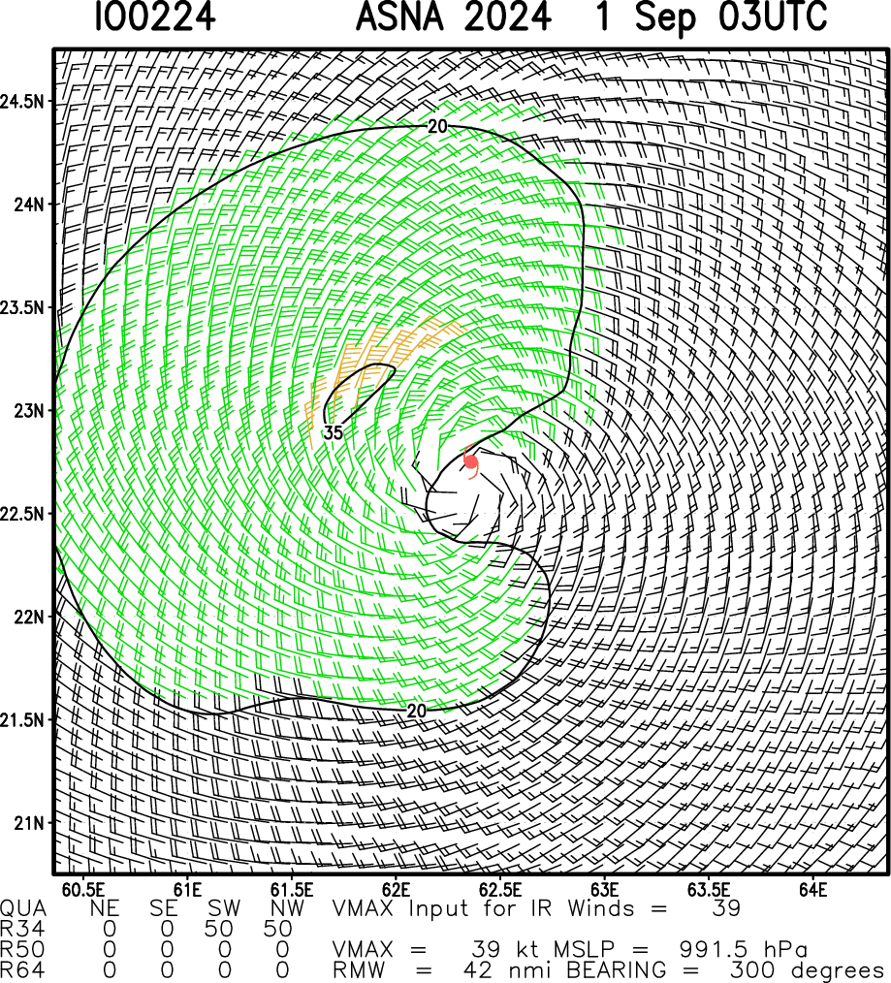
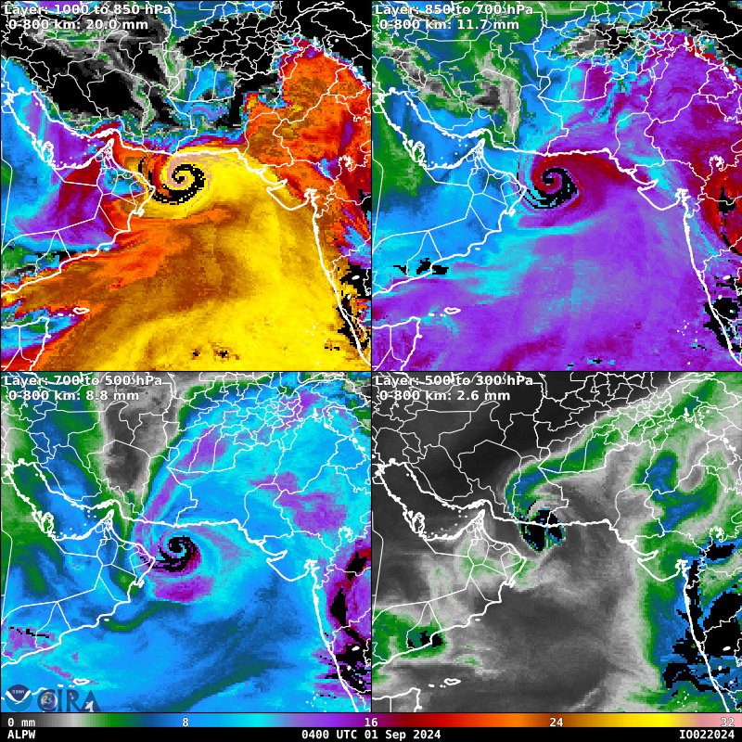
Meteorological Analysis of a unique Cyclonic Storm – ASNA during monsoon 2024
Santosh Singh, Shashi Kant, and Satya Prakash
India Meteorological Department, Ministry of Earth Sciences, New Delhi-110003
Abstract: During the peak monsoon months, only two and three cyclonic storms moved over the Arabian Sea in July and August months, respectively in the recorded history. A unique cyclonic storm – ‘ASNA’ formed over the Arabian Sea on 30th August 2024 and weakened into a Deep Depression over the Northwest Arabian Sea on 1st September. It was the first cyclonic storm over the Arabian Sea during the peak monsoon months in the Indian meteorological satellite era. In this study, rainfall associated with changes in intensity of this cyclonic storm across its path is examined using satellite and rain gauge observations. The other meteorological parameters have also been examined to explore the characteristics of this unique cyclonic storm.
Salient Features of Cyclonic Storm “ASNA”
Origin
A low pressure area formed over northwest Bay of Bengal (B0B) and adjoining areas of West Bengal and Bangladesh in the morning (0530 hrs IST/0000 UTC) of 16th August 2024
Life period
It intensified into a cyclonic storm (CS) "ASNA" over northeast Arabian Sea off Kachchh and adjoining Pakistan coast around noon (1130 hours IST/0600 UTC) of 30th August
it weakened into a depression in the morning (0530 hours IST/0000 UTC) of the 2nd September, 2024 over the northwest Arabian Sea and into a well marked low pressure area over the same region in the afternoon (1130 hours IST/0600 UTC) of 2nd September, 2024
Unique feature
A CS namely, ASNA developed over the AS on 30th August 2024. This is the first CS over the AS basin during the month of August in the Indian meteorological satellite era
The total track length of cyclonic storm “ASNA” was 1780 km against average track length of 1032 km.
It then moved westwards across Gujarat state during 27th -29th August. It emerged into the Northeast Arabian Sea off Kachchh and the adjoining Pakistan coast on 30th August morning (0830 hrs IST/0300 UTC).
The total life period (depression to depression) of “ASNA” was 8 days & 6 hours against the normal of 3 days & 18 hours for cyclonic storm category over the NIO in monsoon season based on the data of 1990-2013.
Fig.1(a): Track of Cyclonic Storm “ASNA”
Fig.1(b): An example of Wind Shear with Cyclonic Storm “ASNA”
Fig. 1: (c) Historical Track of Cyclones in month of August (1891-2023) (B) Visible imaginary of Cyclone Storm “ASNA” (31st August 0315 UTC)
Fig.1(d): Rainfall associated with Cyclonic Storm “ASNA”
Fig.2:(a) active microwave imagery from the Oceansat-3 scatterometer (b) An example of Multiplatform Satellite Surface Wind
Fig1(g): An example of Advected Layer Precipitable Water
Acknowledgments: The authors are thankful to the Director General of Meteorology, IMD for all support for this study. The TC products obtained from CIRA website are also thankfully acknowledged.
Alipore Observatory, Kolkata

